Slide 1
The life of Jesus - Part 10 of 18
English – 24 Slides
You are the Christ, become a child, 70 X 7, I am the Light, Transfiguration, Adulterous woman, Heated discussion with Jews
© 2013 Stichting Docete NL
www.docete.nl // info@docete.nl
Edited by Johan Peters
www.johanpeters.in
(Comments are in brackets)
Bible scriptures: New International Version

Slide 2
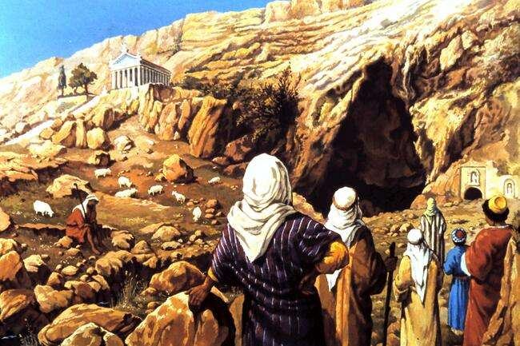
Mat. 16:13-15 When Jesus came to the region of Caesarea Philippi, he asked his disciples, “Who do people say the Son of Man is?” They replied, “Some say John the Baptist; others say Elijah; others, Jeremiah or . . a prophet.” “But what about you?” he asked. “Who do you say I am?”

Slide 3
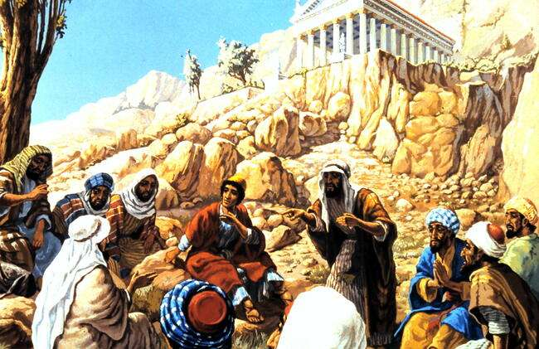
Mat. 16:16-18 Simon Peter answered, “You are the Christ, the Son of the living God.” Jesus replied, “Blessed are you, Simon son of Jonah, for this was not revealed to you by man, but by my Father in heaven. And I tell you that you are Peter, and on this rock (what Peter said) I will build my church, and the gates of hell will not prove stronger than it.

Slide 4
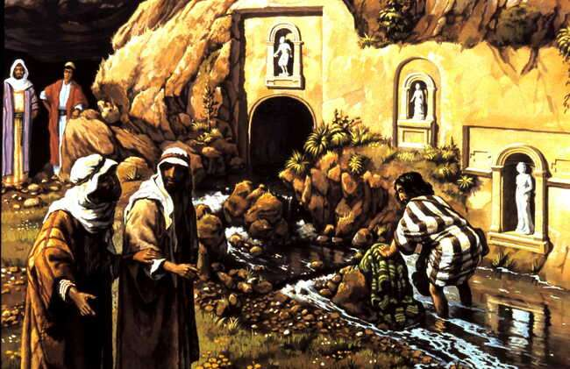
Mat. 16:21-23 . . Jesus began to explain to his disciples that he must go to Jerusalem and suffer many things at the hands of the elders, . . and that he must be killed and on the third day be raised to life. Peter took him aside and began to rebuke him. “Never, Lord!” he said. “This shall never happen to you!” Jesus turned and said to Peter, “Get behind me, Satan! You are a stumbling-block to me; you do not have in mind the things of God, but the things of men.”

Slide 5
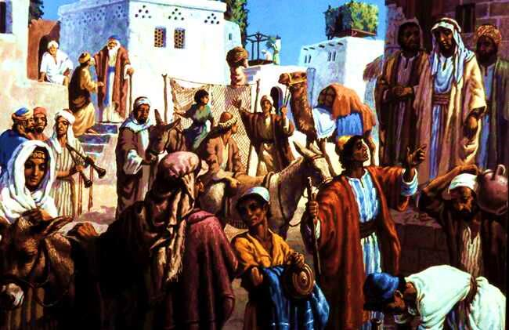
John 7:1-3 After this, Jesus went around in Galilee, purposely staying away from Judea because the Jews there were waiting to take his life. But when the Jewish Feast of Tabernacles was near,
Jesus’ brothers said to him, “You ought to leave here and go to Judea, so that your disciples may see the miracles you do.

Slide 6
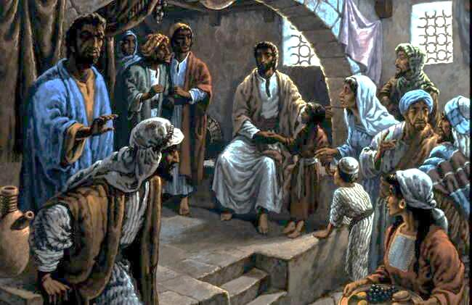
Mat. 18:1-5 At that time the disciples came to Jesus and asked, “Who is the greatest in the kingdom of heaven?” He called a little child and had him stand among them. And he said: “I tell you the truth, unless you change and become like little children, you will never enter the kingdom of heaven. Therefore, whoever humbles himself like this child is the greatest in the kingdom of heaven. “And whoever welcomes a little child like this in my name welcomes me.”

Slide 7
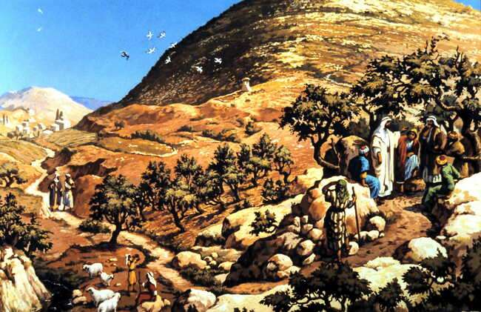
Mat. 18:21,22 Then Peter came to Jesus and asked, “Lord, how many times shall I forgive my brother when he sins against me? Up to seven times?” Jesus answered, “I tell you, not seven times, but seventy times seven.

Slide 8
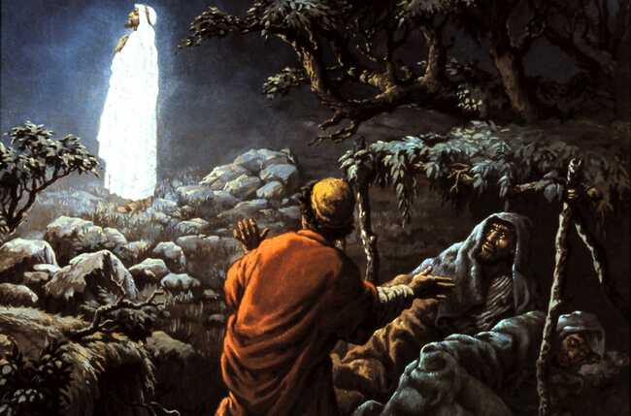
Mark 9:2,3 After six days Jesus took Peter, James and John with him and led them up a high mountain, where they were all alone. There he was transfigured before them. His clothes became dazzling white, whiter than anyone in the world could bleach them.

Slide 9
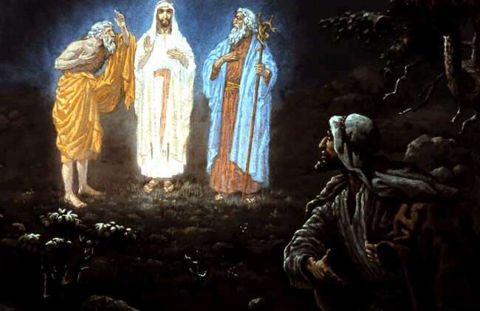
Mark 9:4,5 And there appeared before them Elijah and Moses, who were talking with Jesus. Peter said to Jesus, “Rabbi, it is good for us to be here. Let us put up three shelters - one for you, one for Moses and one for Elijah.”

Slide 10
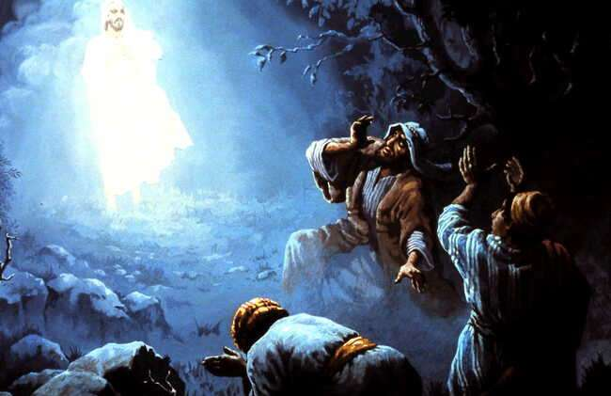
Mark 9:6,7 He did not know what to say, they were so frightened. Then a cloud appeared and enveloped them, and a voice came from the cloud: “This is my Son, whom I love. Listen to him!”

Slide 11
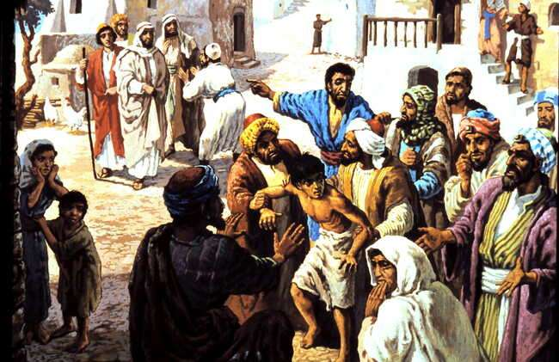
Mat. 17:14-18 When they came to the crowd, a man approached Jesus and knelt before him. “Lord, have mercy on my son,” he said. “He has seizures and is suffering greatly. He often falls into the fire or into the water. I brought him to your disciples, but they could not heal him.” Jesus rebuked the demon, and it came out of the boy, and he was healed from that moment.

Slide 12
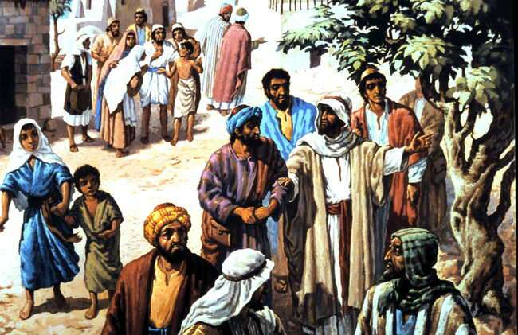
Mat. 17:19-21 Then the disciples came to Jesus in private and asked, “Why couldn’t we drive it out?” He replied, “Because you have so little faith. I tell you the truth, if you have faith as small as a mustard seed, you can say to this mountain, `Move from here to there’ and it will move. Nothing will be impossible for you.” But this kind does not go out except by prayer and fasting.

Slide 13
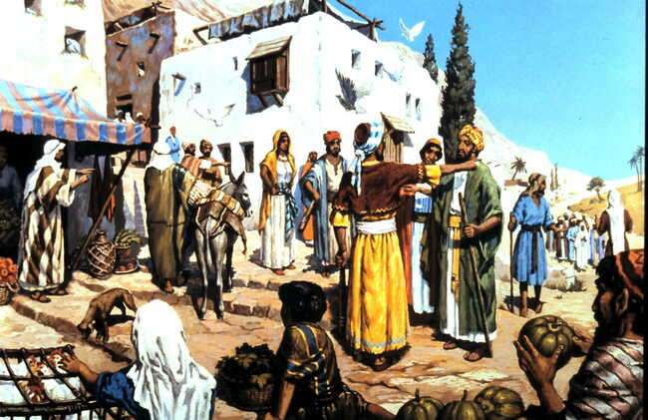
Luke 9:51-56 Jesus resolutely set out for Jerusalem. And he sent messengers on ahead, who went into a Samaritan village to get things ready for him; but the people there did not welcome him, because he was heading for Jerusalem. When the disciples James and John saw this, they asked, “Lord, do you want us to call fire down from heaven to destroy them?” But Jesus turned and rebuked them, And he said, “You do not know what kind of spirit you are of, for the Son of Man did not come to destroy men’s lives, but to save them.” And they went to another village.

Slide 14
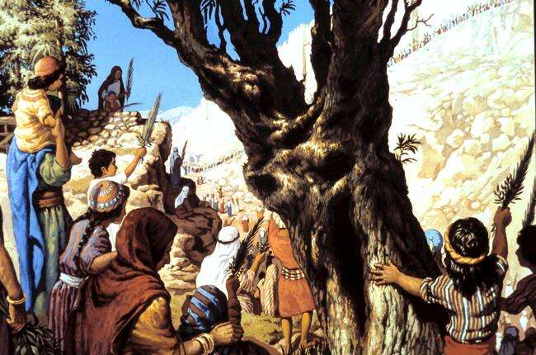
(During the seven days Feast of Tabernacles, after the offerings in the morning the priests went in procession to the spring of Gihon, also called Siloe) Ps. 68:25,26 In front are the singers, after them the musicians; with them are the maidens playing tambourines. Praise God in the great congregation; praise the LORD in the assembly of Israel.

Slide 15
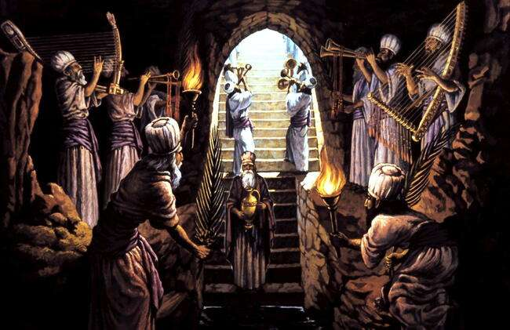
(When the priests sound the trumpet then the water has been drawn and the procession goes in the direction of the temple.) Isaiah 12:3 “With joy you will draw water from the wells of salvation.”

Slide 16
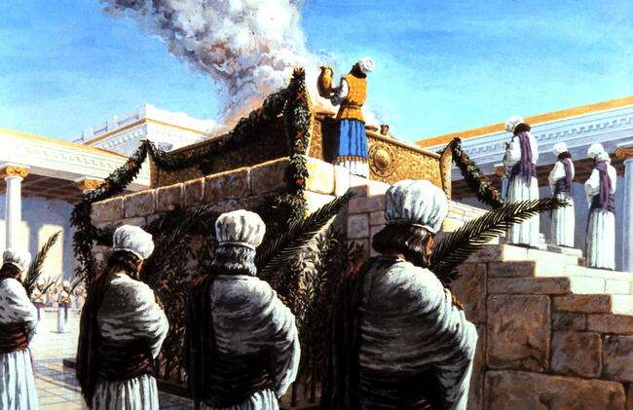
(Once in the temple the priest lifts up the water urn giving in thanks and pours it out over the altar.) Psalm. 116:13 “I will lift up the cup of salvation and call on the name of the LORD.”

Slide 17
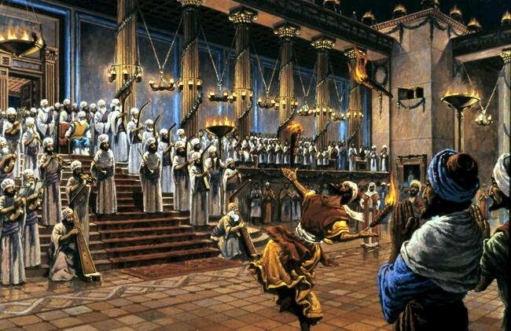
(After the evening offering a marvelous feast of light was held in the Court of the Women with joyful dancing and singing, celebrating the Law which was Light for the way.) Psalm 119:105 “Your word is a lamp to my feet and a light for my path.”

Slide 18
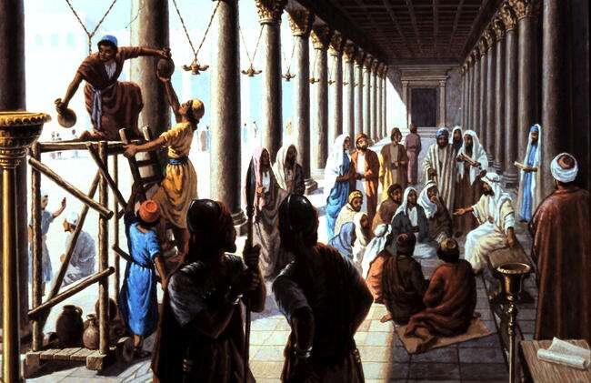
John 7:14-17 Not until halfway through the Feast did Jesus go up to the temple courts and begin to teach. The Jews were amazed and asked, “How did this man get such learning without having studied?” Jesus answered, “My teaching is not my own. It comes from him who sent me. 7 If anyone chooses to do God’s will, he will find out whether my teaching comes from God or whether I speak on my own.

Slide 19
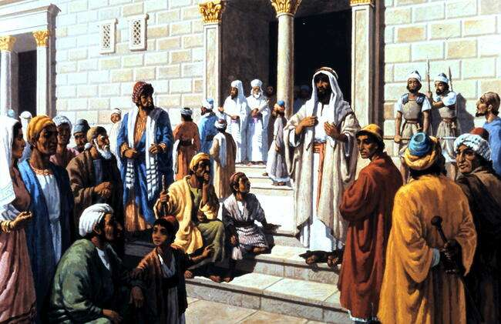
John 7:37,38 On the last and greatest day of the Feast, Jesus stood and said in a loud voice, “If anyone is thirsty, let him come to me and drink. Whoever believes in me, as the Scripture has said, streams of living water will flow from within him.”

Slide 20
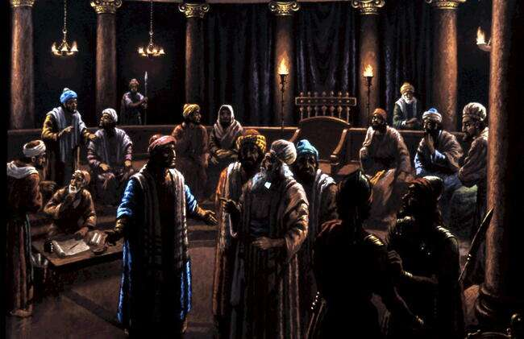
John 7:45-53 . . the temple guards went back to the chief priests and Pharisees, who asked them, “Why didn’t you bring him in?” “No-one ever spoke the way this man does,” the guards declared. “You mean he has deceived you also? Has any of the rulers or of the Pharisees believed in him? No! But this mob that knows nothing of the law - there is a curse on them.” Nicodemus, who had gone to Jesus earlier and who was one of their own number, asked, “Does our law condemn a man without first hearing him . .?” . . Then each went to his own home.

Slide 21
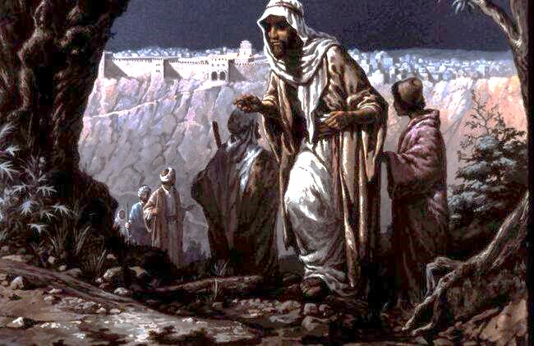
John 8:1 But Jesus went to the Mount of Olives.

Slide 22
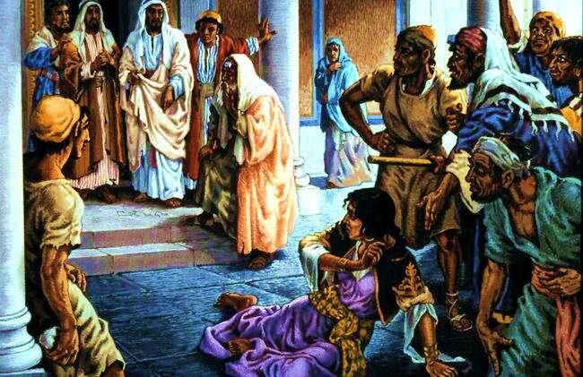
John 8:2-5 At dawn he appeared again in the temple courts, where all the people gathered round him, and he sat down to teach them. The teachers of the law and the Pharisees brought in a woman caught in adultery. They made her stand before the group and said to Jesus, “Teacher, this woman was caught in the act of adultery. In the Law Moses commanded us to stone such women. Now what do you say?”

Slide 23
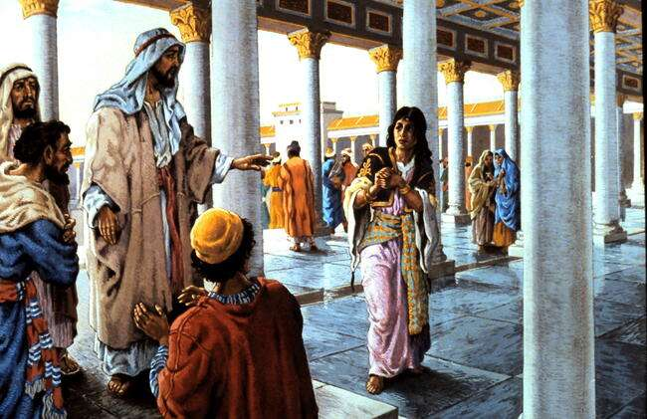
John 8:7-11 He said to them, “If any one of you is without sin, let him be the first to throw a stone at her.” At this, those who heard began to go away one at a time, the older ones first, until only Jesus was left, with the woman still standing there. Jesus straightened up and asked her, “Woman, where are they? Has no-one condemned you?” “No-one, sir,” she said. “Then neither do I condemn you,” Jesus declared. “Go now and sin no more.”

Slide 24
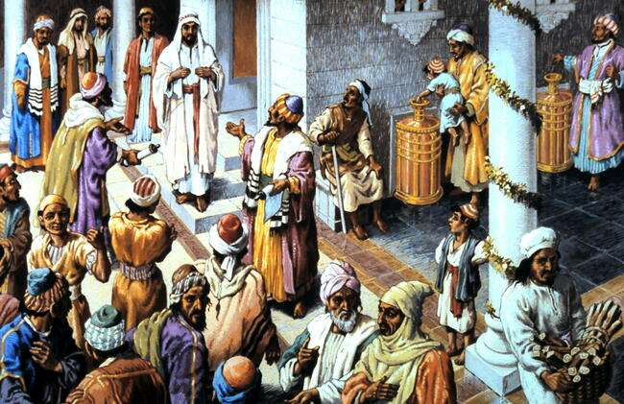
John 8:12-19 When Jesus spoke again to the people, he said, “I am the light of the world. Whoever follows me will never walk in darkness, but will have the light of life.” The Pharisees challenged him, “Here you are, appearing as your own witness; your testimony is not valid.” I am one who testifies for myself; my other witness is the Father, who sent me.” Then they asked him, “Where is your father?” “You do not know me or my Father,” Jesus replied. “If you knew me, you would know my Father also.”

Slide 25
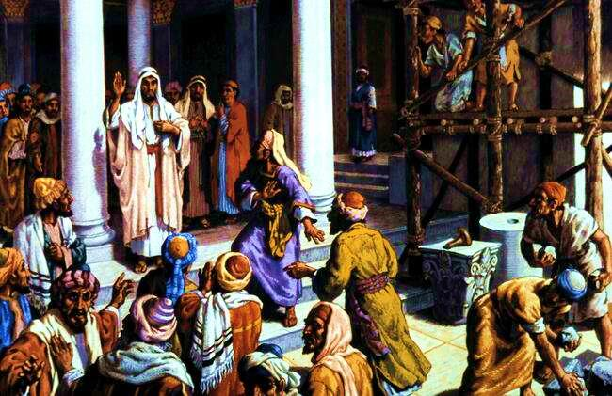
John 8:31,32,47,55, 59 To the Jews who had believed him, Jesus said, “If you hold to my teaching, you are really my disciples. Then you will know the truth, and the truth will set you free.” Jn. 8:47 He who belongs to God hears what God says. The reason you do not hear is that you do not belong to God.” Though you do not know him, I know him. If I said I did not, I would be a liar like you, but I do know him and keep his word. . . . they picked up stones to stone him, but Jesus hid himself, slipping away from the temple grounds.

