Slide 1
The life of Jesus - Part 7 of 18
English - 24 Slides
Nain dead man, Jesus on John the Baptist, Disciple women, Simon Pharisee, Parables of the Sowers, Who is my family?
© 2013 Stichting Docete NL
www.docete.nl // info@docete.nl
Edited by Johan Peters
www.johanpeters.in
(Comments are in brackets)
Bible scriptures: New International Version

Slide 2
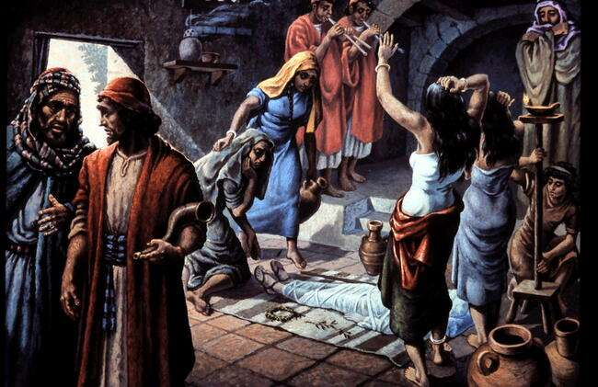
When someone dies, the body is prepared for burial and is wrapped in strips of linen, flute players and professional mourners are hired, the horn blower will go before the procession

Slide 3
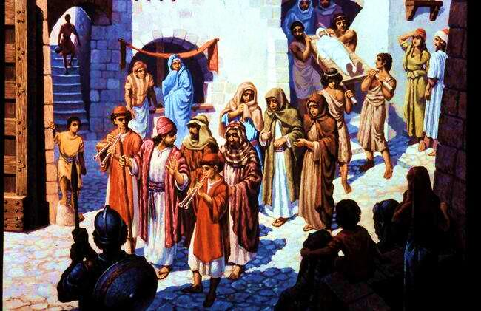
(Here we see the procession on its way to the burial site.)

Slide 4
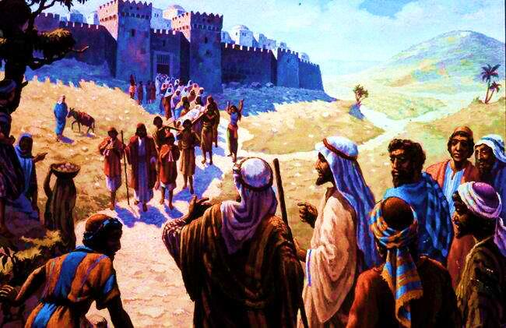
Luke 7:11,12 Soon afterwards, Jesus went to a town called Nain, and his disciples and a large crowd went along with him. As he approached the town gate, a dead person was being carried out - the only son of his mother, and she was a widow. And a large crowd from the town was with her.

Slide 5
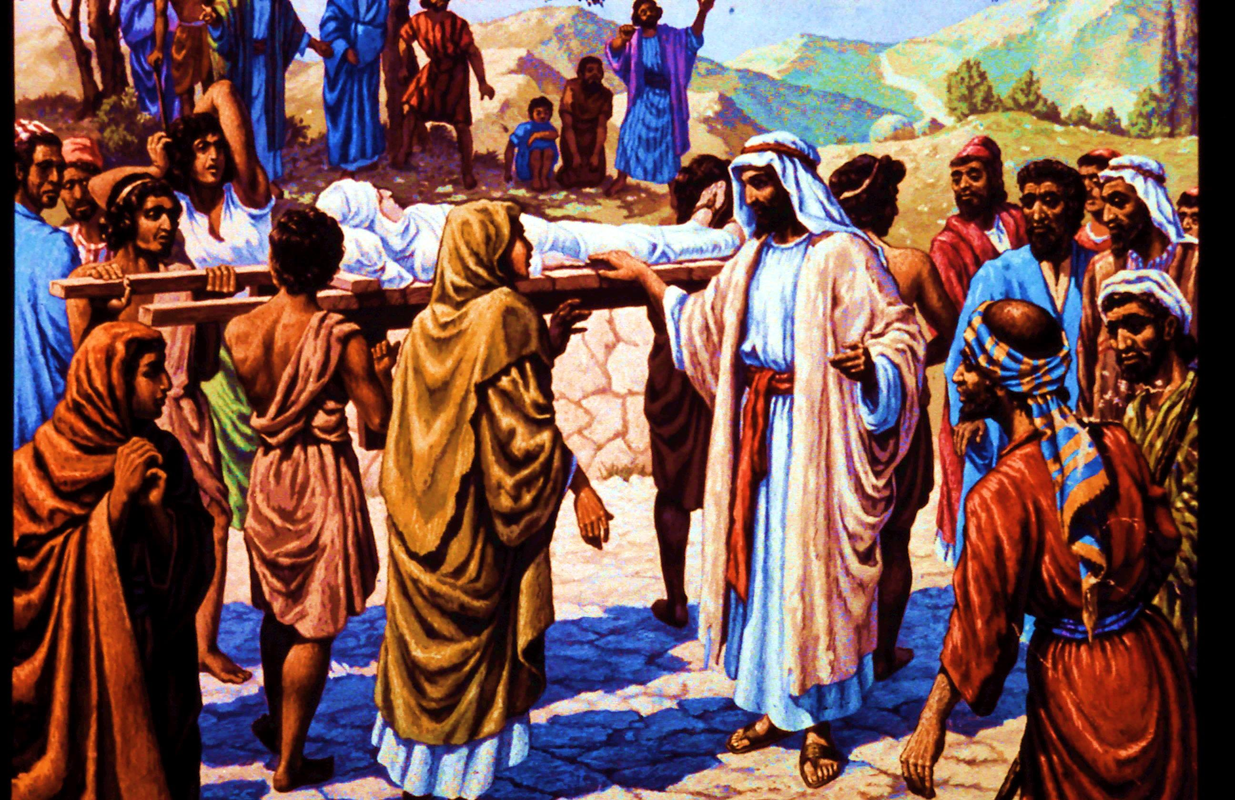
Luke 7:13,14 When the Lord saw her, his heart went out to her and he said, “Don’t cry.” Then he went up and touched the coffin, and those carrying it stood still.

Slide 6
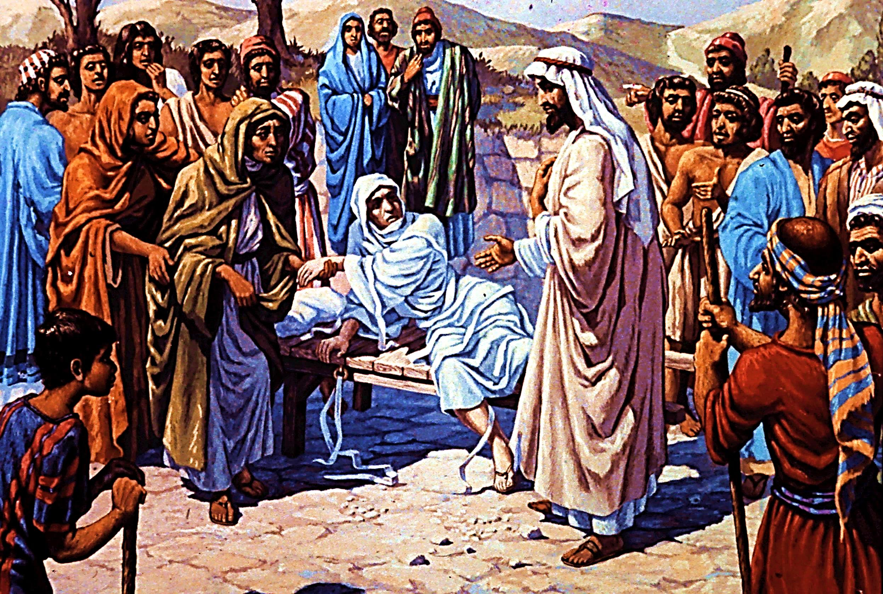
Luke 7:14b-16 He said, “Young man, I say to you, get up!” The dead man sat up and began to talk, and Jesus gave him back to his mother. They were all filled with awe and praised God.
“A great prophet has appeared among us,” they said. “God has come to help his people.”

Slide 7
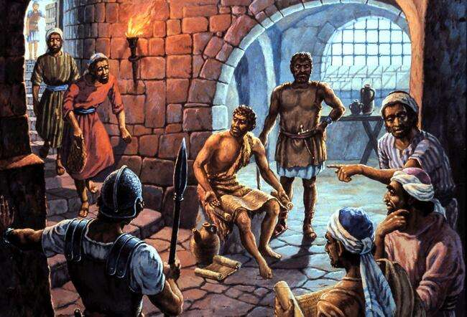
Luke 7:17,18 This news about Jesus spread throughout Judea and the surrounding country. John’s disciples told him about all these things. Calling two of them,

Slide 8
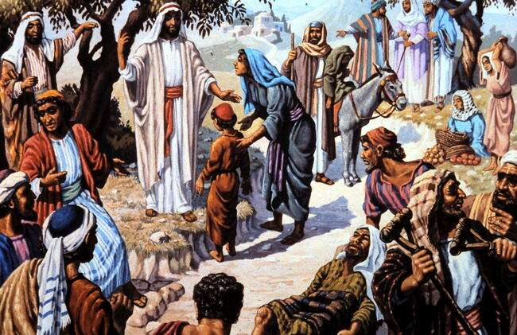
Luke 7:19-21 he sent them to the Lord to ask, “Are you the one who was to come, or should we expect someone else?” When the men came to Jesus, they said, “John the Baptist sent us to you to ask, `Are you the one who was to come, or should we expect someone else?’“ At that very time Jesus cured many who had diseases, sicknesses and evil spirits, and gave sight to the blind.

Slide 9
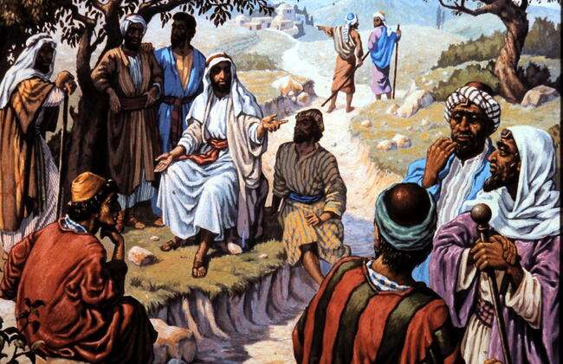
Luke 7:22-23 So he replied to the messengers, “Go back and report to John what you have seen and heard: The blind receive sight, the lame walk, those who have leprosy are cured, the deaf hear, the dead are raised, and the good news is preached to the poor. Blessed is the man who does not fall away on account of me.”

Slide 10
Luke 7:24-30 After John’s messengers left, Jesus began to speak to the crowd about John: “This is the one about whom it is written: “`I will send my messenger ahead of you, who will prepare your way before you.’ [Mal. 3:1] ; All the people, . . . had been baptised by John. But the Pharisees and experts in the law rejected God’s purpose for themselves, because they had not been baptised by John.

Slide 11
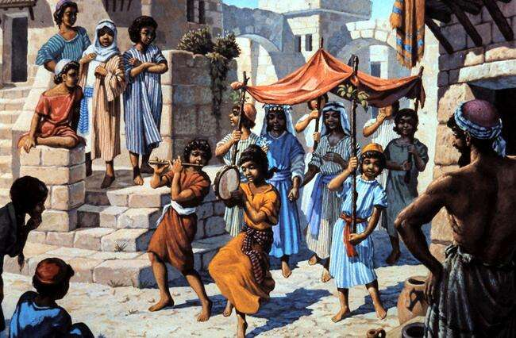
Luke 7:31 “To what, then, can I compare the people of this generation? What are they like? They are like children sitting in the market-place and calling out to each other: “`We played the flute for you, and you did not dance;

Slide 12
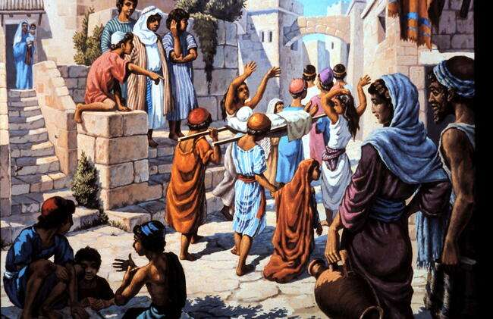
Luke 7:32b-34 ‘we sang a dirge, and you did not cry.’ For John the Baptist came neither eating bread nor drinking wine, and you say, `He has a demon.’ The Son of Man came eating and drinking, and you say, `Here is a glutton and a drunkard, a friend of tax collectors and “sinners”.’

Slide 13
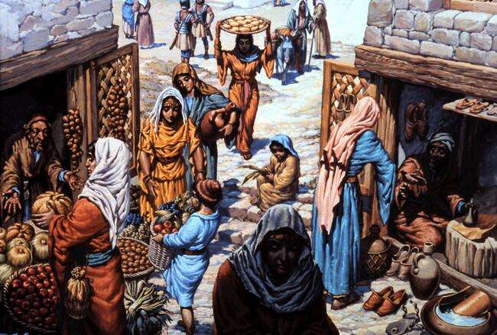
Luke 8:1-2 After this, Jesus travelled about from one town and village to another, proclaiming the good news of the kingdom of God. The Twelve were with him, and also some women who had been cured of evil spirits and diseases: Mary Magdalene from whom seven demons had come out;

Slide 14
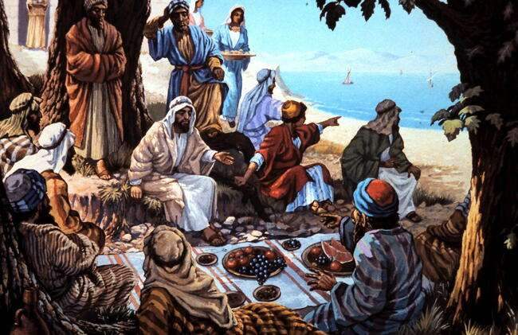
Luke 8:3 Joanna the wife of Chuza, the manager of Herod’s household; Susanna; and many others. These women were helping to support them out of their own means.

Slide 15
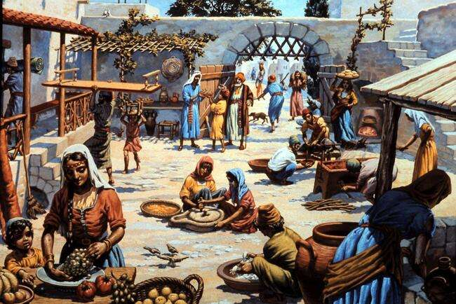
(Preparing the meal at the house of Simon the Pharisee, where Jesus is invited.)

Slide 16
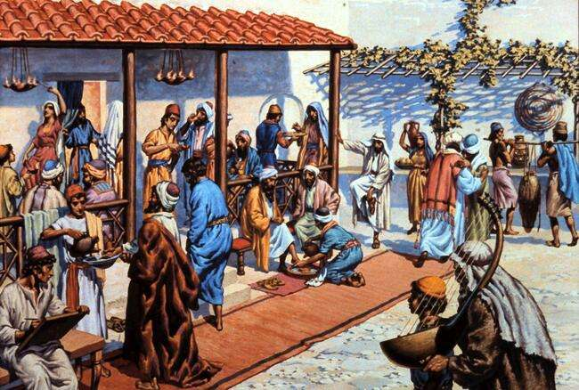
Luke 7:36 Now one of the Pharisees invited Jesus to have dinner with him, so he went to the Pharisee’s house (We see Jesus next to the veranda pole removing his own shoes)

Slide 17
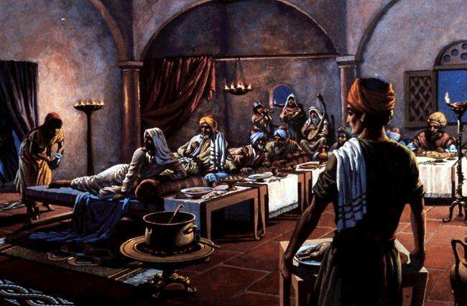
Luke 7:36b-38 Jesus reclined at the table. When a woman who had lived a sinful life in that town learned that Jesus was eating at the Pharisee’s house, she brought an alabaster jar of perfume, and as she stood behind him at his feet weeping, she began to wet his feet with her tears. Then she wiped them with her hair, kissed them and poured perfume on them.

Slide 18
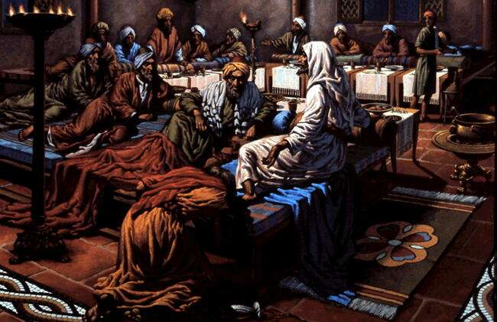
Luke 7:39-41 When the Pharisee who had invited him saw this, he said to himself, “If this man were a prophet, he would know who is touching him and what kind of woman she is - that she is a sinner.” Jesus answered him, “Simon, I have something to tell you.” “Tell me, teacher,” he said.
“Two men owed money to a certain money-lender. One owed him five hundred pence, and the other fifty. (a penny was about a day’s wages.)

Slide 19
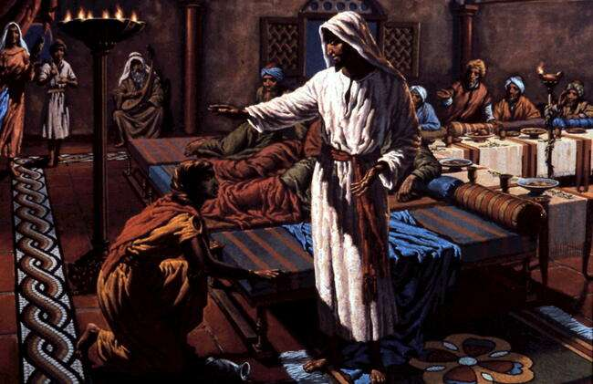
Luke 7:42-48 Neither of them had the money to pay him back, so he cancelled the debts of both. Now which of them will love him more?” Simon replied, “I suppose the one who had the bigger debt cancelled.” “You have judged correctly,” Jesus said. . “Do you see this woman? I came into your house. You did not give me any water for my feet, but she wet my feet with her tears and wiped them with her hair. . . You did not put oil on my head, but she has poured perfume on my feet. Therefore, . her many sins have been forgiven - for she loved much. But he who has been forgiven little loves little.” Then Jesus said to her, “Your sins are forgiven.”

Slide 20
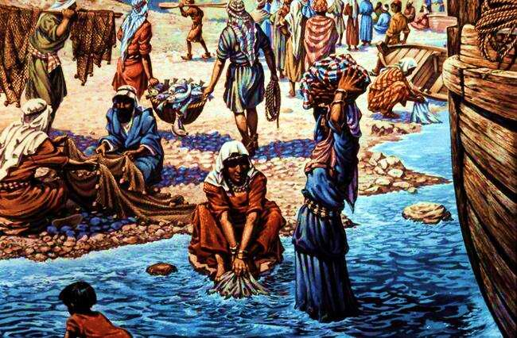
Mark 4:1 Again Jesus began to teach by the lake. The crowd that gathered round him was so large that he got into a boat and sat in it out on the lake, while all the people were along the shore at the water’s edge.

Slide 21
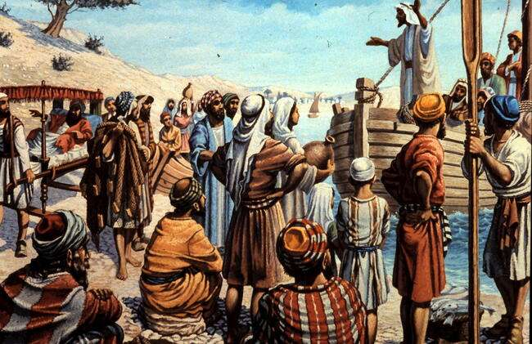
Mark 4:3-9 “A farmer went out to sow his seed. . . some fell along the path, and the birds came and ate it up. Some fell on rocky places, But when the sun came up, the plants . . withered because they had no root. Other seed fell among thorns, . and choked the plants, Still other seed fell on good soil. It came up, grew and produced a crop, multiplying thirty, sixty, or even a hundred times.” “He who has ears to hear, let him hear.”

Slide 22
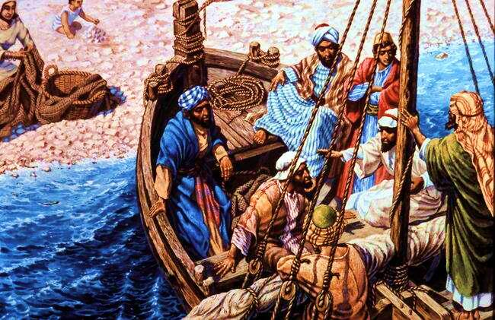
Mark 4:10,11,15 When he was alone, the Twelve and the others around him asked him about the parables. He told them, “The secret of the kingdom of God has been given to you. . . Some people are like seed along the path, where the word is sown. As soon as they hear it, Satan comes and takes away the word that was sown in them.

Slide 23
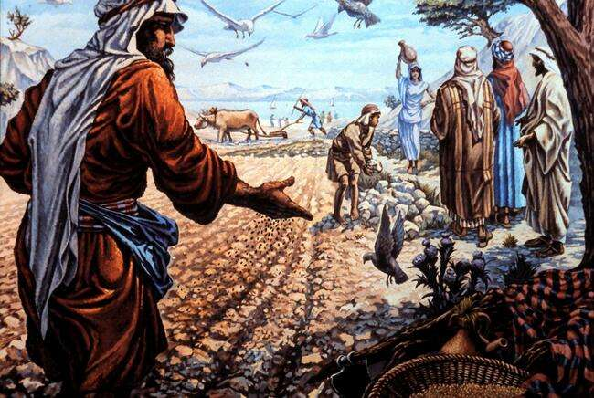
Mark 4:16-20 Others, like seed sown on rocky places, . . But when trouble or persecution comes because of the word, they quickly fall away. Still others, like seed sown among thorns, hear the word; but the worries of this life, the deceitfulness of wealth . . choke the word, making it unfruitful. Others, like seed sown on good soil, hear the word, accept it, and produce a crop - thirty, sixty or even a hundred times what was sown.”

Slide 24
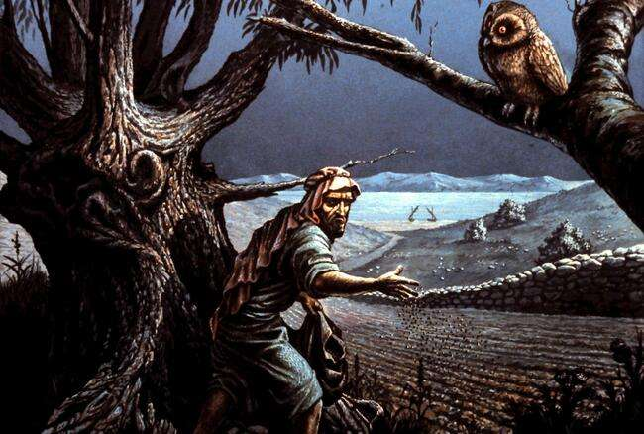
Mat.13:24-30 Jesus told them another parable: “The kingdom of heaven is like a man who sowed good seed in his field. But while everyone was sleeping, his enemy came and sowed weeds among the wheat, When the wheat sprouted . . , then the weeds also appeared. The servants said, `Sir, didn’t you sow good seed in your field? Where then did the weeds come from?’ “`An enemy did this,’ “The servants asked, `Do you want us to go and pull them up? `No,’ Let both grow together until the harvest. At that time I will tell the harvesters: First collect the weeds and tie them in bundles to be burned; then gather the wheat and bring it into my barn.’“

Slide 25
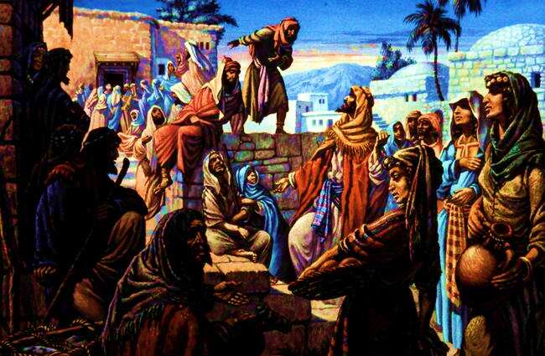
Mark 3:31,32 Then Jesus’ mother and brothers arrived. Standing outside, they sent someone in to call him. A crowd was sitting around him, and they told him, “Your mother and brothers are outside looking for you.”

Slide 26
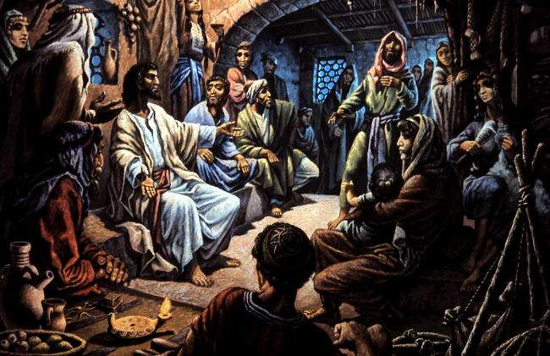
Mark 3:33-35 “Who are my mother and my brothers?” he asked. Then he looked at those seated in a circle around him and said, “Here are my mother and my brothers! Whoever does God’s will is my brother and sister and mother.”

