Slide 1
The life of Jesus - Part 8 of 18
English - 24 Slides
Storm calmed, Legion, Hem of garment, Jairus daughter, two blind men, Jesus in Nazareth, John beheaded.
© 2013 Stichting Docete NL
www.docete.nl // info@docete.nl
Edited by Johan Peters
www.johanpeters.in
(Comments are in brackets)
Bible scriptures: New International Version

Slide 2
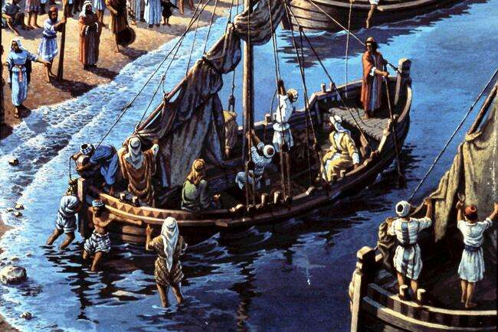
Luke 8:22 One day Jesus said to his disciples, “Let’s go over to the other side of the lake.” So they got into a boat and set out.

Slide 3
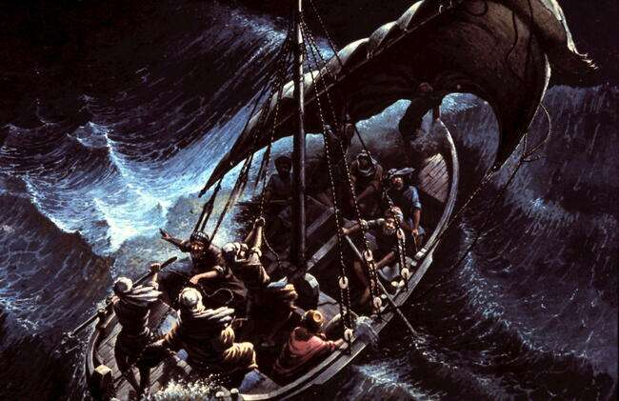
Luke 8:23,24 As they sailed, he fell asleep. A storm came down on the lake, so that the boat was being swamped, and they were in great danger. The disciples went and woke him, saying, “Master, Master, we’re going to drown!”

Slide 4
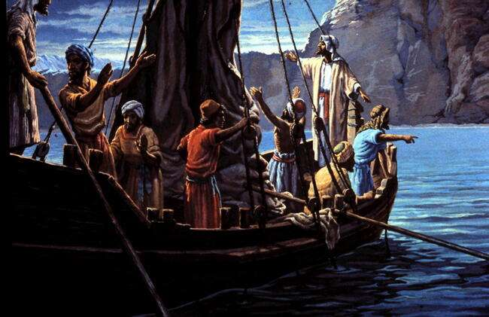
Luke 8:24,25 He got up and rebuked the wind and the raging waters; the storm subsided, and all was calm. “Where is your faith?” he asked his disciples. In fear and amazement they asked one another, “Who is this? He commands even the winds and the water, and they obey him.”

Slide 5
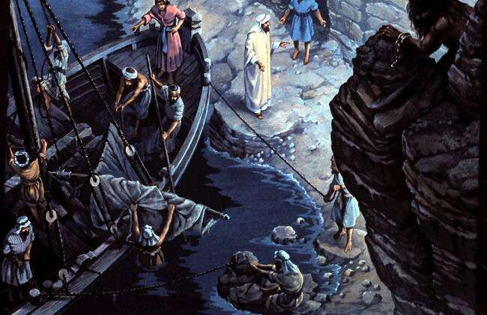
Luke 8:26-33 They sailed to the region of the Gerasenes, which is across the lake from Galilee . . . he was met by a demon possessed man . .who lived in the tombs. Jesus asked him, “What is your name?” “Legion,” he replied, because many demons had gone into him. . . The demons begged Jesus to let them go into the pigs, and he gave them permission. . and the herd rushed down the steep bank into the lake and was drowned.

Slide 6
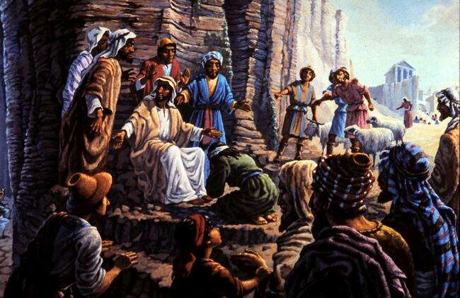
Luke 8:34-37 When those tending the pigs saw what had happened, they ran off and reported this in the town and countryside, and the people went out to see what had happened. When they came to Jesus, they found the man from whom the demons had gone out, sitting at Jesus’ feet, dressed and in his right mind; and they were afraid. Then all the people of the region of the Gerasenes asked Jesus to leave them, because they were overcome with fear.

Slide 7
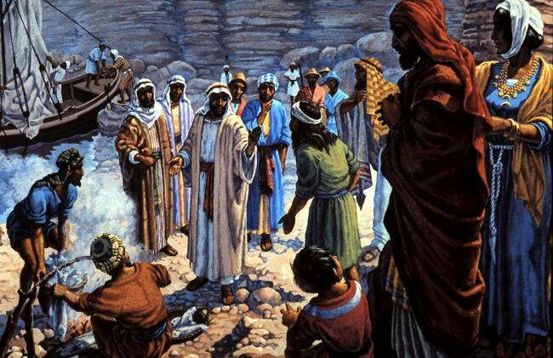
Luke 8:37-39 So he got into the boat and left. The man from whom the demons had gone out begged to go with him, but Jesus sent him away, saying, “Return home and tell how much God has done for you.” So the man went away and told all over the town how much Jesus had done for him.

Slide 8
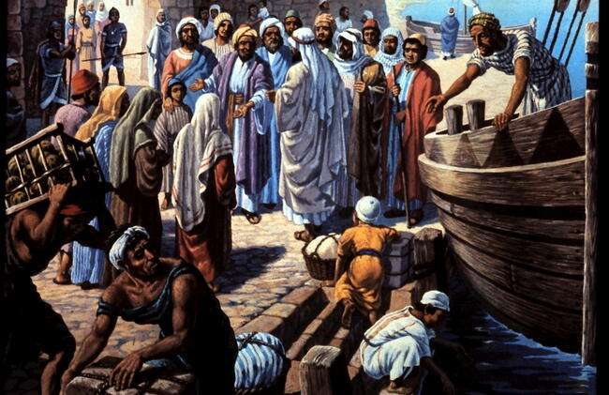
Luke 8:40 Now when Jesus returned (to Galilee), a crowd welcomed him, for they were all expecting him.

Slide 9
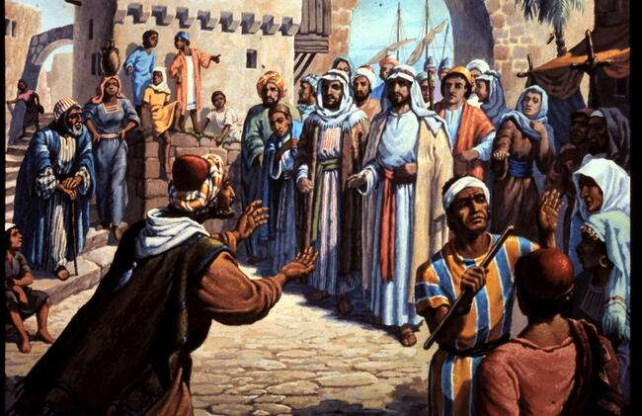
Luke 8:41,42 Then a man named Jairus, a ruler of the synagogue, came and fell at Jesus’ feet, pleading with him to come to his house because his only daughter, a girl of about twelve, was dying. As Jesus was on his way, the crowds almost crushed him.

Slide 10
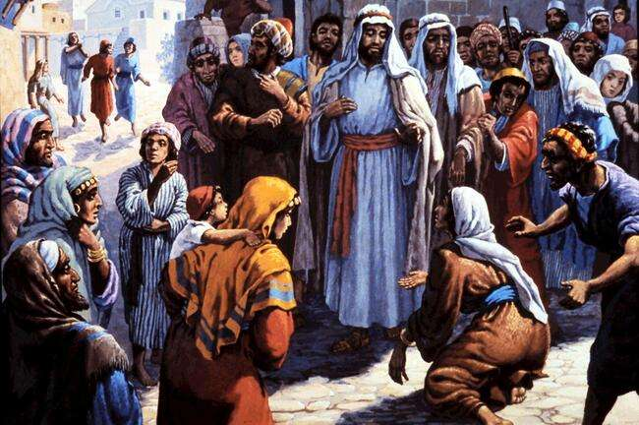
Luke 8:43-48 And a woman was there who had been subject to bleeding for twelve years, . no-one could heal her. She came up behind him and touched the edge of his cloak, and immediately her bleeding stopped. . . Jesus said, “Someone touched me; I know that power has gone out from me.” Then the woman, . . why she had touched him and how she had been instantly healed. Then he said to her, “Daughter, your faith has healed you. Go in peace.”

Slide 11
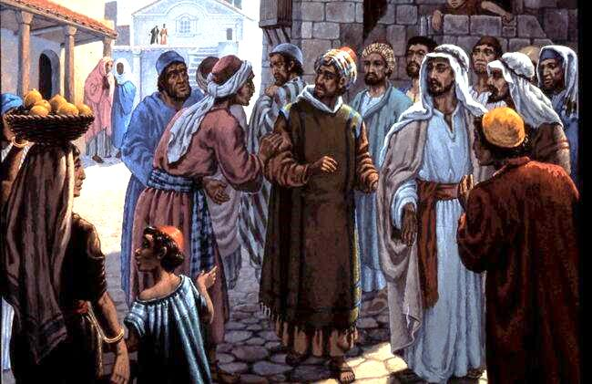
Luke 8:49-50 While Jesus was still speaking, someone came from the house of Jairus, the synagogue ruler. “Your daughter is dead,” he said. “Don’t bother the teacher any more.” Hearing this, Jesus said to Jairus, “Don’t be afraid; just believe, and she will be healed.”

Slide 12
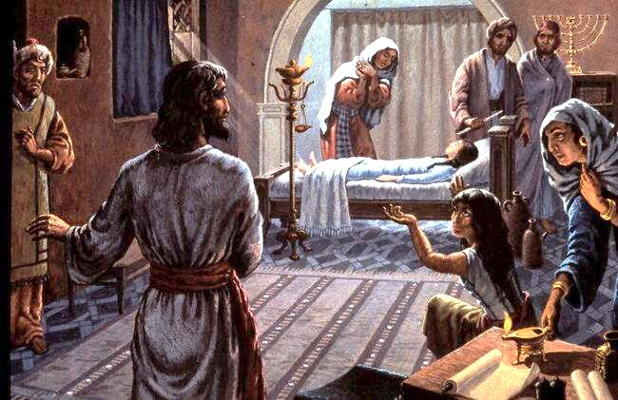
Luke 8:51- 54 When he arrived at the house of Jairus, he did not let anyone go in with him except Peter, John and James, and the child’s father and mother. Meanwhile, all the people were wailing . . for her. “Stop wailing,” Jesus said. “She is not dead but asleep.” They laughed at him, knowing that she was dead. But he took her by the hand and said, “My child, get up!”

Slide 13
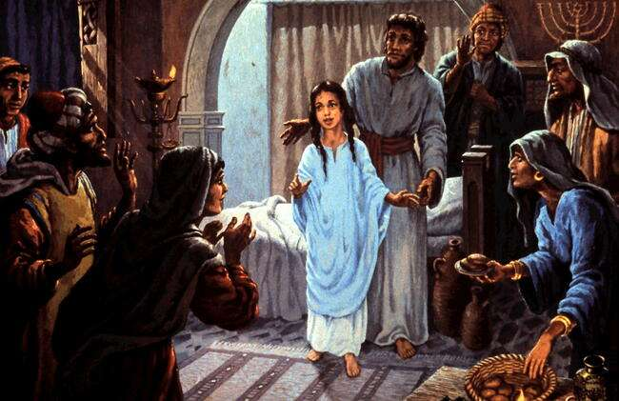
Luke 8:55,56 Her spirit returned, and at once she stood up. Then Jesus told them to give her something to eat. Her parents were astonished, but he ordered them not to tell anyone what had happened.

Slide 14
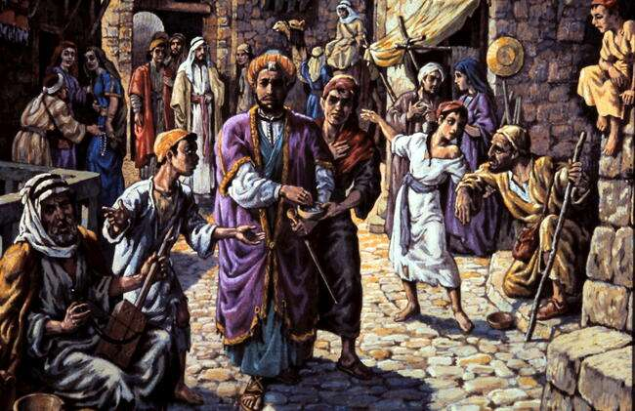
Mat. 6:2 “So when you give to the needy, do not announce it with trumpets, as the hypocrites do in the synagogues and on the streets, to be honoured by men. I tell you the truth, they have received their reward in full.”

Slide 15
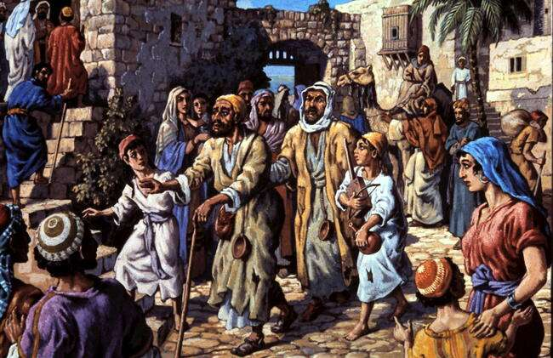
Mat. 9:27,28 As Jesus went on from there, two blind men followed him, calling out, “Have mercy on us, Son of David!” When he had gone indoors, the blind men came to him, and he asked them, “Do you believe that I am able to do this?” “Yes, Lord,” they replied.

Slide 16
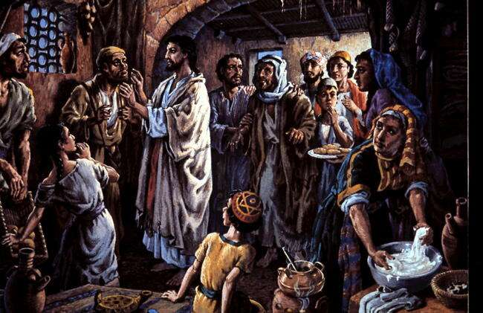
Mat. 9:29-31 Then he touched their eyes and said, “According to your faith will it be done to you”; and their sight was restored. Jesus warned them sternly, “See that no-one knows about this.” But they went out and spread the news about him all over that region.

Slide 17
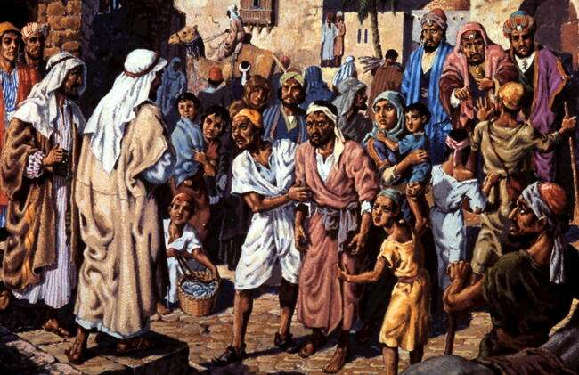
Mat. 9:32,33 While they were going out, a man who was demon-possessed and could not talk was brought to Jesus. And when the demon was driven out, the man who had been mute spoke. The crowd was amazed and said, “Nothing like this has ever been seen in Israel.”

Slide 18
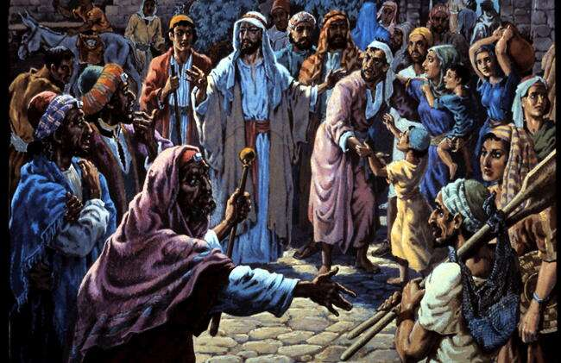
Mat. 9:34,35 But the Pharisees said, “It is by the prince of demons that he drives out demons.”
Jesus went through all the towns and villages, teaching in their synagogues, preaching the good news of the kingdom and healing every disease and sickness.

Slide 19
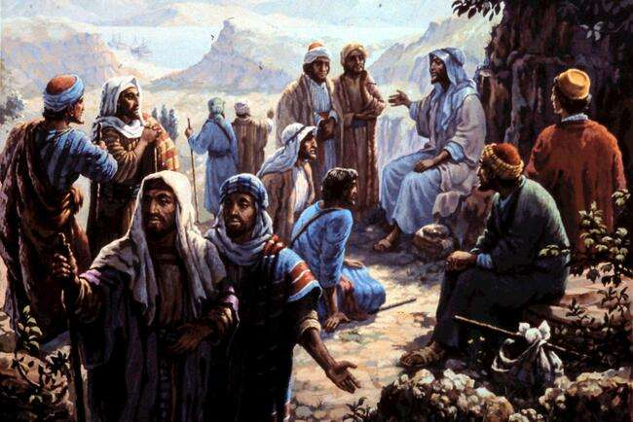
Mat. 9:36-38 When he saw the crowds, he had compassion on them, because they were harassed and helpless, like sheep without a shepherd. Then he said to his disciples, “The harvest is plentiful but the workers are few. Ask the Lord of the harvest, therefore, to send out workers into his harvest field.”

Slide 20
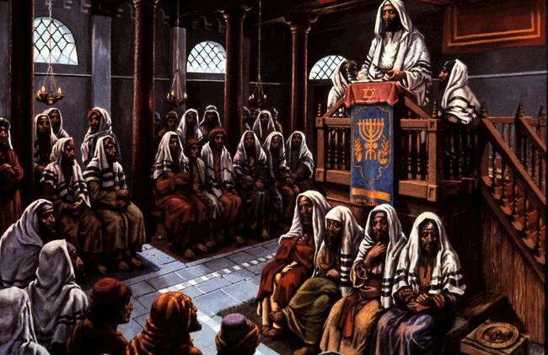
Luke 4:16-21 He went to Nazareth, and on the Sabbath day he went into the synagogue. He read from the prophet Isaiah: “The Spirit of the Lord is on me, because he has anointed me to preach good news to the poor. He has sent me to proclaim freedom for the prisoners and recovery of sight for the blind, to release the oppressed, to proclaim the year of the Lord’s favour.” [Isaiah 61:1,2] He said to them, “Today this scripture is fulfilled in your hearing.”

Slide 21
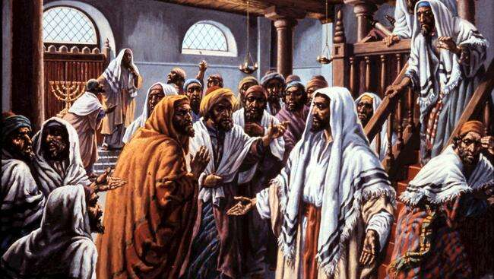
Luke 4:24-28 Jesus said “I tell you the truth, no prophet is accepted in his home town. I assure you that there were many widows in Israel in Elijah’s time, when there was a severe famine throughout the land. Yet Elijah was not sent to any of them, but to a widow in Zarephath in the region of Sidon. (Sidon is not in Israel) And there were many in Israel with leprosy in the time of Elisha the prophet, yet not one of them was cleansed - only Naaman the Syrian.” All the people in the synagogue were furious when they heard this.

Slide 22
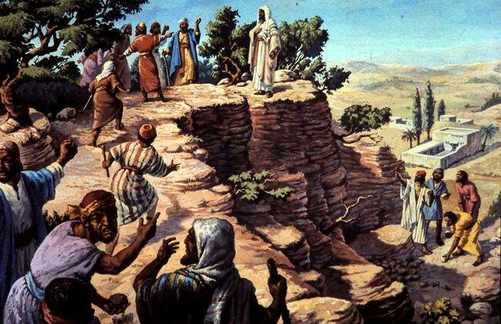
Luke 4:29,30 They got up, drove him out of the town, and took him to the brow of the hill on which the town was built, in order to throw him down the cliff. But he walked right through the crowd and went on his way.

Slide 23
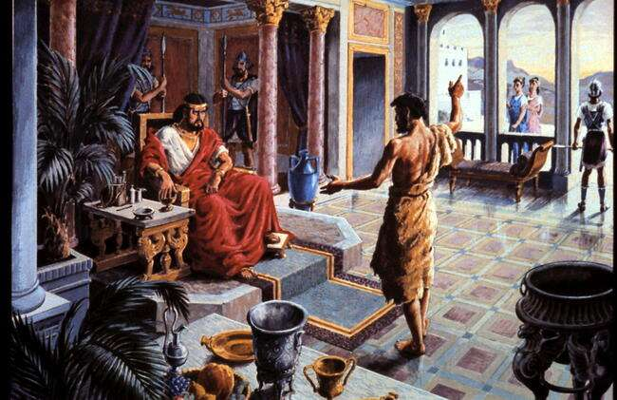
Mark 6:18-20 John had been saying to Herod, “It is not lawful for you to have your brother’s wife.” So Herodias . . wanted to kill him. But she was not able to, because Herod feared John and protected him, knowing him to be a righteous and holy man.

Slide 24
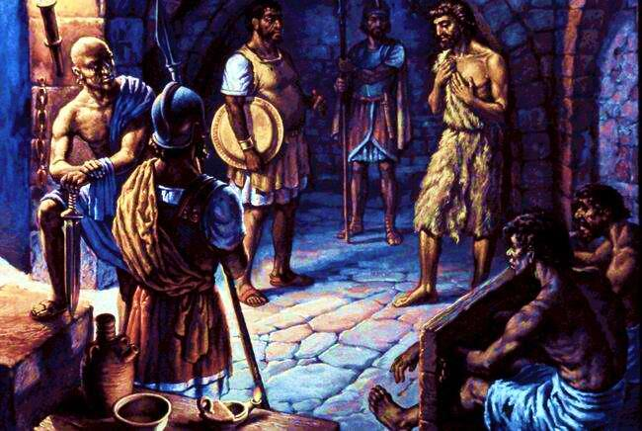
Mk. 6:22-28 When the daughter of Herodias . . danced, she pleased Herod . . The king said to the girl, “Ask me for anything you want, and I’ll give it to you.” She went out and said to her mother, “What shall I ask for?” “The head of John the Baptist,” she answered. So he immediately sent an executioner with orders to bring John’s head. The man went, beheaded John in the prison, He presented it to the girl, and she gave it to her mother.

Slide 25
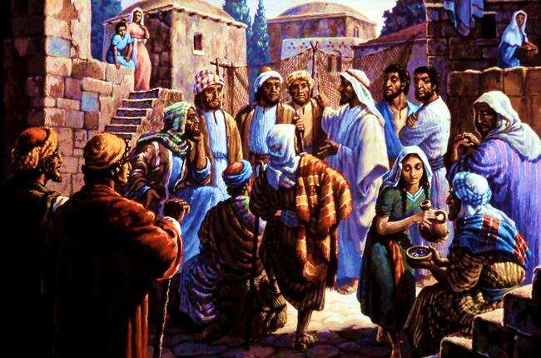
Mark 6:30,31 The apostles gathered round Jesus and reported to him all they had done and taught. Then, because so many people were coming and going that they did not even have a chance to eat, he said to them, “Come with me by yourselves to a quiet place, get some rest.”

