Slide 1
The life of Jesus - Part 11 of 18
English - 24 slides
Blind man healed, Good Samarithan, Martha, Crippled lady, Humble seat, Highways and byways, One Lost sheep
© 2013 Stichting Docete NL
www.docete.nl // info@docete.nl
Edited by Johan Peters
www.johanpeters.in
(Comments are in brackets)
Bible scriptures: New International Version

Slide 2
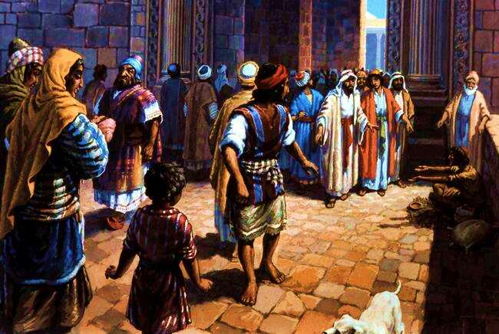
Jn. 9:1-6 As he went along, he saw a man blind from birth. His disciples asked him, “Rabbi, who sinned, this man or his parents, that he was born blind?” “. . this happened so that the work of God might be displayed in his life. As long as it is day, we must do the work of him who sent me. Night is coming, when no-one can work. . , I am the light of the world.”

Slide 3
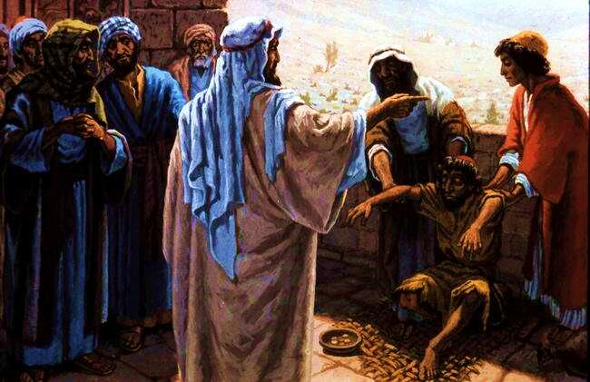
John 9:6,7 Having said this, he spat on the ground, made some mud with the saliva, and put it on the man’s eyes. “Go,” he told him, “wash in the Pool of Siloam”

Slide 4
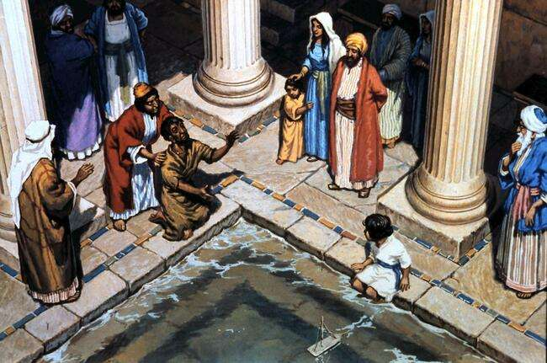
John 9:7 So the man went and washed, and came home seeing.

Slide 5
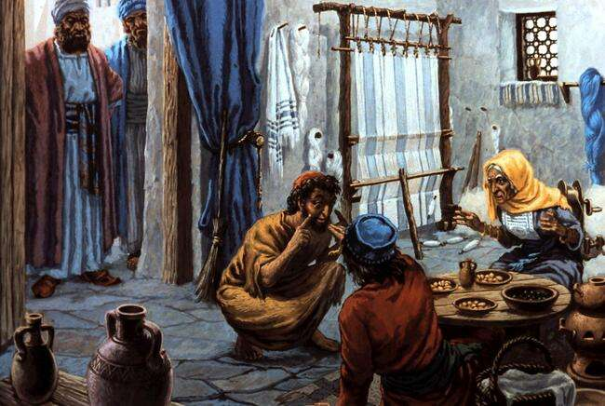
John 9:8-12 His neighbours . . asked, “Isn’t this the same man who used to sit and beg?” . . .” But he himself insisted, “I am the man.” “How then were your eyes opened?” they demanded. He replied, “The man they call Jesus made some mud and put it on my eyes. He told me to go to Siloam and wash. So I went and washed, and then I could see.”

Slide 6
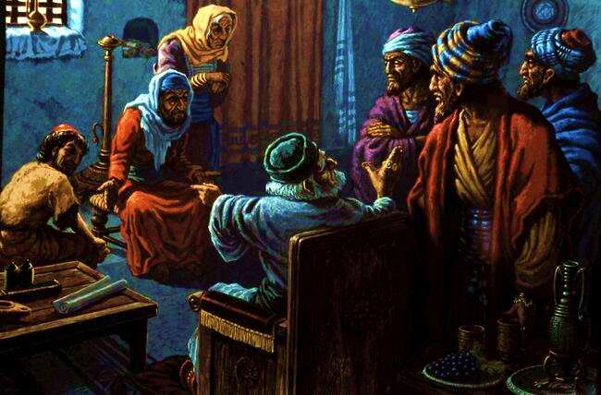
John 9:13-18 They brought him to the Pharisees. . Now the day on which Jesus had made the mud and opened the man’s eyes was a Sabbath. Therefore the Pharisees also asked him how he had received his sight. “He put mud on my eyes,” the man replied, “and I washed, and now I see.” Some of the Pharisees said, “This man is not from God, for he does not keep the Sabbath.” But others asked, “How can a sinner do such miraculous signs?” So they were divided. . . The Jews did not believe that he had been blind. . until they sent for the man’s parents.

Slide 7
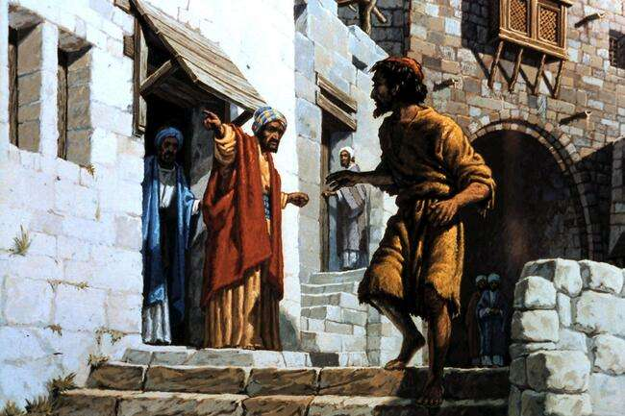
John 9:20-34 “We know he is our son,” the parents answered, “and we know he was born blind. But how he can see now, or who opened his eyes, we don’t know. Ask him. He is of age; he will speak for himself.” . . Then they asked him, “What did he do to you? How did he open your eyes?” . . He answered. . ,“If this man were not from God, he could do nothing.” To this they replied, “You were steeped in sin at birth; how dare you lecture us!” And they threw him out.

Slide 8
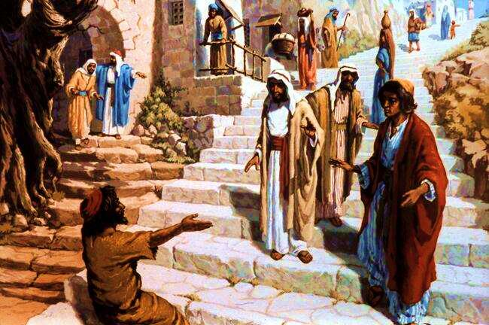
John 9:35-38 Jesus heard that they had thrown him out, and when he found him, he said, “Do you believe in the Son of Man?” “Who is he, sir?” the man asked. “Tell me so that I may believe in him.” Jesus said, “You have now seen him; in fact, he is the one speaking with you.” Then the man said, “Lord, I believe,” and he worshipped him.

Slide 9
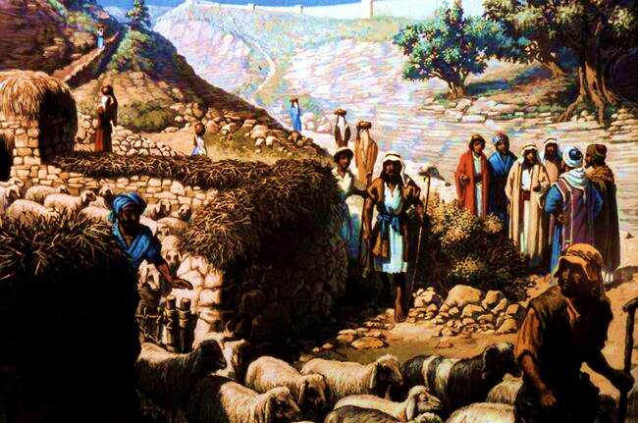
John 10:14,15 “I am the good shepherd; I know my sheep and my sheep know me - just as the Father knows me and I know the Father - and I lay down my life for the sheep. The reason my Father loves me is that I lay down my life - No-one takes it from me, but I lay it down of my own accord. I have authority to lay it down and authority to take it up again. This command I received from my Father.” . . the Jews were again divided. . “He is . . raving mad. Why listen to him?”

Slide 10
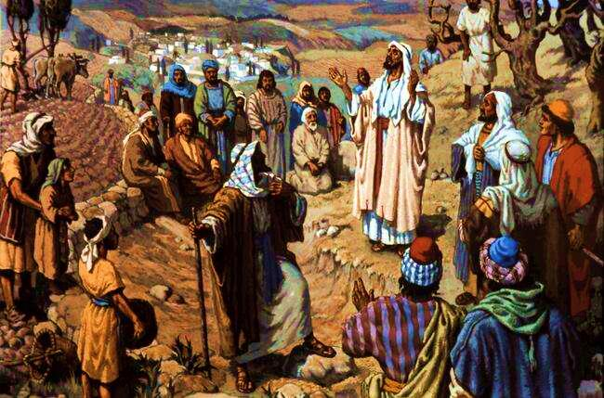
Lk. 10:17-21 The disciples returned with joy and said, “Lord, even the demons submit to us in your name.” He replied “I have given you authority to trample on snakes and scorpions and to overcome all the power of the enemy; nothing will harm you. However, do not rejoice that the spirits submit to you, but rejoice that your names are written in heaven.”

Slide 11
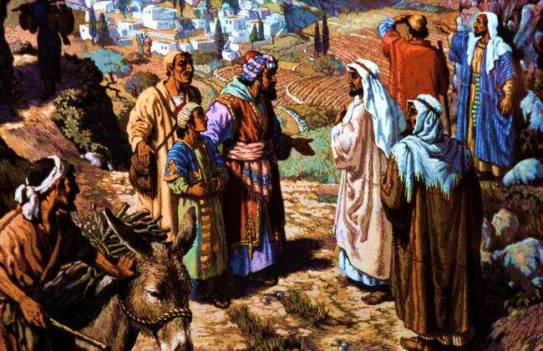
Luke 10:25-29 an expert in the law stood up to test Jesus. “Teacher,” he asked, “what must I do to inherit eternal life?” “What is written in the Law?” he replied. He answered: “`Love the Lord your God with all your heart and with all your soul and with all your strength and with all your mind’; [Deut. 6:5] and, `Love your neighbour as yourself.’“ [Lev. 19:18] “You have answered correctly,” Jesus replied. “Do this and you will live.” But he asked Jesus, “who is my neighbour?”

Slide 12
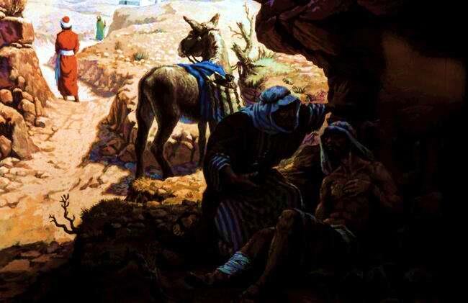
Lk. 10:30 In reply Jesus said: “A man . . fell into the hands of robbers. They stripped him of his clothes, beat him and went away, leaving him half-dead. A priest, when he saw the man, he passed by on the other side. So too, a Levite, . . But a Samaritan, . . when he saw him, he took pity on him. He. . bandaged his wounds, . Then he. . brought him to an inn and took care of him. The next day he took out two silver coins and gave them to the innkeeper. `Look after him,’ he said, `and when I return, I will reimburse you for any extra expense you may have.’ “Which of these three do you think was a neighbour to the man who fell into the hands of robbers?” The lawyer replied, “The one who had mercy on him.” Jesus told him, “Go and do likewise.”

Slide 13
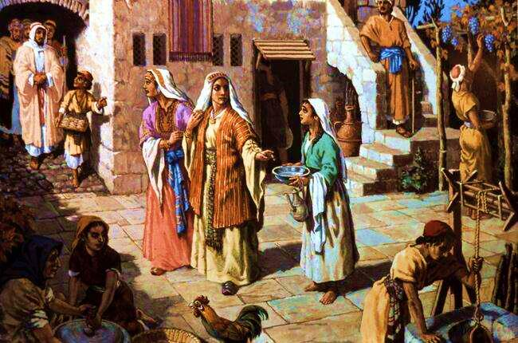
Luke 10:38,39 As Jesus and his disciples were on their way, he came to a village where a woman named Martha opened her home to him. She had a sister called Mary, who sat at the Lord’s feet listening to what he said.

Slide 14
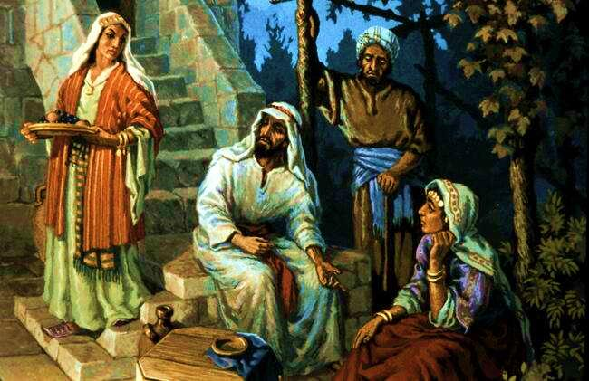
Luke 10:40-42 But Martha was distracted by all the preparations that had to be made. She came to him and asked, “Lord, don’t you care that my sister has left me to do the work by myself? Tell her to help me!” “Martha, Martha,” the Lord answered, “you are worried and upset about many things, but only one thing is needed. Mary has chosen what is better, and it will not be taken away from her.”

Slide 15
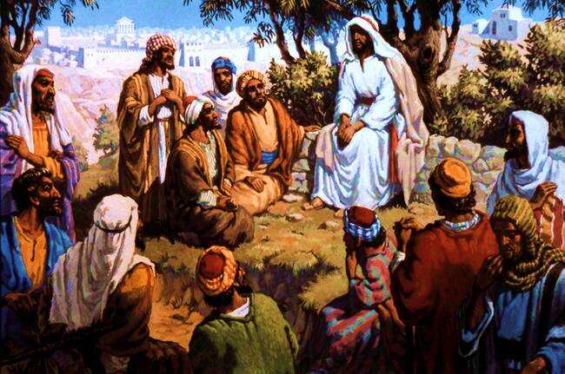
Mat 6:9-13 “This is how you should pray: “`Our Father in heaven, hallowed be your name, your kingdom come, your will be done on earth as it is in heaven. Give us today our daily bread. Forgive us our debts, as we also have forgiven our debtors. And lead us not into temptation, but deliver us from evil, for yours is the kingdom and the power and the glory for ever. Amen.’”

Slide 16
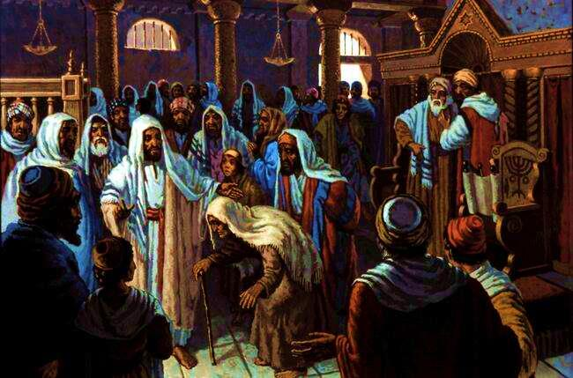
Luke 13:10-17 On a Sabbath Jesus was teaching in one of the synagogues, and a woman was there who had been crippled by a spirit for eighteen years. She was bent over . . he put his hands on her, and immediately she straightened up and praised God. . the synagogue ruler said to the people, “There are six days for work. So come and be healed on those days, not on the Sabbath.” The Lord answered him, “You hypocrites! Doesn’t each of you on the Sabbath untie his ox or donkey from the stall and lead it out to give it water? Then should not this daughter of Abraham, whom Satan has kept bound for eighteen long years, be set free on the Sabbath day?”

Slide 17
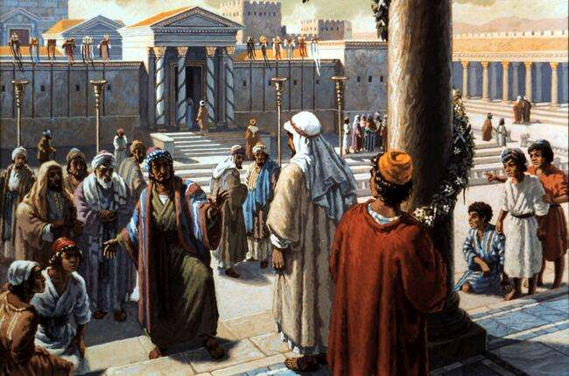
Jn. 10:22-31 Then came the Feast of Dedication (Hanukkah) . . It was winter, and Jesus was in the temple . . The Jews gathered round him, saying, “How long will you keep us in suspense? If you are the Christ, tell us plainly.” “The miracles I do in my Father’s name speak for me, but you do not believe because you are not my sheep. My sheep hear my voice; I know them, and they follow me. I give them eternal life, and they shall never perish; no-one can snatch them out of my hand. My Father, who has given them to me, is greater than all; no-one can snatch them out of my Father’s hand. I and the Father are one.” Again the Jews picked up stones to stone him,

Slide 18
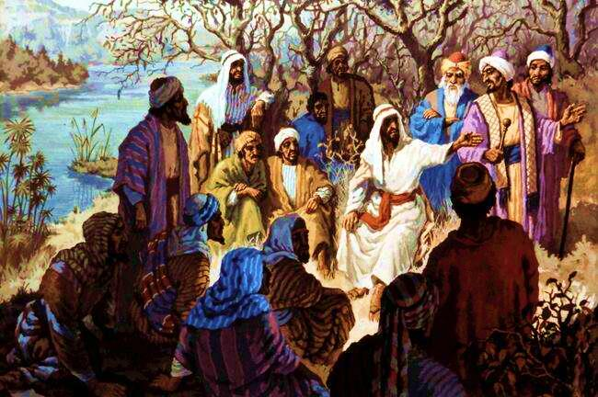
John 10:39-42 Again they tried to seize him, but he escaped their grasp. Then Jesus went back across the Jordan to the place where John had been baptising in the early days. Here he stayed and many people came to him. They said, “Though John never performed a miraculous sign, all that John said about this man was true.” And in that place many believed in Jesus.

Slide 19
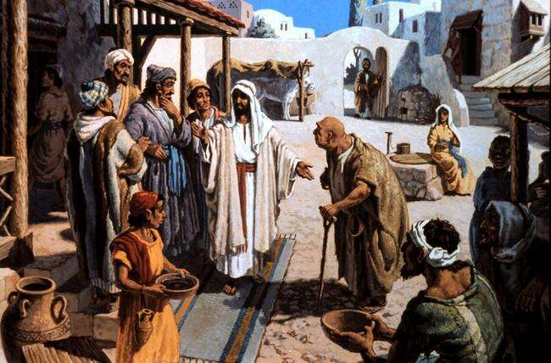
Luke 14:1-6 One Sabbath, when Jesus went to eat in the house of a prominent Pharisee, he was being carefully watched. There . . was a man suffering from dropsy. Jesus asked . . “Is it lawful to heal on the Sabbath or not?” But they remained silent. So taking hold of the man, he healed him and sent him away. Then he asked them, “If one of you has a son or an ox that falls into a well on the Sabbath day, will you not immediately pull him out?” And they had nothing to say.

Slide 20
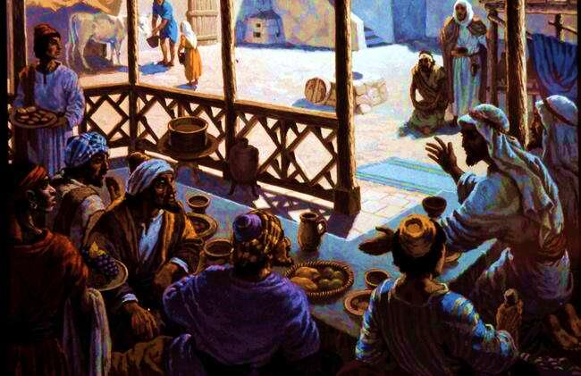
Luke 14:7-14 “When someone invites . , do not take the place of honour, . take the lowest place, For everyone who exalts himself will be humbled, and he who humbles himself will be exalted.”
Then Jesus said to his host, “When you give a meal, do not invite your friends, relatives, or your rich neighbours; But when you give a banquet, invite the poor, the crippled, the lame, the blind,
Although they cannot repay you, you will be repaid at the resurrection of the righteous.”

Slide 21
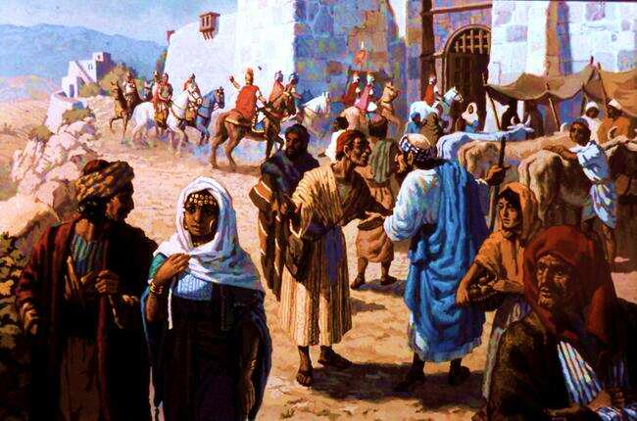
Luke 14:16-24 Jesus replied: “A certain man was preparing a great banquet and invited many guests. . But they all alike began to make excuses. . .Then the owner of the house became angry and ordered his servant, `Go out quickly into the streets and alleys of the town and bring in the poor, the crippled, the blind and the lame.’ `Go out . . and make them come in, so that my house will be full.’ I tell you, not one of those men who were invited will get a taste of my banquet.’“

Slide 22
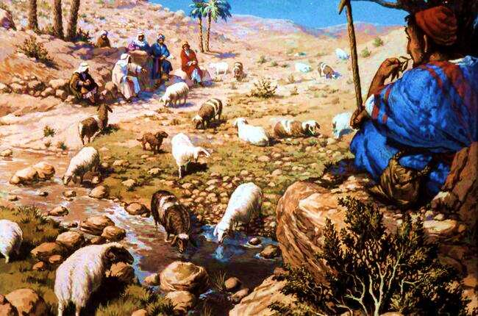
Mark 10:1-9 Jesus then . . went across the Jordan. Some Pharisees tested him by asking, “Is it lawful for a man to divorce his wife?” “What did Moses command you?” he replied. They said, “Moses permitted a man to write a certificate of divorce and send her away.” “It was because your hearts were hard that Moses wrote you this law,” Jesus replied. “But at the beginning of creation God `made them male and female’. , and the two will become one flesh.’ [Gen. 2:24] So they are no longer two, but one. Therefore what God has joined together, let man not separate.”

Slide 23
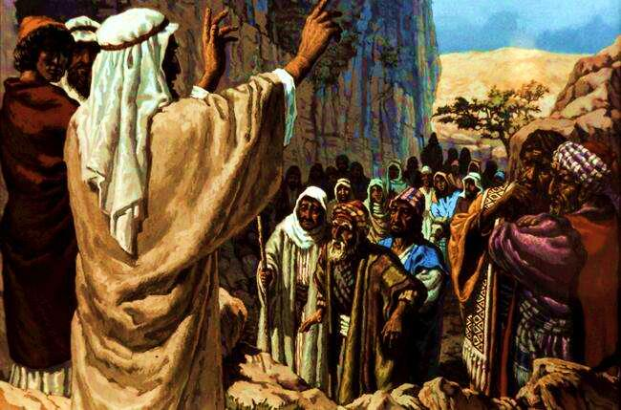
Luke 15:1-4 Now the tax collectors and “sinners” were all gathering round to hear him. But the Pharisees and the teachers of the law muttered, “This man welcomes sinners, and eats with them.” Then Jesus told them this parable: “Suppose one of you has a hundred sheep and loses one of them. Does he not leave the ninety-nine . . and go after the lost sheep until he finds it?”

Slide 24
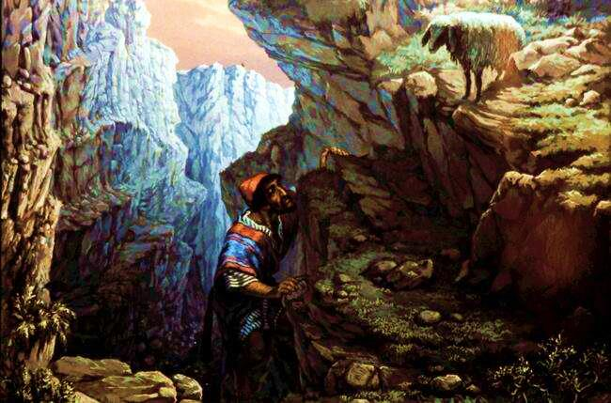
Luke 15:5-7 And when he finds it, he joyfully puts it on his shoulders and goes home. Then he calls his friends and neighbours together and says, `Rejoice with me; I have found my lost sheep.’ I tell you that in the same way there will be more rejoicing in heaven over one sinner who repents than over ninety-nine righteous persons who do not need to repent.

Slide 25
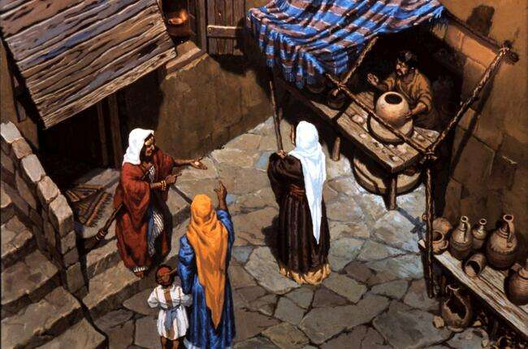
Lk. 15:8-10 “Or suppose a woman has ten silver coins and loses one. Does she not light a lamp, sweep the house and search carefully until she finds it? And when she finds it, she calls her friends and neighbours together and says, `Rejoice with me; I have found my lost coin.’ I tell you, there is rejoicing in the presence of the angels of God over one sinner who repents

