Slide 1
The life of Jesus - Part 12 of18
English - 26 Slides
Prodigal Son, Beggar, Forgiveness,
Ten Lepers, Lazarus
© 2013 Stichting Docete NL
www.docete.nl // info@docete.nl
Edited by Johan Peters
www.johanpeters.in
(Comments are in brackets)
Bible scriptures: New International Version

Slide 2
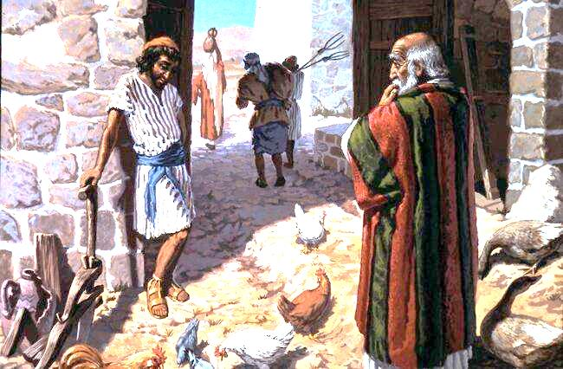
Luke 15:11,12 Jesus continued: “There was a man who had two sons. The younger one said to his father, `Father, give me my share of the estate.’ So he divided his property between them.”

Slide 3
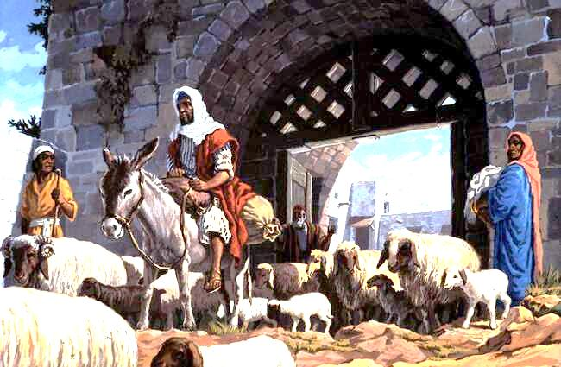
Luke 15:13-16 “Not long after that, the younger son got together all he had, set off for a distant country and there squandered his wealth in wild living. After he had spent everything, there was a severe famine in that whole country, and he began to be in need. So he went and hired himself out to a citizen of that country, who sent him to his fields to feed pigs. He longed to fill his stomach with the pods that the pigs were eating, but no-one gave him anything.”

Slide 4
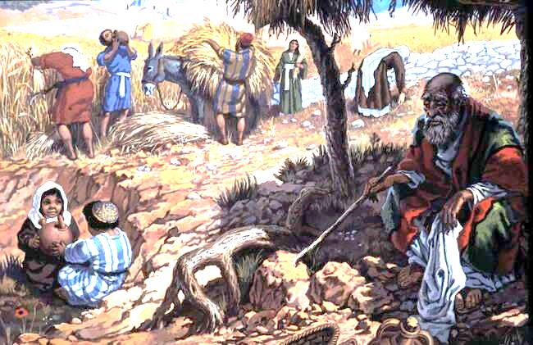
Luke 15:17-19 “When he came to his senses, he said, `How many of my father’s hired men have food to spare, and here I am starving to death! I will set out and go back to my father and say to him: Father, I have sinned against heaven and against you. I am no longer worthy to be called your son; make me like one of your hired men.’”

Slide 5
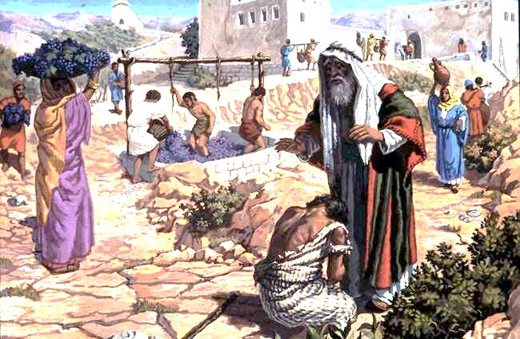
Luke 15:20-24 So he got up and went to his father. “But while he was still a long way off, his father saw him and was filled with compassion for him; he ran to his son, threw his arms around him and kissed him. The son said to him, `Father, I have sinned against heaven and against you. I am no longer worthy to be called your son. Make me like one of your hired men.’ “But the father said to his servants, `Quick! Bring the best robe and put it on him. Put a ring on his finger and sandals on his feet. . Let’s have a feast and celebrate. For this son of mine was dead and is alive again; he was lost and is found.’ So they began to celebrate.

Slide 6
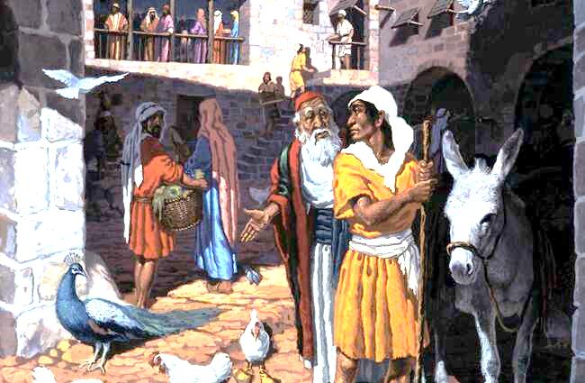
Luke 15:25-32 “Meanwhile, the older son was in the field. When he came near the house, he heard music and dancing. So he called one of the servants and asked him what was going on. `Your brother has come, . .’ “The older brother became angry and refused to go in. So his father went out and pleaded with him. But he answered his father, `Look! All these years I’ve been slaving for you and never disobeyed your orders. Yet you never gave me anything. . so I could celebrate with my friends. But when this son of yours who has squandered your property with prostitutes comes home, . . you make him a feast!’ “`My son,’ the father said, `you are always with me, and everything I have is yours. But we had to celebrate and be glad, because this brother of yours was dead and is alive again; he was lost and is found.’“

Slide 7
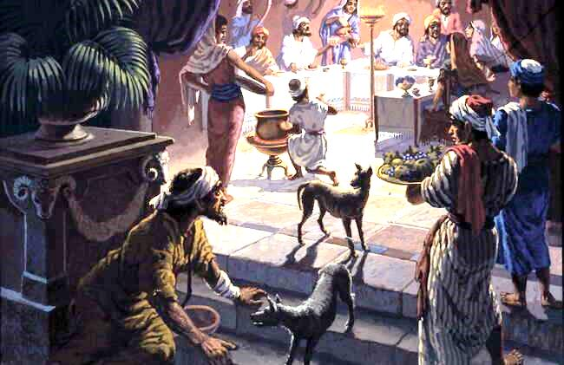
Luke 16:19-24 “There was a rich man who. . lived in luxury every day. At his gate was a beggar named Lazarus, covered with sores, longing to eat what fell from the rich man’s table. Even the dogs came and licked his sores. “The time came when the beggar died and the angels carried him to Abraham’s side. The rich man also died and was buried. In hell, where he was in torment, he looked up and saw Abraham far away, with Lazarus by his side. So he called to him, `Father Abraham, have pity on me and send Lazarus to dip the tip of his finger in water and cool my tongue, because I am in agony in this fire.’

Slide 8
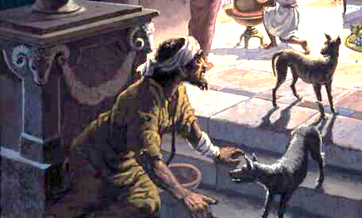
Luke 16:25,26 “But Abraham replied, `Son, remember that in your lifetime you received your good things, while Lazarus received bad things, but now he is comforted here and you are in agony. And besides all this, between us and you a great chasm has been fixed, so that those who want to go from here to you cannot, nor can anyone cross over from there to us.’

Slide 9
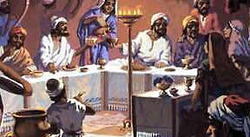
Luke 16:27-31 “He answered, `Then I beg you, father, send Lazarus to my father’s house, for I have five brothers. Let him warn them, so that they will not also come to this place of torment.’ “Abraham replied, `They have Moses and the Prophets; let them listen to them.’ “`No, father Abraham,’ he said, `but if someone from the dead goes to them, they will repent.’ “He said to him, `If they do not listen to Moses and the Prophets, they will not be convinced even if someone rises from the dead.’“

Slide 10
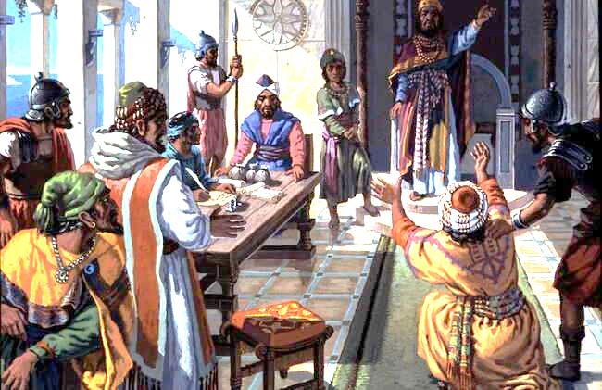
Mat. 18:23-27 “The kingdom of heaven is like a king who wanted to settle accounts with his servants. . , a man who owed him ten thousand talents [lacs of crores] . . Since he was not able to pay, the master ordered that he and his wife and his children and all that he had be sold to repay the debt. “The servant fell on his knees before him. `Be patient with me,’ he begged, `and I will pay back everything.’ The king took pity on him, cancelled the debt and let him go.

Slide 11
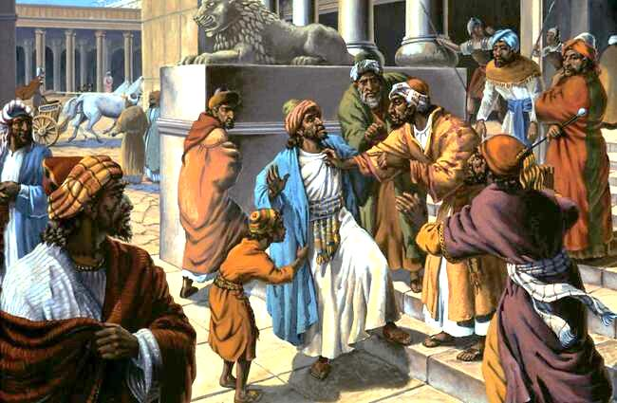
Mat. 18:28-35 “But when that servant went out, he found one of his fellow-servants who owed him a hundred denarii. [That is, a 100 rupees] He grabbed him and began to choke him. `Pay back what you owe me!’ he demanded. “His fellow-servant fell to his knees and begged him, `Be patient with me, and I will pay you back.’ “But he refused. . and had the man thrown into prison until he could pay the debt. . the other servants saw. . and told their master. . “Then the master called the servant in. `You wicked servant,’ he said, `I cancelled all that debt of yours because you begged me to. Shouldn’t you have had mercy on your fellow-servant just as I had on you?’ In anger his master turned him over to the jailers to be tortured, until he should pay back all he owed. “This . . my heavenly Father will do . . unless you forgive your brother from your heart.”

Slide 12
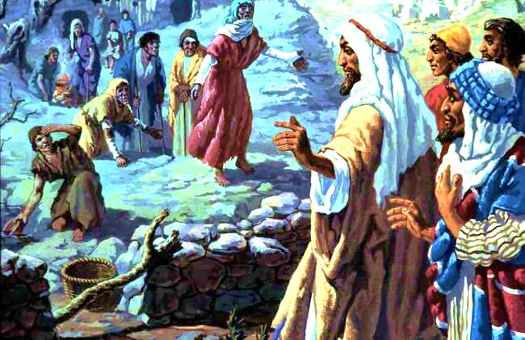
Luke 17:12-14 As he was going into a village, ten men who had leprosy met him. They stood at a distance and called out in a loud voice, “Jesus, Master, have pity on us!” When he saw them, he said, “Go, show yourselves to the priests.” And as they went, they were cleansed.

Slide 13
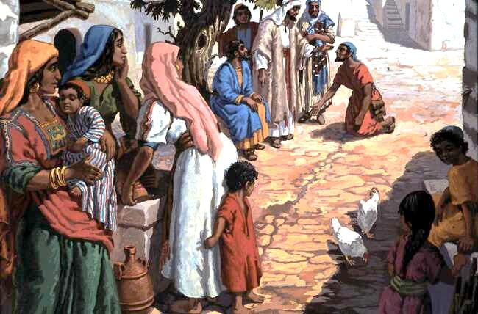
Luke 17:15-19 One of them, who saw he was healed, came back, praising God in a loud voice. He threw himself at Jesus’ feet and thanked him - and he was a Samaritan. Jesus asked, “Were not all ten cleansed? Where are the other nine? Was no-one found to return and give praise to God except this foreigner?” Then he said to him, “Rise and go; your faith has made you well.”

Slide 14
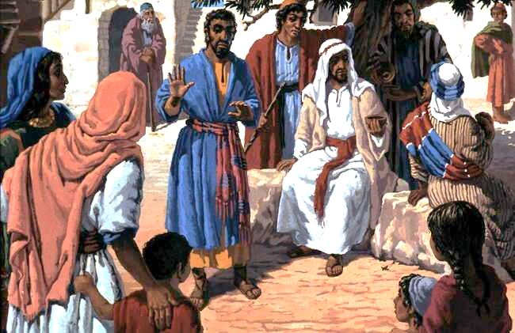
Mark 10:13,14 People were bringing little children to Jesus to have him touch them, but the disciples rebuked them. When Jesus saw this, he was indignant. He said to them, “Let the little children come to me, and do not hinder them, for the kingdom of God belongs to such as these.

Slide 15
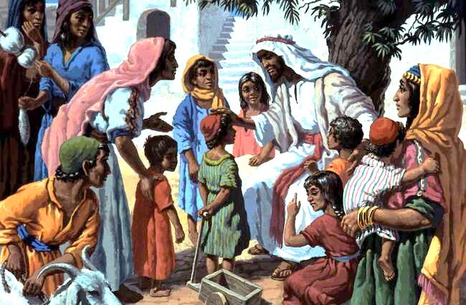
Mark 10:15,16 I tell you the truth, anyone who will not receive the kingdom of God like a little child will never enter it.” And he took the children in his arms, put his hands on them and blessed them.

Slide 16
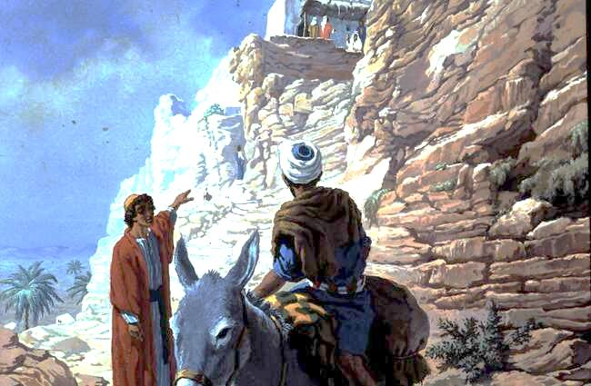
John 11:1-6 Now a man named Lazarus was sick. He was from Bethany, the village of Mary and her sister Martha. . So the sisters sent word to Jesus, “Lord, the one you love is sick.” When he heard this, Jesus said, “This sickness will not end in death. No, it is for God’s glory so that God’s Son may be glorified through it.” . . when he heard that Lazarus was sick, he stayed where he was two more days.

Slide 17
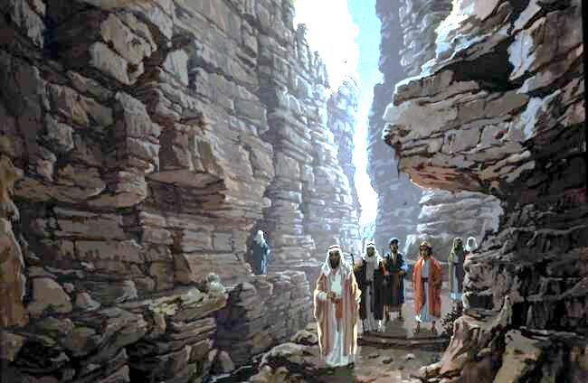
John 11:7-10 Then he said to his disciples, “Let us go back to Judea.” “But Rabbi,” they said, “a short while ago the Jews tried to stone you, and yet you are going back there?” Jesus answered, “Are there not twelve hours of daylight? A man who walks by day will not stumble, for he sees by this world’s light. It is when he walks by night that he stumbles, for he has no light.”

Slide 18
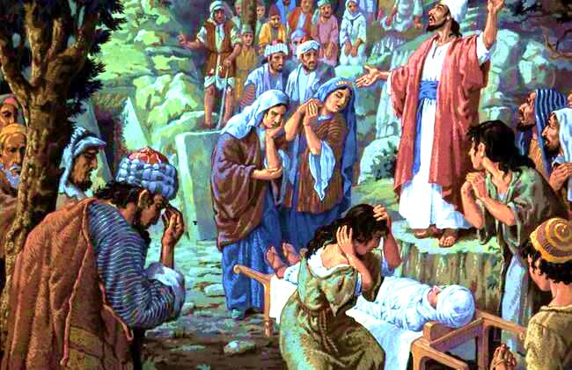
John 11:11-13 After he had said this, he went on to tell them, “Our friend Lazarus has fallen asleep; but I am going there to wake him up.” His disciples replied, “Lord, if he sleeps, he will get better.” Jesus had been speaking of his death, but his disciples thought he meant natural sleep.

Slide 19
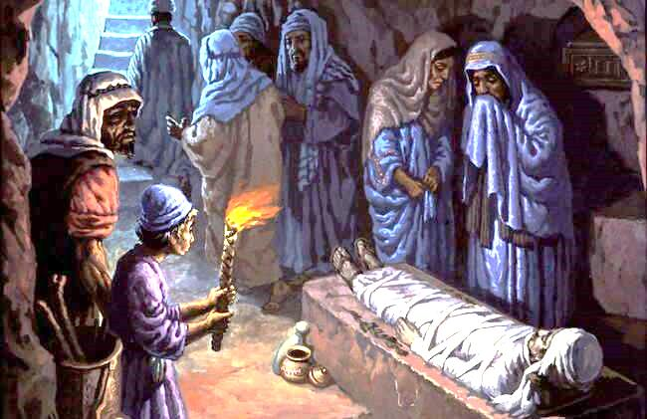
John 11:14-17 So then he told them plainly, “Lazarus is dead, and for your sake I am glad I was not there, so that you may believe. But let us go to him.” Then Thomas (called Didymus) said to the rest of the disciples, “Let us also go, that we may die with him.” On his arrival, Jesus found that Lazarus had already been in the tomb for four days.

Slide 20
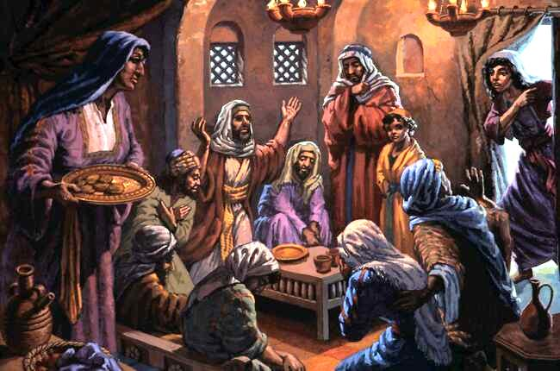
John 11:18-20 Bethany was about 3 kilometers from Jerusalem, and many Jews had come to Martha and Mary to comfort them in the loss of their brother. When Martha heard that Jesus was coming, she went out to meet him, but Mary stayed at home.

Slide 21
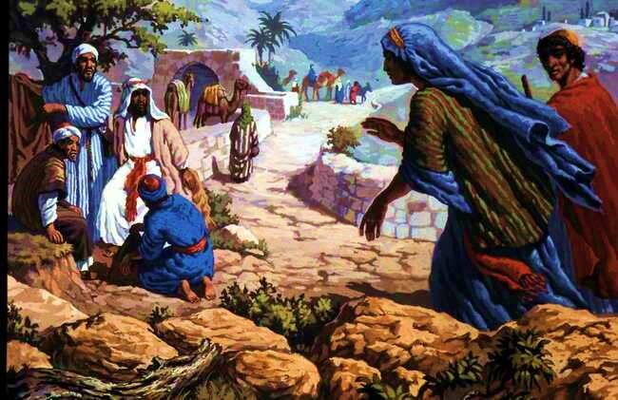
John 11:21-27 “Lord,” Martha said to Jesus, “if you had been here, my brother would not have died. But I know that even now God will give you whatever you ask.” Jesus said to her, “Your brother will rise again.” Martha answered, “I know he will rise again in the resurrection at the last day.” Jesus said to her, “I am the resurrection and the life. He who believes in me will live, even though he dies; and whoever lives and believes in me will never die. Do you believe this?” “Yes, Lord,” she told him, “I believe that you are the Christ, the Son of God, who was to come into the world.”

Slide 22
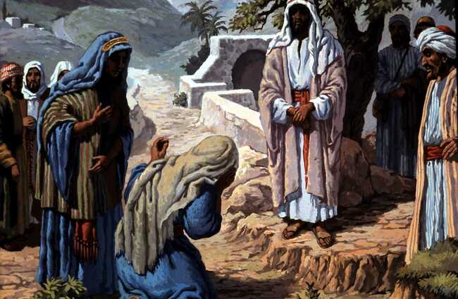
John 11:28-35 And after she had said this, she went back and called her sister . . When Mary reached the place where Jesus was and saw him, she fell at his feet and said, “Lord, if you had been here, my brother would not have died.” When Jesus saw her weeping, and the Jews who had come along with her also weeping, he was deeply moved in spirit and troubled. “Where have you laid him?” he asked. “Come and see, Lord,” they replied. Jesus wept.

Slide 23
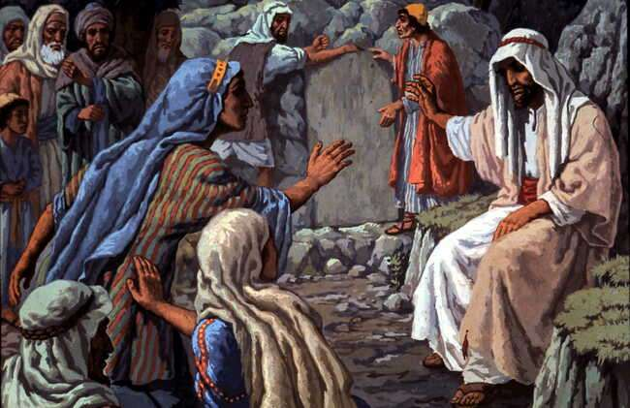
John 11:36-40 Then the Jews said, “See how he loved him!” But some of them said, “Could not he who opened the eyes of the blind man have kept this man from dying?” Jesus, once more deeply moved, came to the tomb. It was a cave with a stone laid across the entrance. “Take away the stone,” he said. “But, Lord,” said Martha, the sister of the dead man, “by this time there is a bad odour, for he has been there four days.” Then Jesus said, “Did I not tell you that if you believed, you would see the glory of God?”

Slide 24
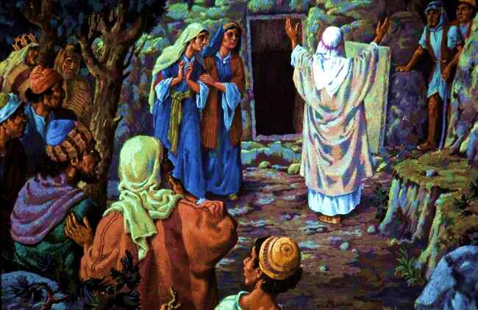
John 11:41-43 So they took away the stone. Then Jesus looked up and said, “Father, I thank you that you have heard me. I knew that you always hear me, but I said this for the benefit of the people standing here, that they may believe that you sent me.” When he had said this, Jesus called in a loud voice, “Lazarus, come out!”

Slide 25
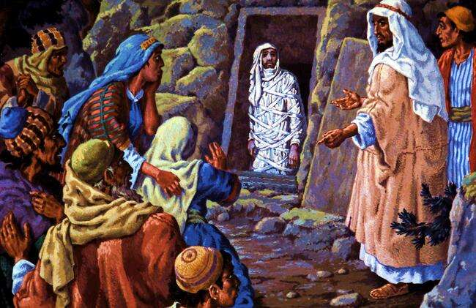
John 11:44-45 The dead man came out, his hands and feet wrapped with strips of linen, and a cloth around his face. Jesus said to them, “Take off the grave clothes and let him go.” Therefore many of the Jews who had come to visit Mary, and had seen what Jesus did, believed in him.

Slide 26
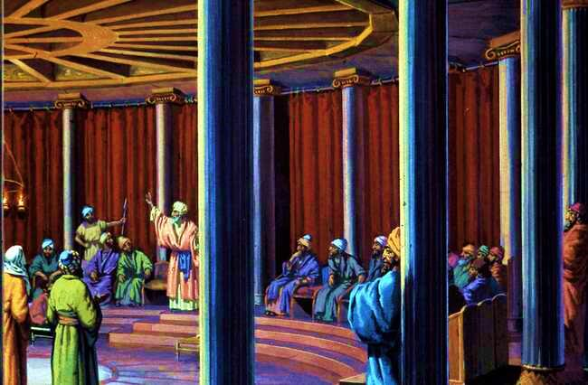
John 11:46-52 But some of them went to the Pharisees and told them what Jesus had done. Then the chief priests and the Pharisees called a meeting of the Sanhedrin. “Here is this man performing many miraculous signs. If we let him go on like this, everyone will believe in him, and then the Romans will come and take away both our temple and our nation.” Then Caiaphas, who was high priest that year, spoke up, “ . . it is better for you that one man die for the people than that the whole nation perish.” He did not say this on his own, but as high priest that year he prophesied that Jesus would die for the Jewish nation, and not only for that nation but also for the scattered children of God, to bring them together and make them one.

Slide 27
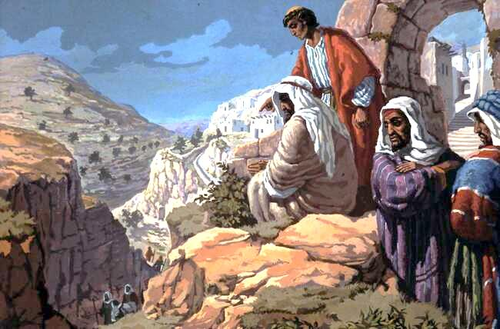
John 11:53,54 So from that day on they plotted to take his life. Therefore Jesus no longer moved about publicly among the Jews. Instead he withdrew to a region near the desert, to a village called Ephraim, where he stayed with his disciples.

