Slide 1
The life of Jesus - Part 13 of 18
English - 25 Slides
Unjust Judge, Rich young Ruler, Vineyard Workers, Two Blind, Zacchaeus, Mary anoints, Hosanna, Trouble in Temple.
© 2013 Stichting Docete NL
www.docete.nl // info@docete.nl
Edited by Johan Peters
www.johanpeters.in
(Comments are in brackets)
Bible scriptures: New International Version

Slide 2
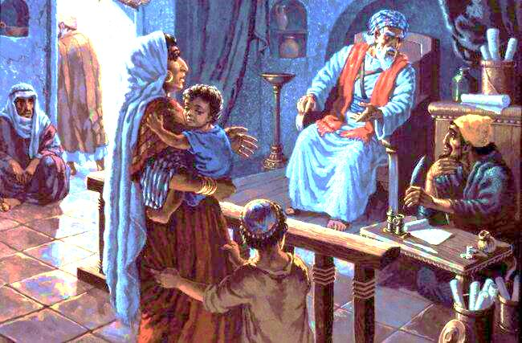
Luke 18:1-6 Then Jesus told his disciples . . that they should always pray and not give up. He said: “. . There was a judge who neither feared God nor cared about men and there was a widow in that town who kept coming to him with the plea, `Grant me justice against my adversary.’ “For some time he refused. But finally he said to himself, `Even though I don’t fear God or care about men, yet because this widow keeps bothering me, I will see that she gets justice, so that she won’t eventually wear me out with her coming!’“ And the Lord said, “Listen to what the unjust judge says. And will not God bring about justice for his chosen ones, who cry out to him day and night? Will he keep putting them off? He will see that they get justice and quickly.

Slide 3
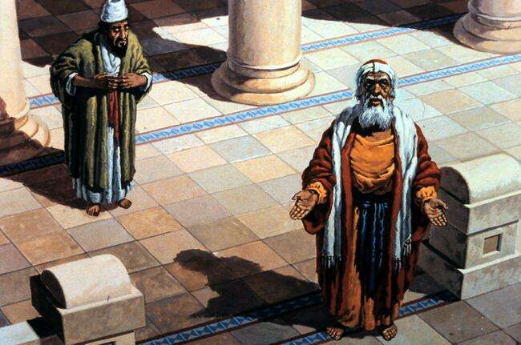
Luke 18:9-14 To some who . . looked down on everybody else, Jesus told this parable: “Two men went up to the temple to pray, one a Pharisee and the other a tax collector. The Pharisee stood up and prayed to himself: `God, I thank you that I am not like other men - robbers, evildoers, adulterers - or even like this tax collector. I fast twice a week and give a tenth of all I get.’
“But the tax collector stood at a distance. He would not even look up to heaven, but beat his breast and said, `God, have mercy on me, a sinner.’ “I tell you that this man, rather than the other, went home justified before God. For everyone who exalts himself will be humbled, and he who humbles himself will be exalted.”

Slide 4
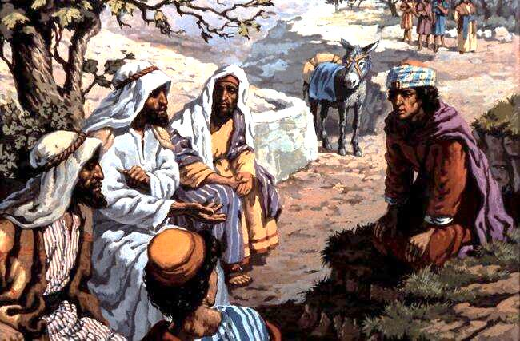
Luke 18:18-22 A certain ruler asked him, “Good teacher, what must I do to inherit eternal life?”
You know the commandments: `Do not commit adultery, do not murder, do not steal, do not give false testimony, honour your father and mother.’“ [Ex. 20:12-16; Deut. 5:16-20] “All these I have kept since I was a boy,” he said. When Jesus heard this, he said to him, “You still lack one thing. Sell everything you have and give to the poor, and you will have treasure in heaven. Then come, follow me.”

Slide 5
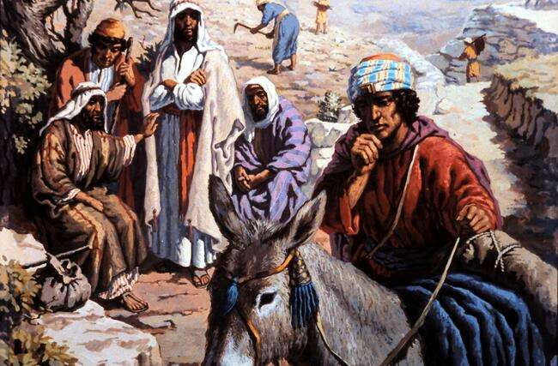
Luke 18:23-27 When he heard this, he became very sad, because he was a man of great wealth. Jesus looked at him and said, “How hard it is for the rich to enter the kingdom of God! Indeed, it is easier for a camel to go through the eye of a needle than for a rich man to enter the kingdom of God.” Those who heard this asked, “Who then can be saved?” Jesus replied, “What is impossible with men is possible with God.”

Slide 6
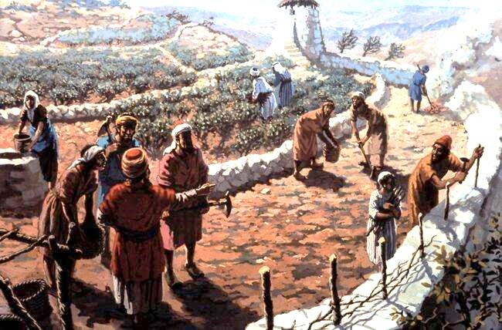
Mat. 20:1-7 “The kingdom of heaven is like a landowner who went out early in the morning to hire men to work in his vineyard. He agreed to pay them a penny for the day and sent them into his vineyard. “About the third hour he went out and saw others standing in the market-place doing nothing. He told them, `You also go and work in my vineyard, and I will pay you whatever is right.’ So they went. “He went out again about the sixth hour and the ninth hour and did the same thing. About the eleventh hour he went out and found still others standing around. He asked them, `Why have you been standing here all day long doing nothing?’ “`Because no-one has hired us,’ they answered. “He said to them, `You also go and work in my vineyard.’

Slide 7
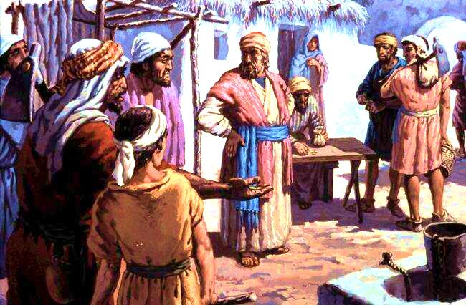
Mat. 20:8-16 “When evening came, he . . said to his foreman, `Call the workers and pay them their wages, beginning with the last ones hired and going on to the first.’ “The workers who were hired about the eleventh hour came and each received a penny. So when those came who were hired first, they expected to receive more. But each one of them also received a penny . . they began to grumble against the landowner. `These men who were hired last worked only one hour,’ they said, `and you have made them equal to us who have borne the burden of the work and the heat of the day.’ “But he answered. . `Friend, I am not being unfair to you. Didn’t you agree to work for a penny? Take your pay and go. I want to give the man who was hired last the same as I gave you . . Or are you envious because I am generous?’ “So the last will be first, and the first will be last.”

Slide 8
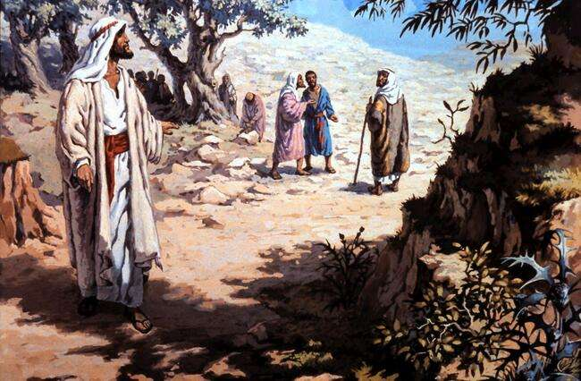
Mat. 20:17-19 Now as Jesus was going up to Jerusalem, he took the twelve disciples aside and said to them, “We are going up to Jerusalem, and the Son of Man will be betrayed to the chief priests and the teachers of the law. They will condemn him to death and will turn him over to the Gentiles to be mocked and flogged and crucified. On the third day he will be raised to life!”

Slide 9
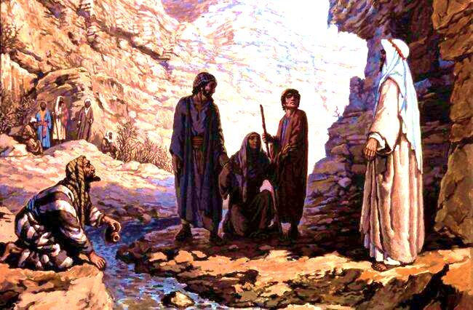
Mat. 20:20-23 The mother of Zebedee’s sons came to Jesus with her sons . . “What is it you want?” he asked. She said, “Grant that one of these two sons of mine may sit at your right and the other at your left in your kingdom.” “You don’t know what you are asking,” Jesus said to them. “Can you drink the cup I am going to drink?” “We can,” they answered. Jesus said to them, “You will indeed drink from my cup, but to sit at my right or left is not for me to grant. These places belong to those for whom they have been prepared by my Father.”

Slide 10
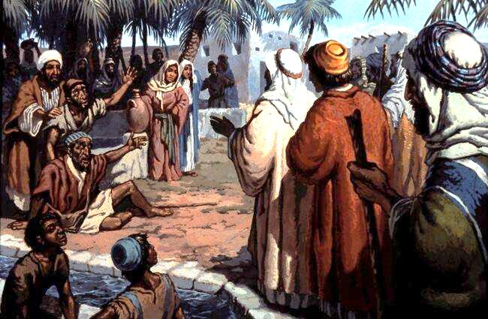
Mat. 20:30-34 Two blind men were sitting by the roadside, and when they heard that Jesus was going by, they shouted, “Lord, Son of David, have mercy on us!” The crowd rebuked them and told them to be quiet, but they shouted all the louder, “Lord, Son of David, have mercy on us!”

Slide 11
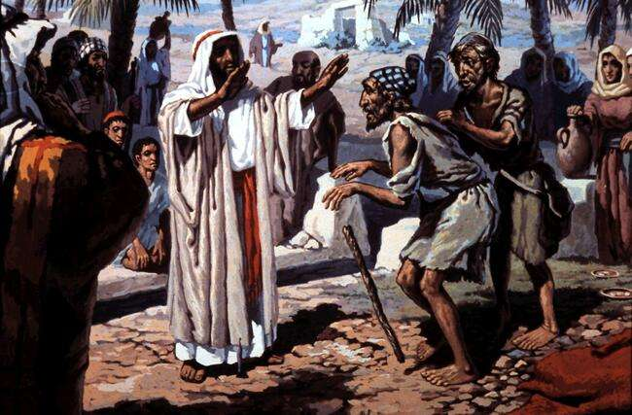
Mat. 20:32-34 Jesus stopped and called them. “What do you want me to do for you?” he asked. “Lord,” they answered, “we want our sight.” Jesus had compassion on them and touched their eyes. Immediately they received their sight and followed him.

Slide 12
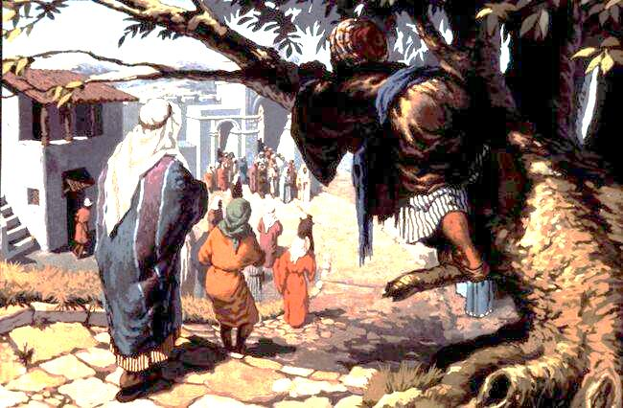
Luke 19:1-5 Jesus entered Jericho . . A man was there by the name of Zacchaeus; he was a chief tax collector and was wealthy. He wanted to see who Jesus was, but being a short man he could not, because of the crowd. So he ran ahead and climbed a sycamore-fig tree to see him, since Jesus was coming that way. When Jesus reached the spot, he looked up and said to him, “Zacchaeus, come down immediately. I must stay at your house today.”

Slide 13
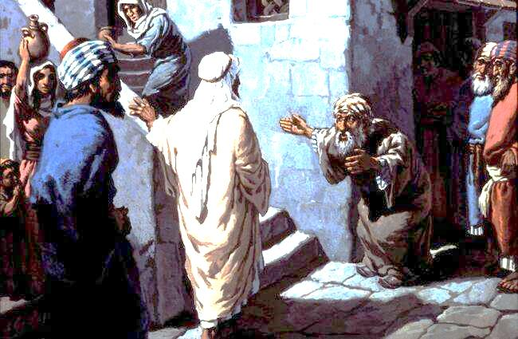
Luke 19:6-10 So he came down at once and welcomed him gladly. All the people saw this and began to mutter, “He has gone to be the guest of a `sinner’.” But Zacchaeus stood up and said to the Lord, “Look, Lord! Here and now I give half of my possessions to the poor, and if I have cheated anybody out of anything, I will pay back four times the amount.” Jesus said to him, “Today salvation has come to this house, because this man, too, is a son of Abraham. For the Son of Man came to seek and to save what was lost.”

Slide 14
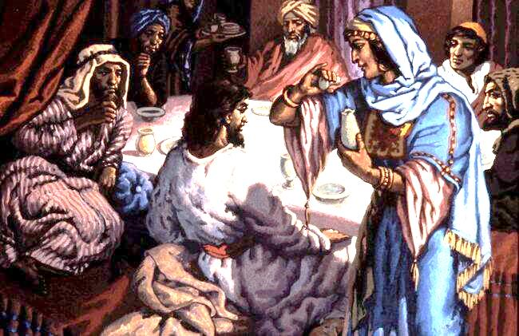
John 12:1-3 Six days before the Passover, Jesus arrived at Bethany, where Lazarus lived, whom Jesus had raised from the dead. Here a dinner was given in Jesus’ honour. Martha served, while Lazarus was among those reclining at the table with him. Then Mary took about a pint of pure nard, an expensive perfume; she poured it on Jesus’ feet and wiped his feet with her hair. And the house was filled with the fragrance of the perfume.

Slide 15
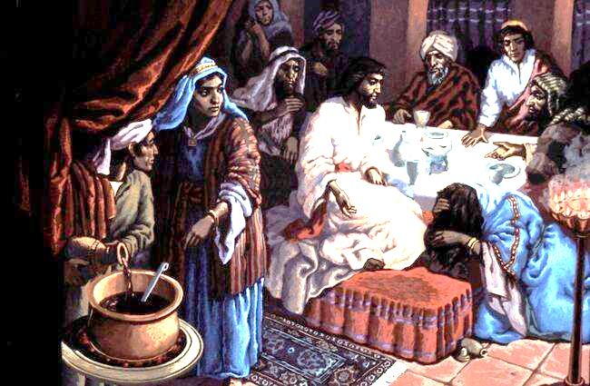
John 12:4-8 But one of his disciples, Judas Iscariot, . . Objected, “Why wasn’t this perfume sold and the money given to the poor? It was worth three hundred pennies. . “Leave her alone,” Jesus replied. “It was intended that she should save this perfume for the day of my burial. You will always have the poor among you, but you will not always have me.”

Slide 16
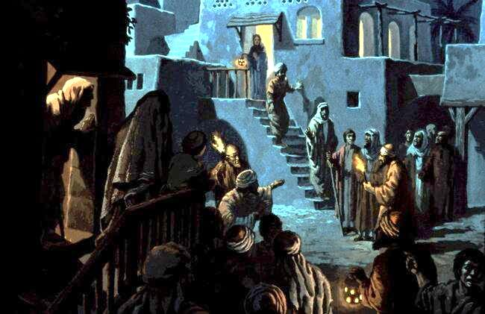
John 12:9-11 Meanwhile a large crowd of Jews found out that Jesus was there and came, not only because of him but also to see Lazarus, whom he had raised from the dead. So the chief priests made plans to kill Lazarus as well, for on account of him many of the Jews were going over to Jesus and putting their faith in him.

Slide 17
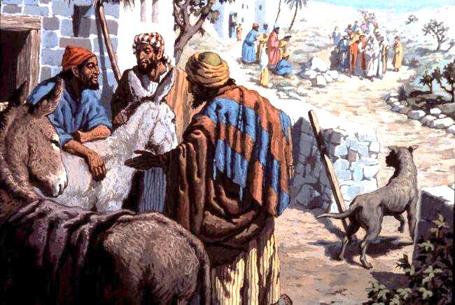
Luke 19:29-34 As he approached Bethphage and Bethany near the Mount of Olives, he sent two of his disciples, saying to them, “Go to the village ahead of you, and as you enter it, you will find a colt tied there, which no-one has ever ridden. Untie it and bring it here. If anyone asks you, `Why are you untying it?’ tell him, `The Lord needs it.’“ Those who were sent ahead went and found it just as he had told them. As they were untying the colt, its owners asked them, “Why are you untying the colt?” They replied, “The Lord needs it.”

Slide 18
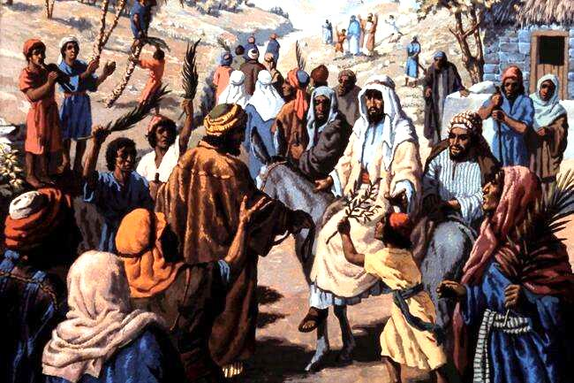
Luke 19:35-36 They brought it to Jesus, threw their cloaks on the colt and put Jesus on it. As he went along, people spread their cloaks on the road.

Slide 19
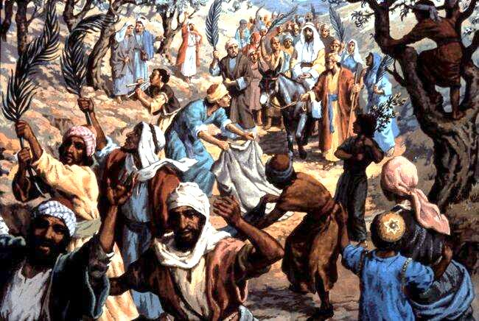
Luke 19:37-38 When he came near the place where the road goes down the Mount of Olives, the whole crowd of disciples began joyfully to praise God in loud voices for all the miracles they had seen: “Blessed is the king who comes in the name of the Lord!” [Psalm 118:26] “Peace in heaven and glory in the highest!”

Slide 20
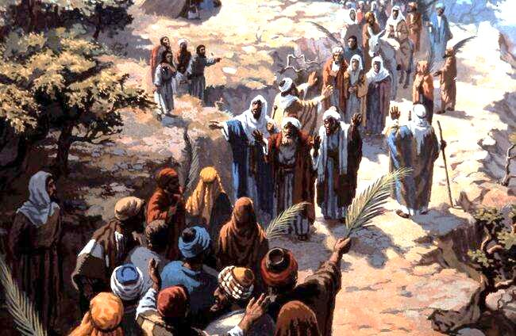
Luke 19:39-42 The Pharisees in the crowd said to Jesus, “Teacher, rebuke your disciples!” “I tell you,” he replied, “if they keep quiet, the stones will cry out.” As he approached Jerusalem and saw the city, he wept over it and said, “If you, even you, had only known on this day what would bring you peace - but now it is hidden from your eyes.”

Slide 21
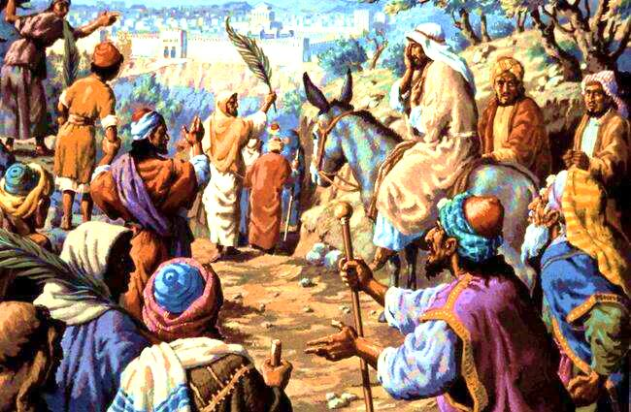
Luke 19:41-44 As he approached Jerusalem and saw the city, he wept over it and said, “If you, even you, had only known on this day what would bring you peace - but now it is hidden from your eyes. “The days will come upon you when your enemies will build an embankment against you and encircle you and hem you in on every side. They will dash you to the ground, you and the children within your walls. They will not leave one stone on another, because you did not recognise the time of God’s coming to you.”

Slide 22
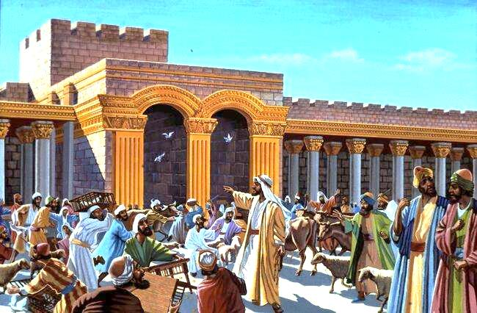
Luke 19:45-46 Then he entered the temple area and began driving out those who were selling. “It is written,” he said to them, “`My house will be a house of prayer’; [Isaiah 56:7] but you have made it `a den of robbers’.” [Jeremiah 7:11]

Slide 23
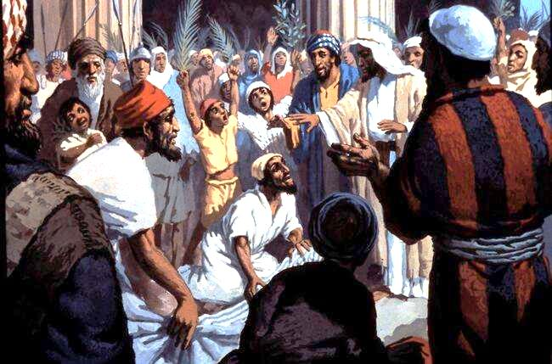
Mat. 21:14,15 The blind and the lame came to him at the temple, and he healed them. But when the chief priests and the teachers of the law saw the wonderful things he did and the children shouting in the temple area, “Hosanna to the Son of David,” they were indignant.

Slide 24
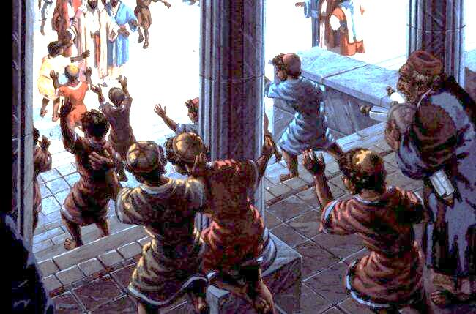
Mat. 21:16,17 “Do you hear what these children are saying?” they asked him. “Yes,” replied Jesus, “have you never read, “`From the lips of children and infants you have ordained praise’?” [Psalm 8:2] And he left them and went out of the city to Bethany, where he spent the night.

Slide 25
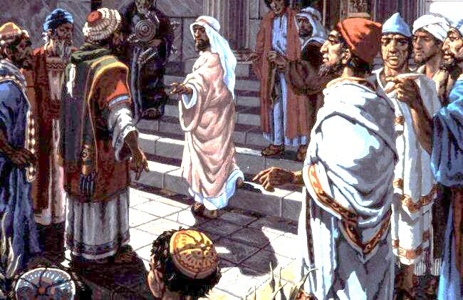
Mark 11:27-30 They arrived again in Jerusalem, and while Jesus was walking in the temple courts, the chief priests, the teachers of the law and the elders came to him. “By what authority are you doing these things?” they asked. “And who gave you authority to do this?” Jesus replied, “I will ask you one question. Answer me, and I will tell you by what authority I am doing these things. John’s baptism - was it from heaven, or from men? Tell me!”

Slide 26
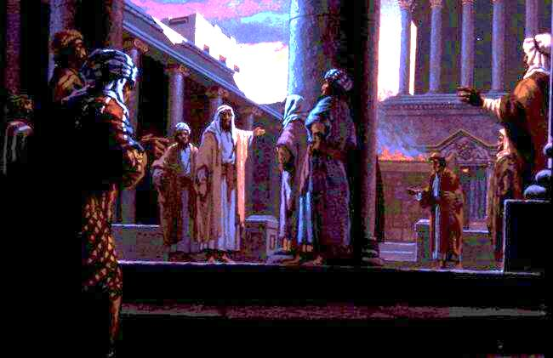
Mark 11:31-33 They discussed it among themselves and said, “If we say, `From heaven’, he will ask, `Then why didn’t you believe him?’ But if we say, `From men’....” (They feared the people, for everyone held that John really was a prophet.) So they answered Jesus, “We don’t know.” Jesus said, “Neither will I tell you by what authority I am doing these things.”

