Slide 1
The life of Jesus - Part 14 of 18
English – 26 Slides
Pharisees trying to trick, Parables,
3rd time Ointment, Judas Betrayal, Passover, Communion, Foot Washing
© 2013 Stichting Docete NL
www.docete.nl // info@docete.nl
Edited by Johan Peters
www.johanpeters.in
(Comments are in brackets)
Bible scriptures: New International Version

Slide 2
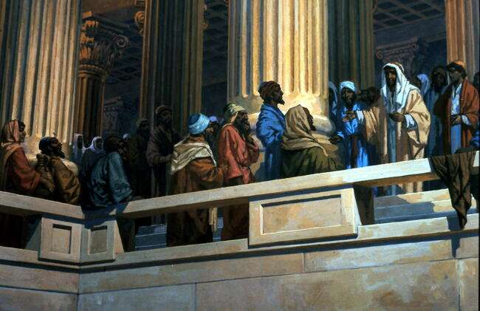
Mark 12:38-40 As he taught, Jesus said, “Watch out for the teachers of the law. They like to walk around in flowing robes and be greeted in the market-places, and have the most important seats in the synagogues and the places of honour at banquets. They devour widows’ houses and for a show make lengthy prayers.” (Jesus hits back hard at their hypocrisy. See also Mat. 23)

Slide 3
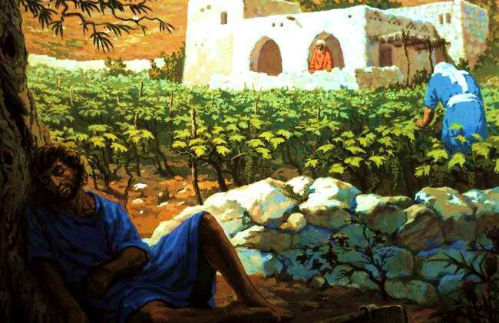
Mat. 21:28-31 “What do you think? There was a man who had two sons. He . . said, `Son, go and work today in the vineyard.’ “`I will not,’ he answered, but later he changed his mind and went. “The father went to the other son and said the same thing. He answered, `I will, sir,’ but he did not go. “Which of the two did what his father wanted?” “The first,” they answered. Jesus said, “I tell you, the tax collectors and the prostitutes are entering the kingdom of God ahead of you.”

Slide 4
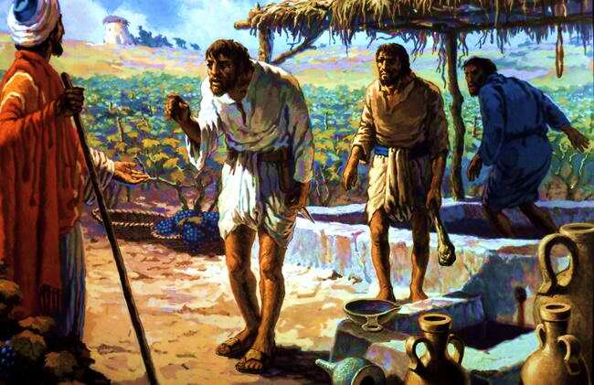
Mat. 21:33-43 “Listen to another parable: There was a landowner who planted a vineyard. . . Then he rented the vineyard . . and went away on a journey. When the harvest time came, he sent his servants to collect his fruit. “The tenants seized his servants; they beat one, killed another, and stoned a third. . . Last of all, he sent his son to them. But when the tenants saw the son, they said to each other, `This is the heir. Come, let’s kill him and take his inheritance.’ So they . . killed him. “Therefore, when the owner of the vineyard comes, what will he do to those tenants?” “He will bring those wretches to a wretched end,” they replied, “and he will rent the vineyard to other tenants, who will give him his share of the crop . .” . . “Therefore I tell you the kingdom of God will be taken away from you and given to a people who will produce its fruit.

Slide 5
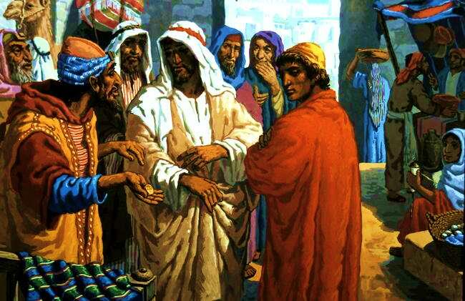
Mark 12:13-17 . . the Pharisees . . came to him and said, “Teacher, we know you are a man of integrity. You aren’t swayed by men, . . but you teach the way of God. . Is it right to pay taxes to Caesar or not? Should we pay or shouldn’t we?” But Jesus knew their hypocrisy. “Why are you trying to trap me?” he asked. “Bring me a penny . .” They brought the coin, and he asked, “Whose portrait is this? And whose inscription?” “Caesar’s,” they replied. Then Jesus said to them, “Give to Caesar what is Caesar’s and to God what is God’s.” And they were amazed at him.

Slide 6
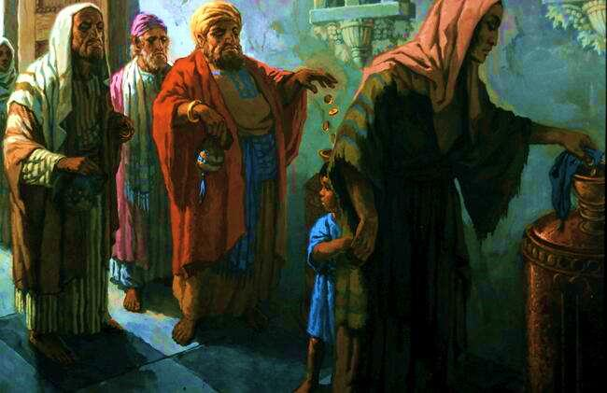
Mark 12:41-44 Jesus sat down opposite the place where the offerings were put and watched the crowd putting their money into the temple treasury. Many rich people threw in large amounts. But a poor widow came and put in two very small copper coins. Calling his disciples, Jesus said, “I tell you, this poor widow has put more into the treasury than all the others. They all gave out of their wealth; but she, out of her poverty, put in everything - all she had to live on.”

Slide 7
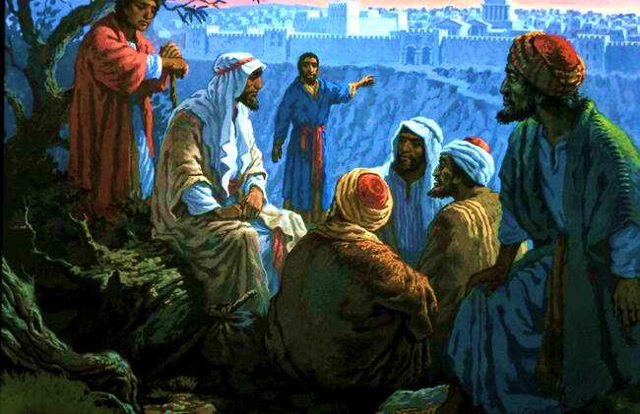
Mark 13:1-8 One of his disciples said to him, “Look at the temple. What magnificent buildings!” “Do you see all these great buildings?” replied Jesus. “Not one stone here will be left on another; all will be thrown down.” As Jesus was sitting on the Mount of Olives opposite the temple, Peter, James, John and Andrew asked him privately, “Tell us, when will these things happen? And what will be the sign of your coming?” Jesus said to them: “Watch out that no-one deceives you. . you hear of wars and rumours of wars, . . There will be earthquakes, famines and pestilences” (for His coming study “The Little Book” free download www.johanpeters.in )

Slide 8
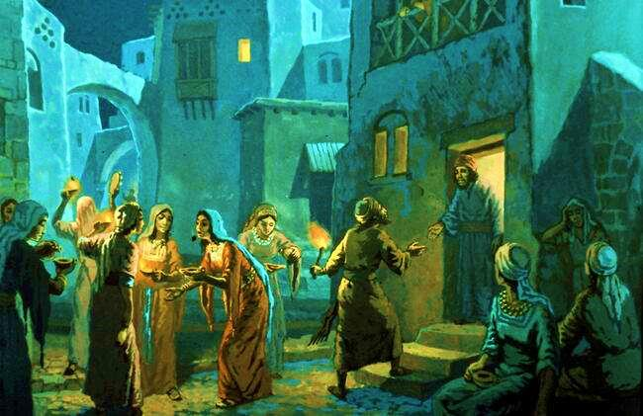
Mat. 25:1-12 “At that time the kingdom of heaven will be like ten virgins who took their lamps and went out to meet the bridegroom. Five of them were foolish and five were wise. The foolish ones took their lamps but did not take any oil with them. (They believe in Jesus, but don’t know the Word) The wise, however, took oil in jars along with their lamps. (These know God’s Word) The bridegroom was a long time in coming, and they all became drowsy and fell asleep. “At midnight the cry rang out: `Here’s the bridegroom! Come out to meet him!’ The foolish ones said to the wise, `Give us some of your oil; our lamps are going out.’ “`No,’ they replied, `. . , go to those who sell oil . .’ But while they went to buy the oil, the bridegroom arrived. The virgins who were ready went in with him to the wedding banquet. And the door was shut. “Later the others also came. `Sir! Sir!’ they said. `Open the door for us!’ “But he replied, `I don’t know you.’

Slide 9
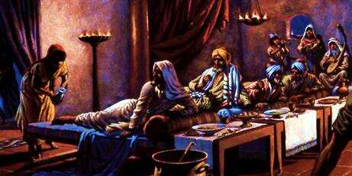
Mat. 26:2,6-16 “As you know, the Passover is two days away . .” While Jesus was in Bethany in the home of a man known as Simon the Leper, a woman came to him with an alabaster jar of very expensive perfume, which she poured on his head as he was reclining at the table. When the disciples saw this, they were indignant. “Why this waste?” they asked. “This perfume could have been sold at a high price and the money given to the poor.” The poor you will always have with you, but you will not always have me. When she poured this perfume on my body, she did it to prepare me for burial . .”
(This was the 3rd time: 1st a sinful woman at the house of Simon the Pharisee-Luke 7:36-39;
2nd was Mary, sister of Lazarus, six days before Passover, Judas alone grumbled-John 12:1-6;
3rd this lady, all grumble, see also Mark 14:1-11.- Judas loses it and goes to betray.)

Slide 10
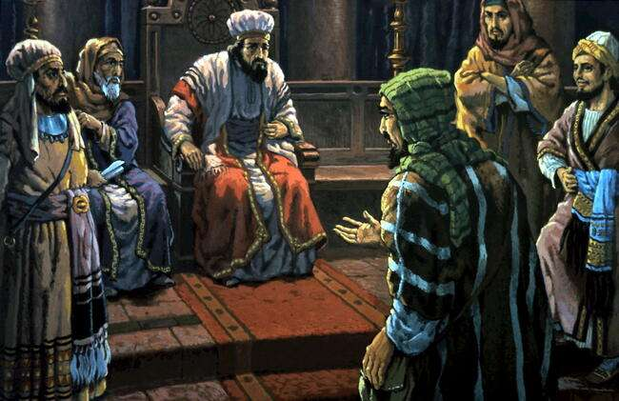
Mat.26:14-16 Then . . Judas Iscariot went to the chief priests and asked, “What are you willing to give me if I hand him over to you?” So they counted out for him thirty pieces of silver. (The price of a slave Exodus 21:32) From then on Judas watched for an opportunity to hand him over.

Slide 11
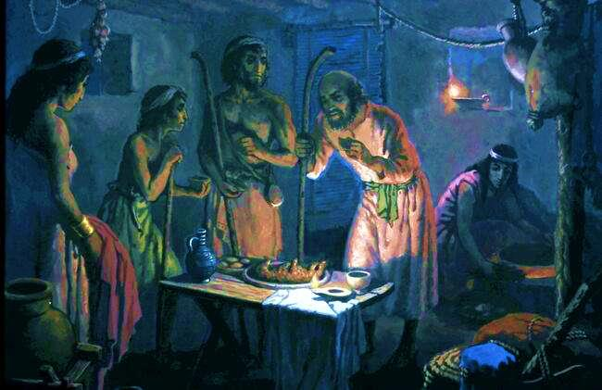
Exodus 12:8-11 PASSOVER: That night they are to eat the meat roasted over the fire, along with bitter herbs, and bread made without yeast. Don’t eat the meat raw or cooked in water, but roast it over fire - head, legs and inner parts. Do not leave any of it till morning; if some is left till morning, you must burn it. This is how you are to eat it: with your cloak tucked into your belt, your sandals on your feet and your staff in your hand. Eat it in haste; it is the LORD’s Passover.

Slide 12
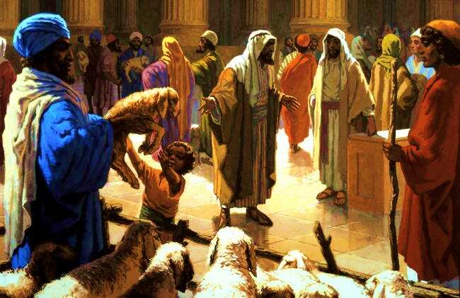
Mat. 26:17 On the first day of the Feast of Unleavened Bread, the disciples came to Jesus and asked, “Where do you want us to make preparations for you to eat the Passover?” He replied, “Go into the city to a certain man and tell him, `The Teacher says: My appointed time is near. I am going to celebrate the Passover with my disciples at your house.’“
(Here we see the disciples buying the Passover lamb)

Slide 13
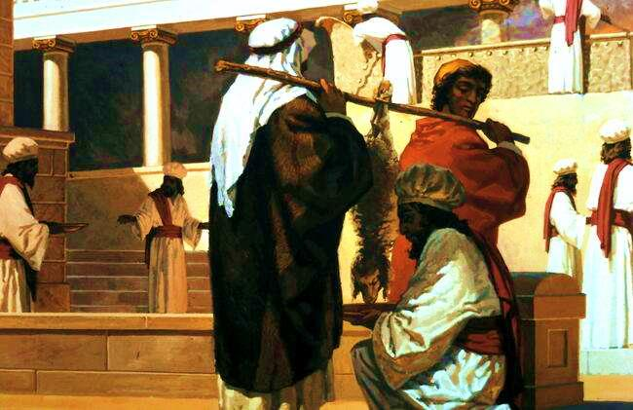
(After the blood is drained and poured out at the foot of the Altar the lamb is taken home to celebrate the Passover)

Slide 14
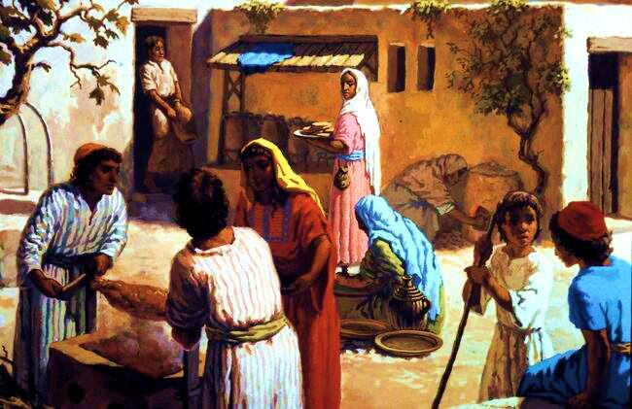
Luke 22:13 They left and found things just as Jesus had told them. So they prepared the Passover.

Slide 15
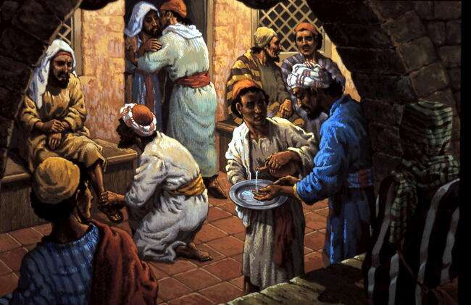
Mark 14:17 When evening came, Jesus arrived with the Twelve.

Slide 16
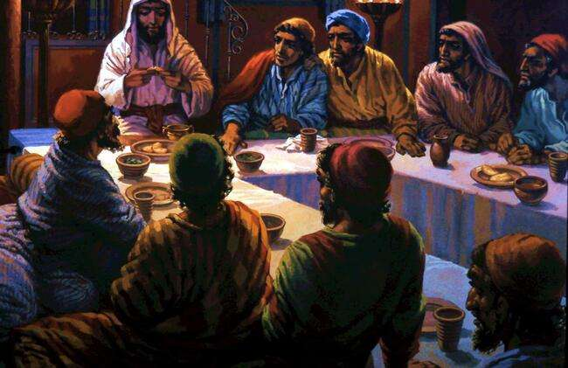
Luke 22:15,19 And he said to them, “I have eagerly desired to eat this Passover with you before I suffer. For I tell you, I will not eat it again until it finds fulfillment in the kingdom of God.”. . And he took bread, gave thanks and broke it, and gave it to them, saying, “This is my body given for you; do this in remembrance of me.”

Slide 17
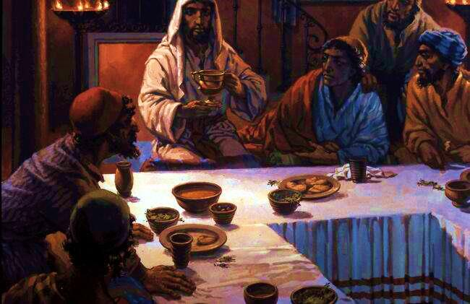
Mat. 26:27,28 Then he took the cup, gave thanks and offered it to them, saying, “Drink from it, all of you. This is my blood of the new covenant, which is poured out for many for the forgiveness of sins.” . . John 6:54-56 Whoever eats my flesh and drinks my blood has eternal life, and I will raise him up at the last day. . John 13:5 After that, he poured water into a basin and began to wash his disciples’ feet, drying them with the towel that was wrapped round him.

Slide 18
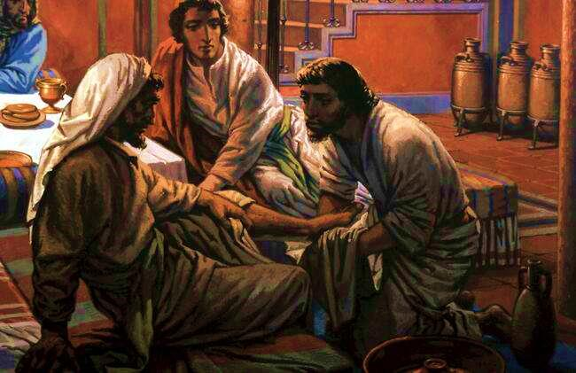
John 13:5-14 He came to Simon Peter, who said to him, “Lord, are you going to wash my feet?” Jesus replied, “You do not realise now what I am doing, but later you will understand.” . . When he had finished washing their feet, . “Do you understand what I have done for you?” he asked them. “You call me `Teacher’ and `Lord’, and rightly so, for that is what I am.” When he had finished washing their feet, he put on his clothes . . “Now that I, your Lord and Teacher, have washed your feet, you also should wash one another’s feet. I have set you an example. .”

Slide 19
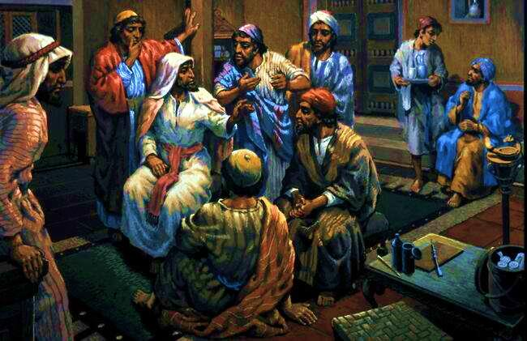
Luke 22:24-27 Also a dispute arose among them as to which of them was considered to be greatest. Jesus said to them, “The kings of the Gentiles lord it over them; . . But you are not to be like that. Instead, the greatest among you should be like the youngest, and the one who rules like the one who serves. For who is greater, the one who is at the table or the one who serves? Is it not the one who is at the table? But I am among you as one who serves.”

Slide 20
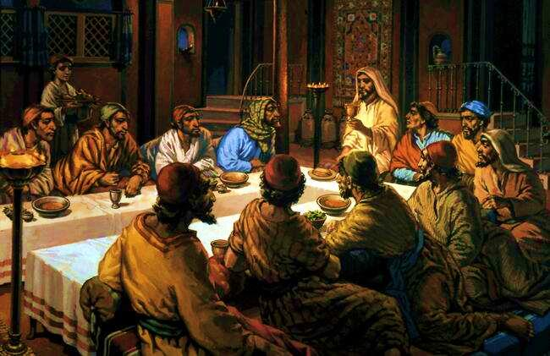
John 13:17-21 “Do you understand what I have done for you?” he asked them. “Now that you know these things, you will be happy if you do them.” “I am not referring to all of you; I know those I have chosen. But this is to fulfill the scripture: `He who shares my bread has lifted up his heel against me.’ [Psalm 41:9] After he had said this, Jesus was troubled in spirit and testified, “I tell you the truth, one of you is going to betray me.”

Slide 21
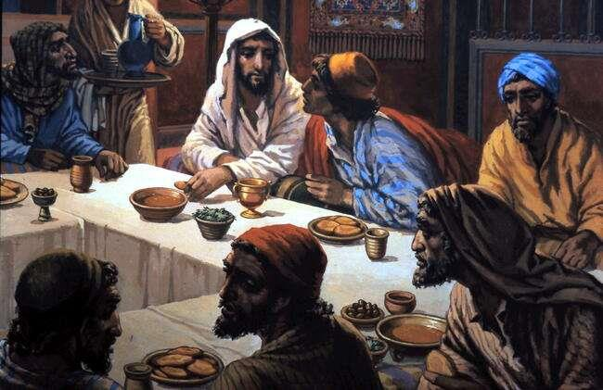
John 13:22-26 His disciples stared at one another, at a loss to know which of them he meant. One of them, the disciple whom Jesus loved, was reclining next to him. Simon Peter motioned to this disciple and said, “Ask him which one he means.” Leaning back against Jesus, he asked him, “Lord, who is it?” Jesus answered, “It is the one to whom I will give this piece of bread when I have dipped it in the dish.” Then. . he gave it to Judas Iscariot, .

Slide 22
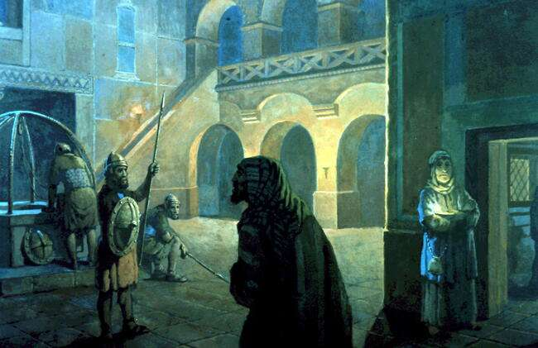
John 13:27-30 As soon as Judas took the bread, Satan entered into him. “What you are about to do, do quickly,” Jesus told him, but no-one at the meal understood why Jesus said this to him. Since Judas had charge of the money, some thought Jesus was telling him to buy what was needed for the Feast, or to give something to the poor. As soon as Judas had taken the bread, he went out. And it was night.

Slide 23
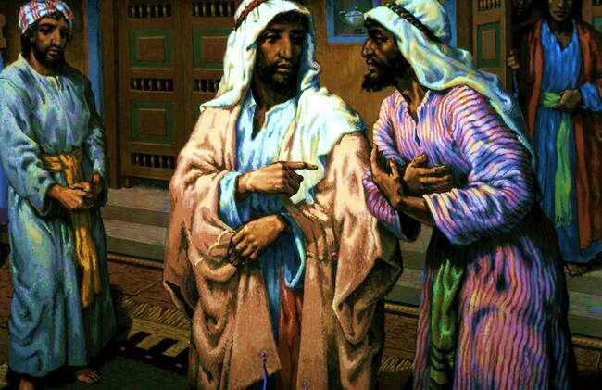
John 13:34-38 “A new command I give you: Love one another. As I have loved you, so you must love one another. By this all men will know that you are my disciples, if you love one another.” Simon Peter asked him, “Lord, where are you going?” Jesus replied, “Where I am going, you cannot follow now, but you will follow later.” Peter asked, “Lord, why can’t I follow you now? I will lay down my life for you.” Then Jesus answered, “Will you really lay down your life for me? I tell you the truth, before the cock crows, you will disown me three times!

Slide 24
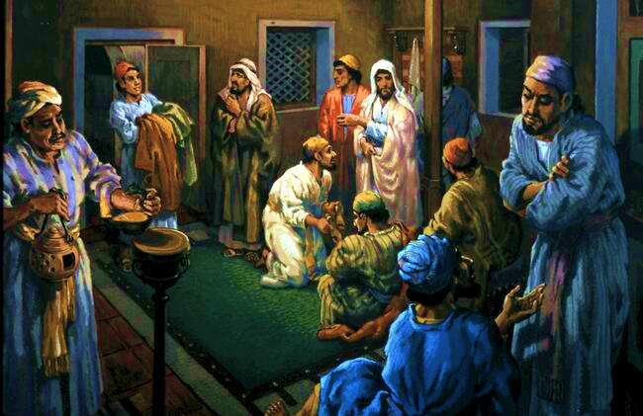
John 14:1-6,26 “Do not let your hearts be troubled. You trust in God trust also in me. In my Father’s house are many rooms; if it were not so, I would have told you. I am going there to prepare a place for you . . ” Thomas said to him, “Lord, we don’t know where you are going, so how can we know the way?” Jesus answered, “I am the way and the truth and the life. No one comes to the Father except through me . . But the Counsellor, the Holy Spirit, whom the Father will send in my name, will teach you all things and will remind you of all that I have said to you.

Slide 25
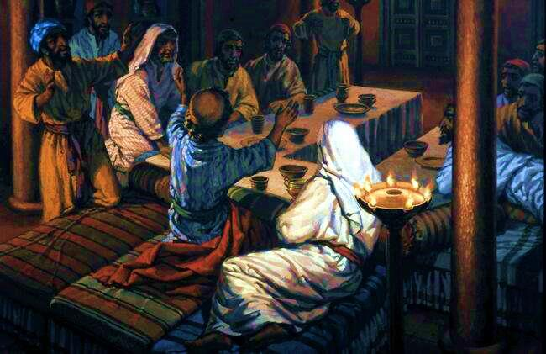
John 18:1 When he had finished praying, . Mark 14:26-28 When they had sung a hymn, they went out to the Mount of Olives. “You will all fall away,” Jesus told them, “for it is written: “`I will strike the shepherd, and the sheep will be scattered.’ [Zech. 13:7] But after I have risen, I will go ahead of you into Galilee.”

Slide 26
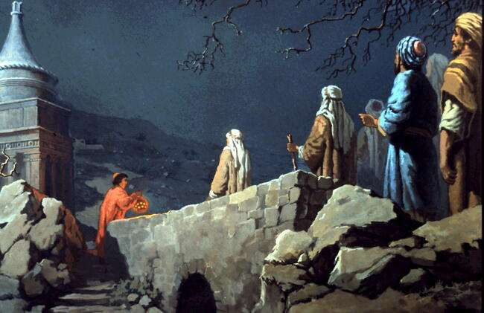
John 18:1,2 Jesus left with his disciples and crossed the Kidron Valley. On the other side there was an olive grove, and he and his disciples went into it. Now Judas, who betrayed him, knew the place, because Jesus had often met there with his disciples.

