Slide 1
The life of Jesus - Part 15 of 18
English - 24 Slides
Gethsemane, Judas’ kiss, Malchus’ ear, Arrest, Caiaphas, Peter’s Denial, Sanhedrin, Death Sentence
© 2013 Stichting Docete NL
www.docete.nl // info@docete.nl
Edited by Johan Peters
www.johanpeters.in
(Comments are in brackets)
Bible scriptures: New International Version

Slide 2
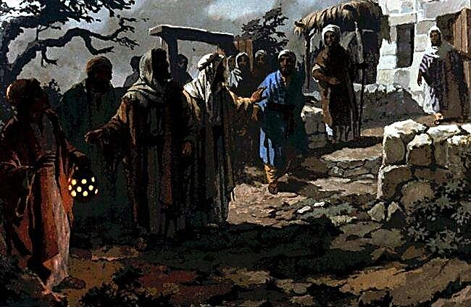
Luke 22:39 Jesus went out as usual to the Mount of Olives, and his disciples followed him.
Mat. 26:36 Then Jesus went with his disciples to a place called Gethsemane, and he said to them, “Sit here while I go over there and pray.” John 18:2 Now Judas, who betrayed him, knew the place, because Jesus had often met there with his disciples.

Slide 3
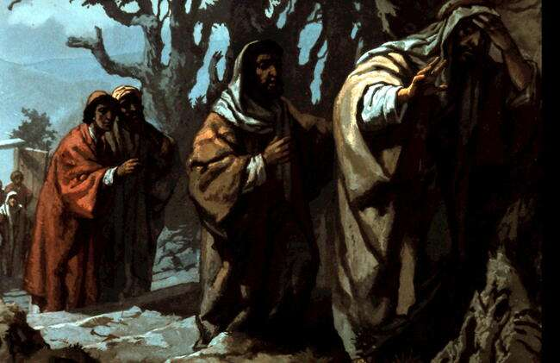
Mat. 26:37,38 He took Peter and the two sons of Zebedee along with him, and he began to be sorrowful and troubled. Then he said to them, “My soul is overwhelmed with sorrow to the point of death. Stay here and keep watch with me.”

Slide 4
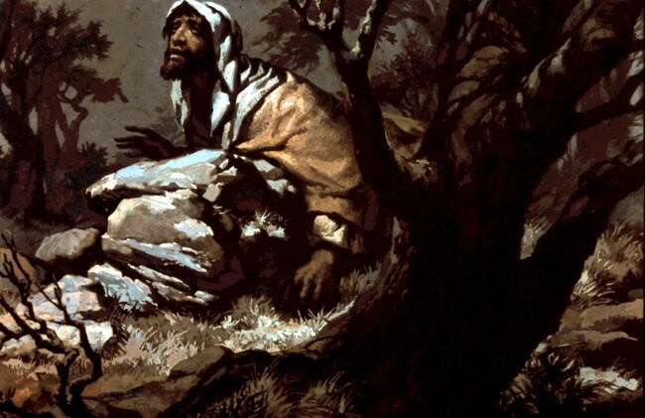
Mat. 26:39 Going a little farther, he fell with his face to the ground and prayed, “My Father, if it is possible, may this cup be taken from me. Yet not as I will, but as you will.”

Slide 5
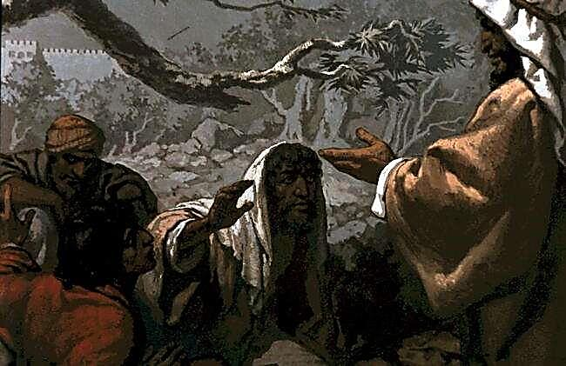
Mat. 26:40,41 Then he returned to his disciples and found them sleeping. “Could you men not keep watch with me for one hour?” he asked Peter. “Watch and pray so that you will not fall into temptation. The spirit is willing, but the body is weak.”

Slide 6
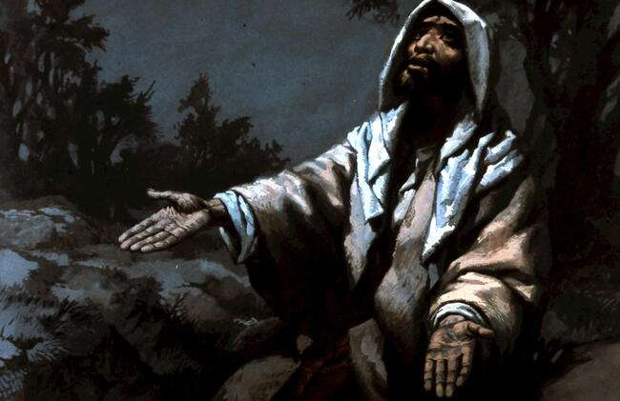
Mat. 26:42-44 He went away a second time and prayed, “My Father, if it is not possible for this cup to be taken away unless I drink it, may your will be done.” An angel from heaven appeared to him and strengthened him. And being in anguish, he prayed more earnestly, and his sweat was like drops of blood falling to the ground.

Slide 7
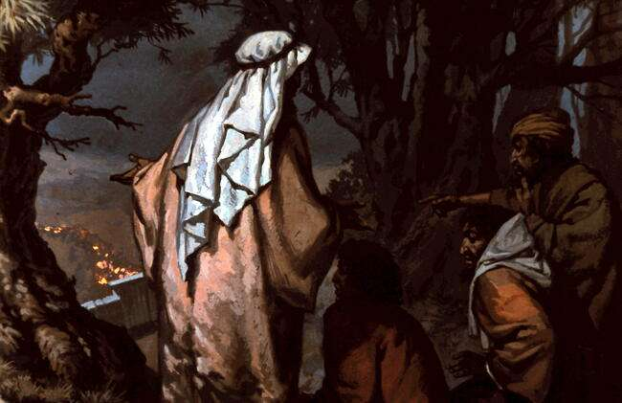
Mat. 26:45,46 Then he returned to the disciples and said to them, “Are you still sleeping and resting? Look, the hour is near, and the Son of Man is betrayed into the hands of sinners. Rise, let us go! Here comes my betrayer!”

Slide 8
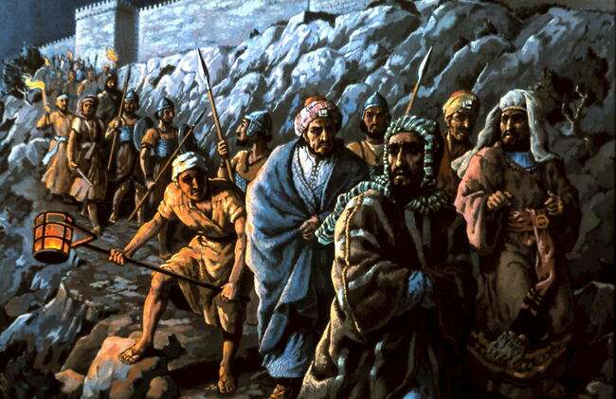
John 18:3 So Judas came to the grove, guiding a detachment of soldiers and some officials from the chief priests and Pharisees. They were carrying torches, lanterns and weapons.

Slide 9
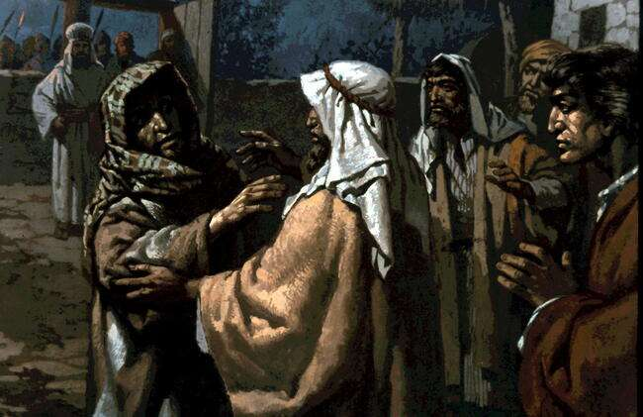
Mat. 26:48,49 Now the betrayer had arranged a signal with them: “The one I kiss is the man; arrest him.” Going at once to Jesus, Judas said, “Greetings, Rabbi!” and kissed him.
John 18:4-8 Jesus, knowing all that was going to happen to him, went out and asked them, “Who is it you want?” “Jesus of Nazareth,” they replied. “I am he,” Jesus said. When Jesus said, “I am he,” they drew back and fell to the ground. Again he asked them, “Who is it you want?” And they said, “Jesus of Nazareth.” “I told you that I am he,” Jesus answered. “If you are looking for me, then let these men go.”

Slide 10
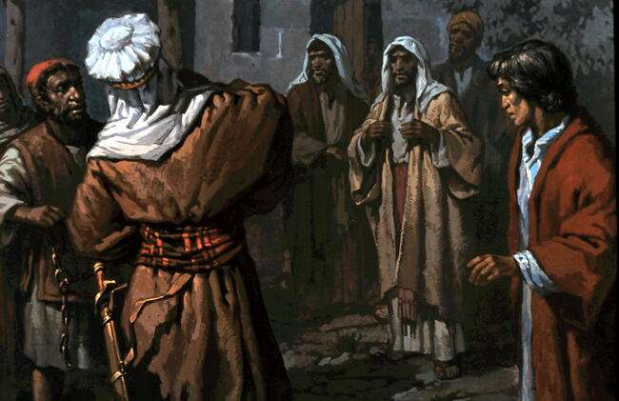
Luke 22:52,53 Then Jesus said to the chief priests, the officers of the temple guard, and the elders, who had come for him, “Am I leading a rebellion, that you have come with swords and clubs? Every day I was with you in the temple courts, and you did not lay a hand on me. But this is your hour - when darkness reigns.”

Slide 11
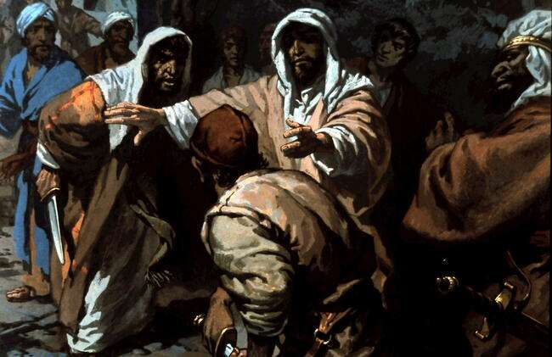
Luke 22:49,50 When Jesus’ followers saw what was going to happen, they said, “Lord, should we strike with our swords?” And one of them struck the servant of the high priest, cutting off his right ear. But Jesus answered, “No more of this!” And he touched the man’s ear and healed him. John 18:10,11 (The servant’s name was Malchus.) Jesus commanded Peter, “Put your sword away! Shall I not drink the cup the Father has given me?” Mat. 26:52,53 “Put your sword back in its place,” Jesus said to him, “for all who draw the sword will die by the sword. Do you think I cannot call on my Father, and he will at once send more than twelve legions of angels?

Slide 12
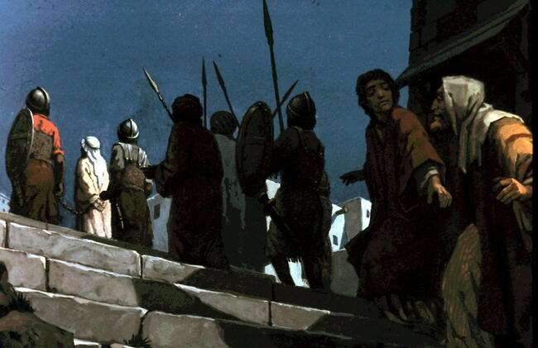
Mark 14:49-52 Every day I was with you, teaching in the temple courts, and you did not arrest me. But the Scriptures must be fulfilled.” Then everyone deserted him and fled. A young man, wearing nothing but a linen garment, was following Jesus. When they seized him, he fled naked, leaving his garment behind. John 18:12 Then the detachment of soldiers with its commander and the Jewish officials arrested Jesus.

Slide 13
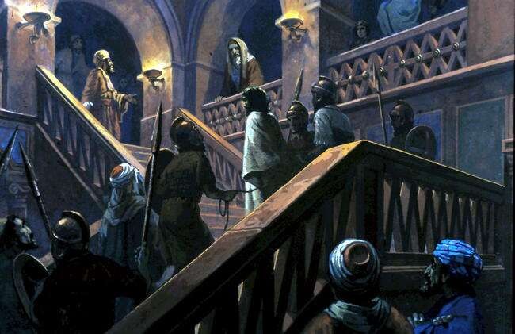
John 18:12-14 . . They bound him and brought him first to Annas, who was the father-in-law of Caiaphas, the high priest that year. Caiaphas was the one who had advised the Jews that it would be good if one man died for the people.

Slide 14
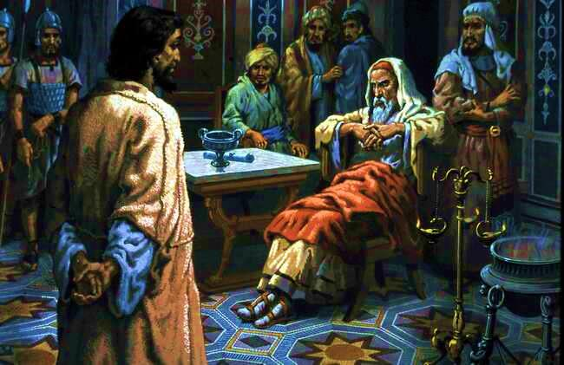
Jn. 18:19-23 the high priest questioned Jesus about his disciples and his teaching. “I have spoken openly to the world,” Jesus replied. “I always taught in synagogues or at the temple, where all the Jews come together. I said nothing in secret. Why question me? Ask those who heard me. Surely they know what I said.” When Jesus said this, one of the officials near by struck him in the face. “Is this the way you answer the high priest?” he demanded. “If I said wrong,” Jesus replied, “testify to what is wrong. But if I spoke the truth, why did you strike me?”

Slide 15
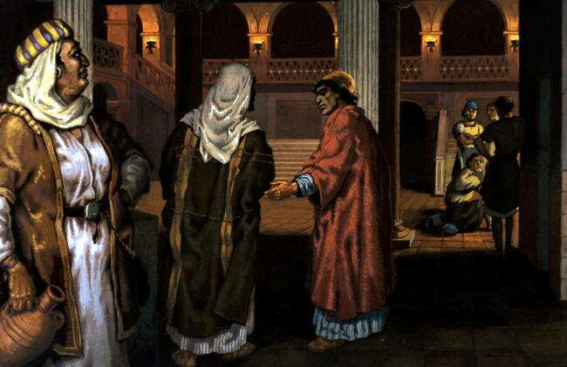
John 18:15,16 Simon Peter and another disciple were following Jesus. Because this disciple was known to the high priest, he went with Jesus into the high priest’s courtyard, but Peter had to wait outside at the door. The other disciple, who was known to the high priest, came back, spoke to the girl on duty there and brought Peter in.

Slide 16
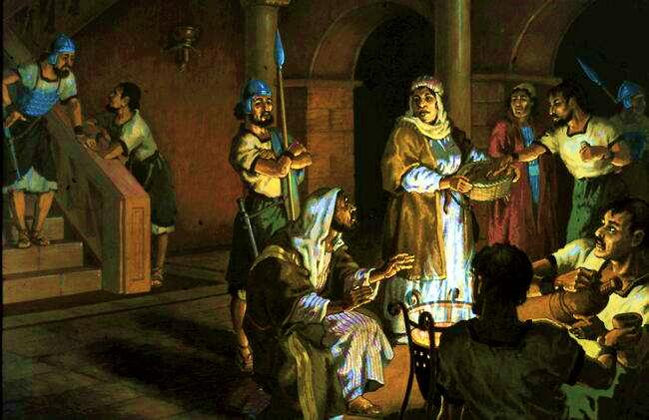
John 18:17,18 “You are not one of his disciples, are you?” the girl at the door asked Peter. He replied, “I am not.” It was cold, and the servants and officials stood round a fire they had made to keep warm. Peter also was standing with them, warming himself.

Slide 17
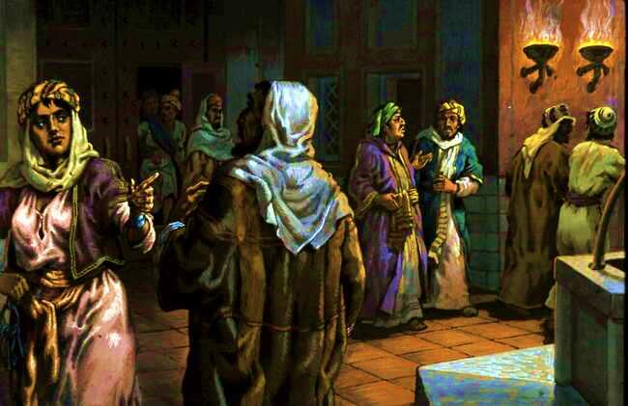
Mat. 26:71,72 Then he (Peter) went out to the gateway, where another girl saw him and said to the people there, “This fellow was with Jesus of Nazareth.” He denied it again, with an oath: “I don’t know the man!”

Slide 18
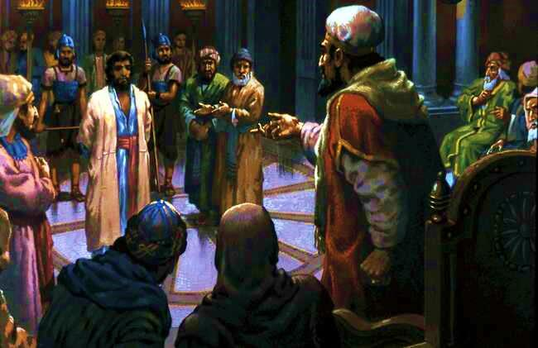
Mat. 26:60-62 . . many false witnesses come forward. Finally two came forward and declared, “This fellow said, `I am able to destroy the temple of God and rebuild it in three days.’“ Then the high priest stood up and said to Jesus, “Are you not going to answer? What is this testimony that these men are bringing against you?”

Slide 19
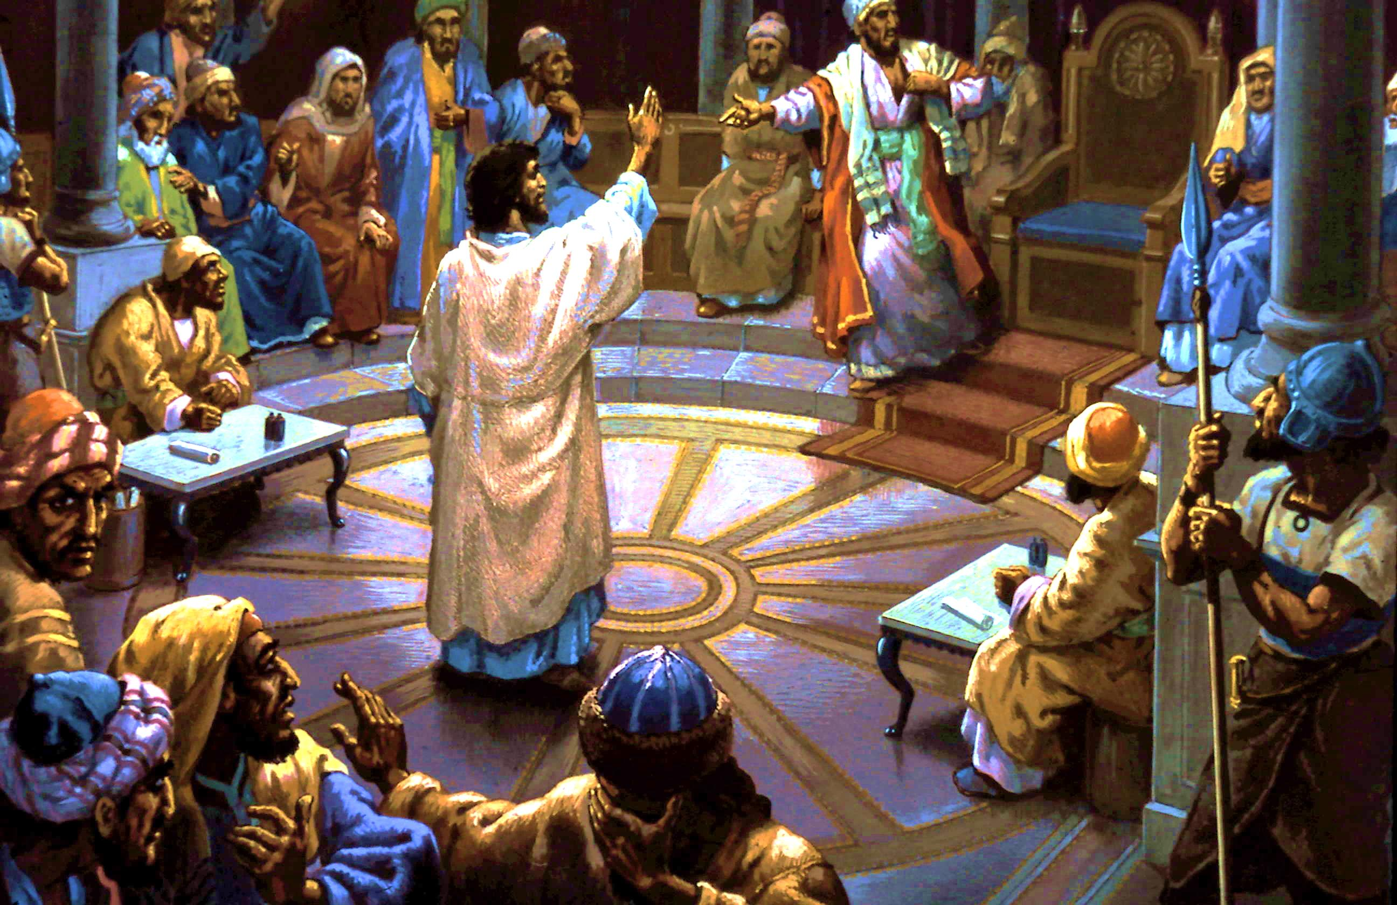
Mat. 26:63-68 But Jesus remained silent. The high priest said to him, “I charge you under oath by the living God: Tell us if you are the Christ, the Son of God.” “Yes, it is as you say,” Jesus replied. “But I say to all of you: In the future you will see the Son of Man sitting at the right hand of the Mighty One and coming on the clouds of heaven.” Then the high priest tore his clothes and said, “He has spoken blasphemy! Why do we need any more witnesses? Look, now you have heard the blasphemy. What do you think?” “He is worthy of death,” they answered. Then they spat in his face and struck him with their fists. . , “Prophesy to us, Christ. Who hit you?”

Slide 20
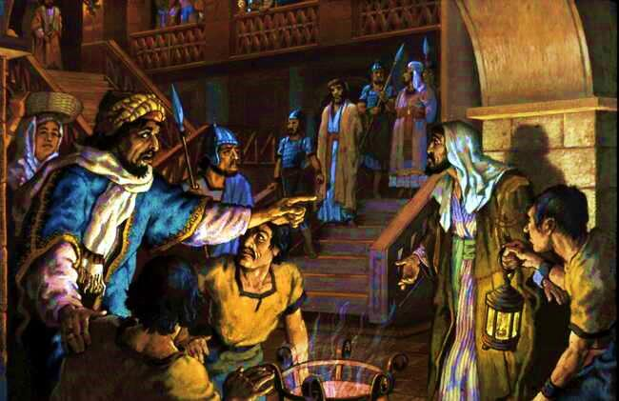
Luke 22:59-61 About an hour later another asserted, “Certainly this fellow was with him, for he is a Galilean.” Peter replied, “Man, I don’t know what you’re talking about!” Just as he was speaking, the cock crowed. The Lord turned and looked straight at Peter.

Slide 21
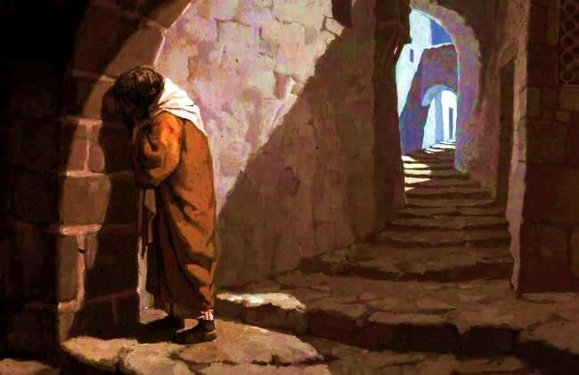
Mat. 26:75 Then Peter remembered the word the Lord had spoken to him: “Before the cock crows today, you will disown me three times.” And he went outside and wept bitterly.

Slide 22
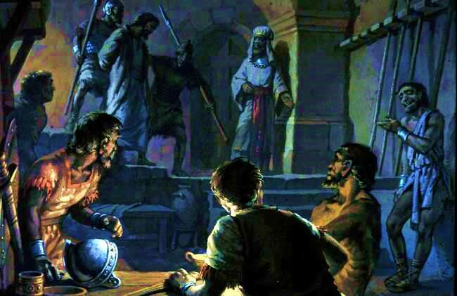
Mark 14:65 Then some began to spit at him; they blindfolded him, struck him with their fists, and said, “Prophesy!” And the guards took him and beat him.

Slide 23
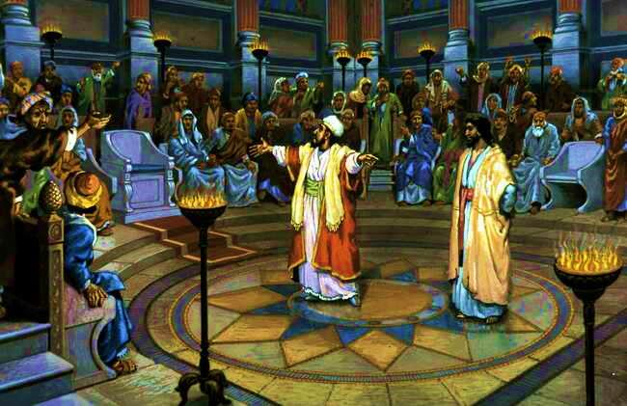
Luke 22:66-71 At daybreak the council of the elders of the people, both the chief priests and teachers of the law, met together, and Jesus was led before them. “If you are the Christ,” they said, “tell us.” Jesus answered, “If I tell you, you will not believe me, and if I asked you, you would not answer. But from now on, the Son of Man will be seated at the right hand of the mighty God.” They all asked, “Are you then the Son of God?” He replied, “You are right in saying I am.” Then they said, “Why do we need any more testimony? We have heard it from his own lips.” Mat. 27:1 . . the chief priests and the elders . . came to the decision to put Jesus to death.

Slide 24
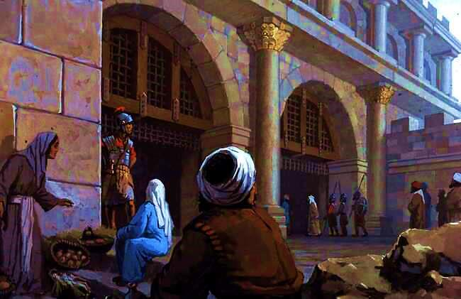
Mark 15:1 Very early in the morning, the chief priests, with the elders, the teachers of the law and the whole Sanhedrin, reached a decision. They bound Jesus, led him away and turned him over to Pilate.

Slide 25
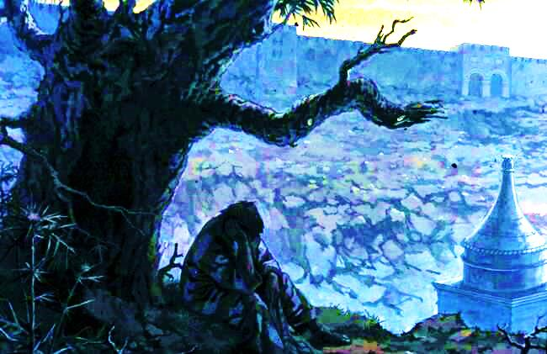
Mt. 27:3-10 When Judas, who had betrayed him, saw that Jesus was condemned, he was seized with remorse and returned the thirty silver coins to the chief priests and the elders. “I have sinned,” he said, “for I have betrayed innocent blood.” they replied. “That’s your responsibility.” So Judas threw the money into the temple and left. Then he went away and hanged himself.
So they decided to use the money to buy the potter’s field as a burial place for foreigners . . called the Field of Blood. Then was the prophecy fulfilled: “They took the thirty silver coins, the price set on him . . to buy the potter’s field . .” [See Zech. 11:12,13; Jer. 19:1-13; 32:6-9.]

