Slide 3
Slide 3

Slide 4
Slide 4

Slide 5
Slide 5

Slide 6
Slide 6

Slide 7
Slide 7

Slide 8
Slide 8

Slide 9
Slide 9

Slide 10
Slide 10

Slide 11
Slide 11

Slide 12
Slide 12

Slide 13
Slide 13

Slide 14
Slide 14
https://johanpeters.in

Slide 15
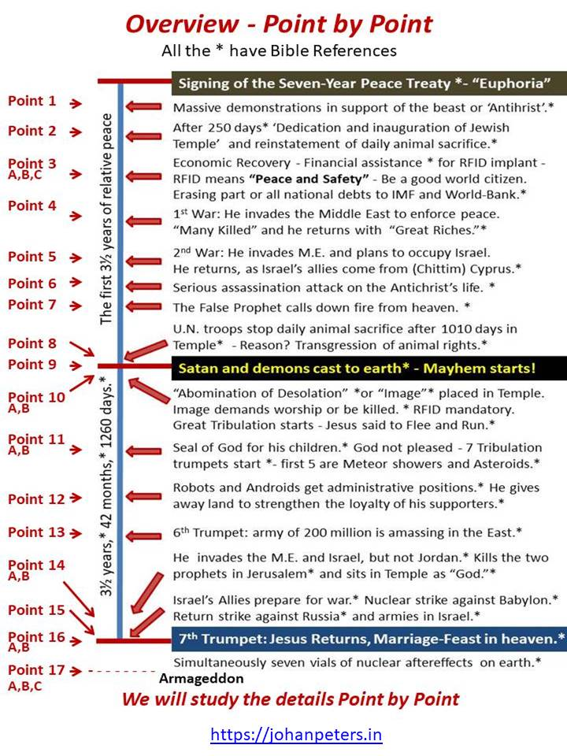
Slide 15

Slide 16
Slide 16

Slide 17
Slide 17

Slide 18
Slide 18

Slide 19
Slide 19
Slide 19
https://johanpeters.in

Slide 20
Slide 20
Slide 20
https://johanpeters.in

Slide 21
Slide 21

Slide 22
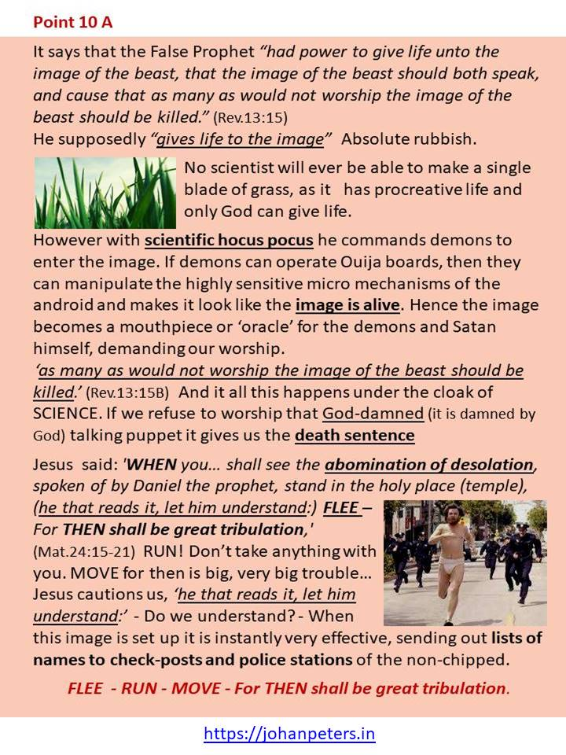
Slide 22

Slide 23
Slide 23

Slide 24
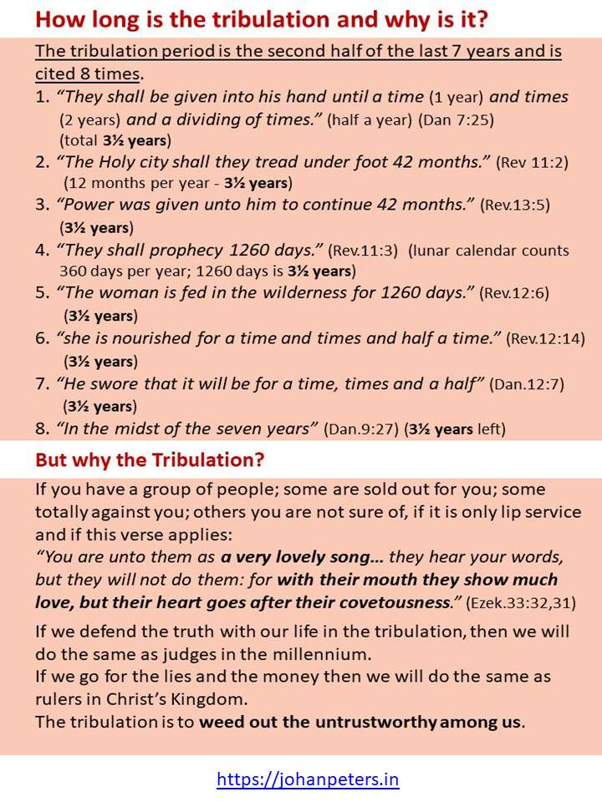
Slide 24

Slide 25
Slide 25

Slide 26
Slide 26

Slide 27
Slide 27

Slide 28
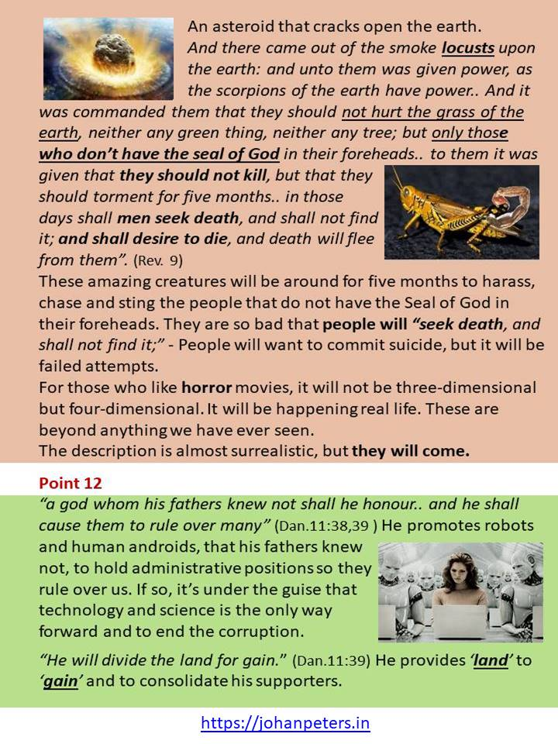
Slide 28

Slide 29
Slide 29

Slide 30
Slide 30

Slide 31
Slide 31

Slide 32
Slide 32

Slide 33
Slide 33

Slide 34
Slide 34

Slide 35
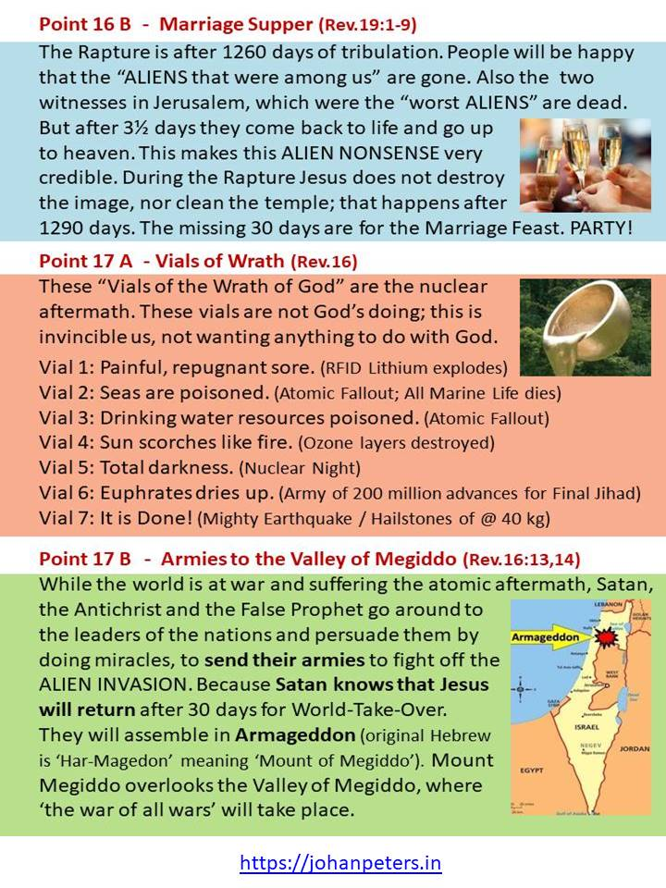
Slide 35

Slide 36
Slide 36

Slide 37
Slide 37

Slide 38
Slide 38

Slide 39
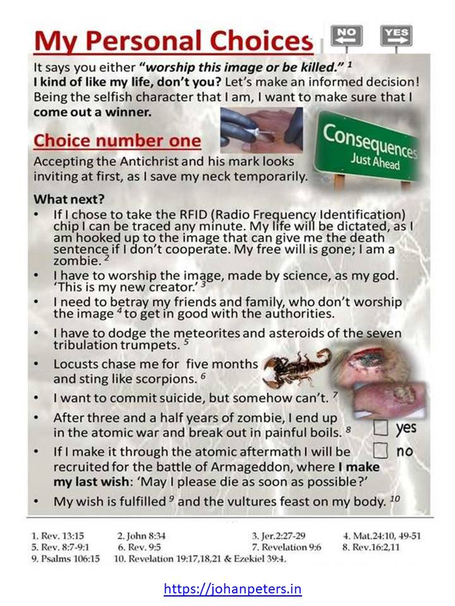
Slide 39

Slide 40
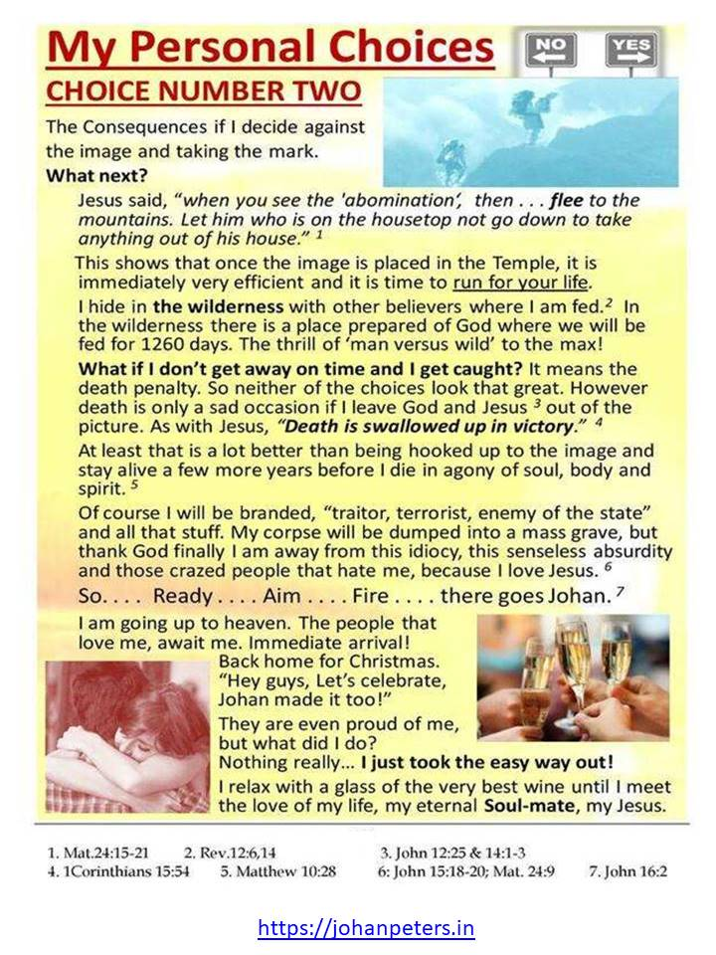
Slide 40

Slide 41
Slide 41

Slide 42
Slide 42

Slide 43
Slide 43

Slide 44
Slide 44

Slide 45
Slide 45

Slide 46
Slide 46

