Slide 1
The life of Jesus part 16
English
Before Pilate, Herod, Barnabas released, Scourging, Simon of Cyrene, Daughters of Jerusalem, Crucifixion, Centurion
© 2013 Stichting Docete NL
www.docete.nl // info@docete.nl
Edited by Johan Peters
www.johanpeters.in
(Comments are in brackets)
Bible scriptures: New International Version

Slide 2
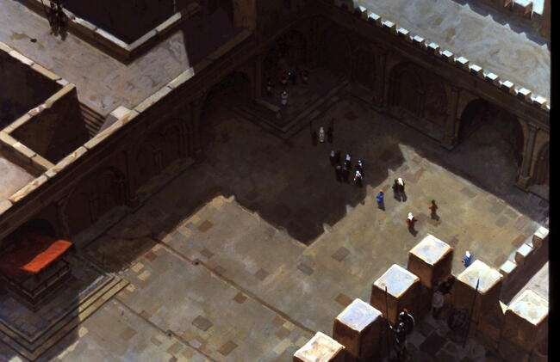
John 18:28 Then the Jews led Jesus from Caiaphas to the palace of the Roman governor. By now it was early morning, and to avoid ceremonial uncleanness the Jews did not enter the palace; they wanted to be able to eat the Passover.

Slide 3
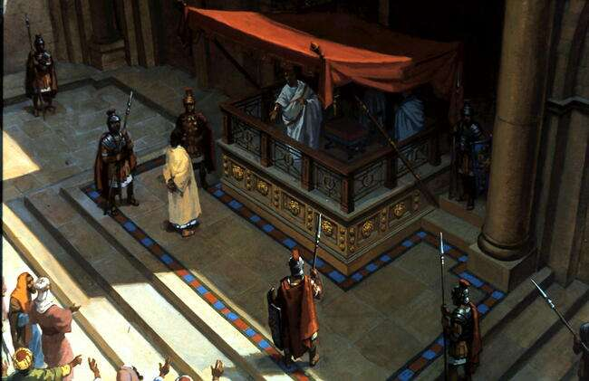
John 18:29 So Pilate came out to them and asked, “What charges are you bringing against this man?”

Slide 4
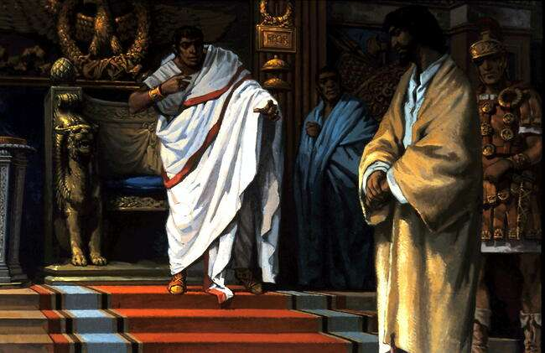
Mat. 27:11-14 Meanwhile Jesus stood before the governor, and the governor asked him, “Are you the king of the Jews?” “Yes, it is as you say,” Jesus replied. When he was accused by the chief priests and the elders, he gave no answer. Then Pilate asked him, “Don’t you hear the testimony they are bringing against you?” But Jesus made no reply, not even to a single charge - to the great amazement of the governor.

Slide 5
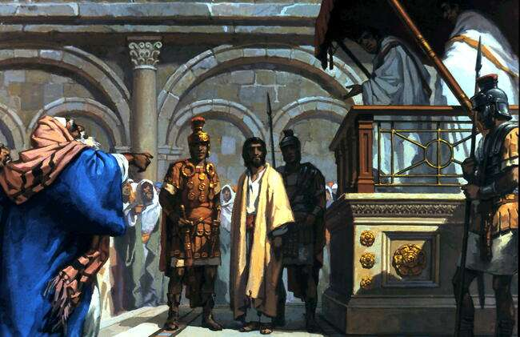
John 18:36-38 Jesus said, “My kingdom is not of this world. If it were, my servants would fight to prevent my arrest by the Jews. But now my kingdom is from another place.” “You are a king, then!” said Pilate. Jesus answered, “You are right in saying I am a king. In fact, for this reason I was born, and for this I came into the world, to testify to the truth. Everyone on the side of truth listens to me.” “What is truth?” Pilate asked. With this he went out again to the Jews and said, “I find no basis for a charge against him.

Slide 6
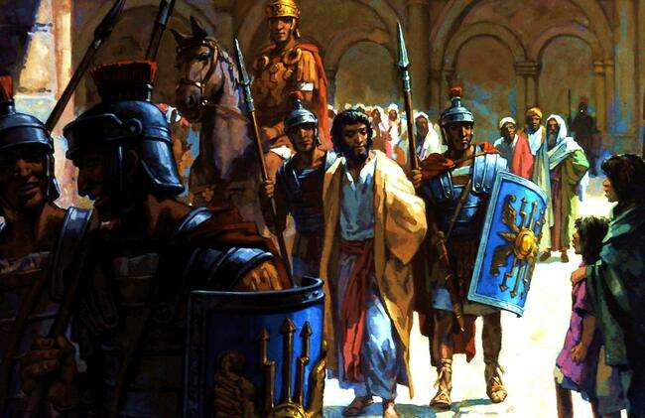
Luke 23:5-7 But they insisted, “He stirs up the people all over Judea by his teaching. He started in Galilee and has come all the way here.” On hearing this, Pilate asked if the man was a Galilean. When he learned that Jesus was under Herod’s jurisdiction, he sent him to Herod, who was also in Jerusalem at that time.

Slide 7
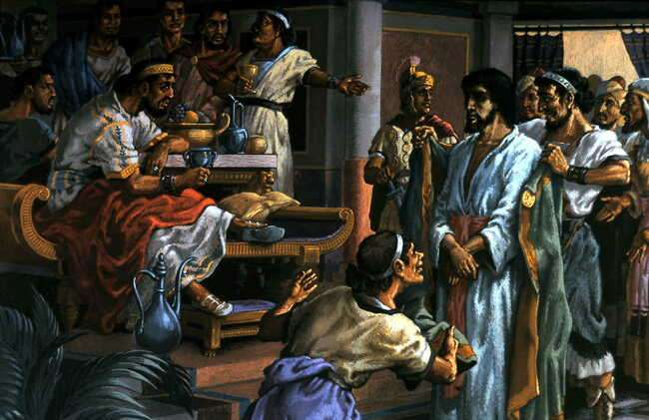
Luke 23:8-11 When Herod saw Jesus, he was greatly pleased, because for a long time he had been wanting to see him. From what he had heard about him, he hoped to see him perform some miracle. He plied him with many questions, but Jesus gave him no answer. The chief priests and the teachers of the law were standing there, vehemently accusing him. Then Herod and his soldiers ridiculed and mocked him. Dressing him in an elegant robe, they sent him back to Pilate.

Slide 8
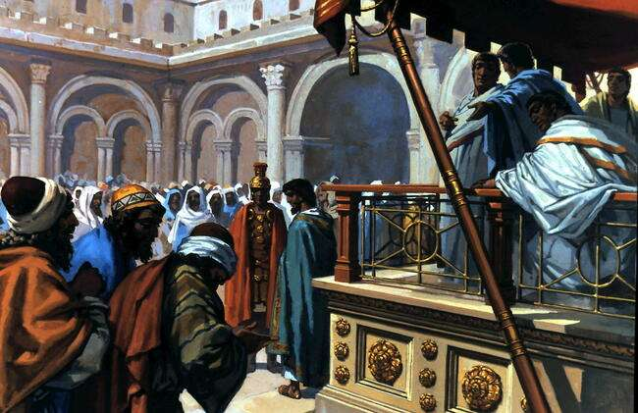
Luke 23:13-16 Pilate called together the chief priests, the rulers and the people, and said to them, “You brought me this man as one who was inciting the people to rebellion. I have examined him in your presence and have found no basis for your charges against him. Neither has Herod, for he sent him back to us; as you can see, he has done nothing to deserve death. Therefore, I will punish him and then release him.”

Slide 9
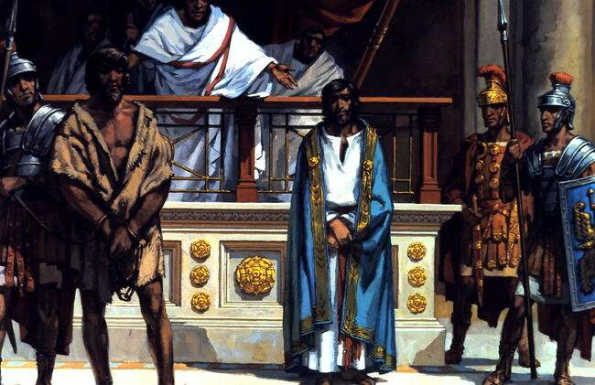
Luke 23:17-19 Now he was obliged to release one man to them at the Feast. With one voice they cried out, “Away with this man! Release Barabbas to us!” (Barabbas had been thrown into prison for an insurrection in the city, and for murder.)

Slide 10
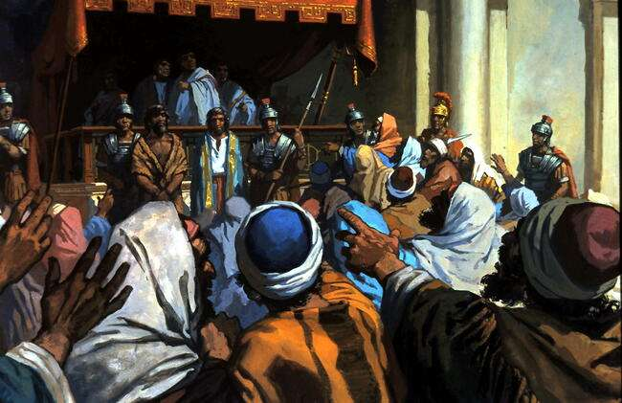
Mat. 27:19 While Pilate was sitting on the judge’s seat, his wife sent him this message: “Don’t have anything to do with that innocent man, for I have suffered a great deal today in a dream because of him.” Luke 23:20-21 Wanting to release Jesus, Pilate appealed to them again. But they kept shouting, “Crucify him! Crucify him!”

Slide 11
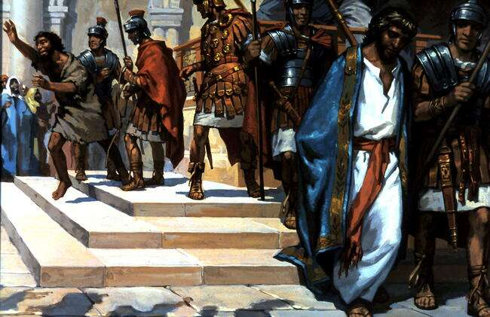
Mat. 27:26,27 Then he released Barabbas to them. But he had Jesus flogged,
Mark 15:16-19 The soldiers led Jesus away into the palace and called together the whole company of soldiers. They put a purple robe on him, then twisted together a crown of thorns and set it on him. And they began to call out to him, “Hail, king of the Jews!” Again and again they struck him on the head with a staff and spat on him. Falling on their knees, they paid homage to him.

Slide 12
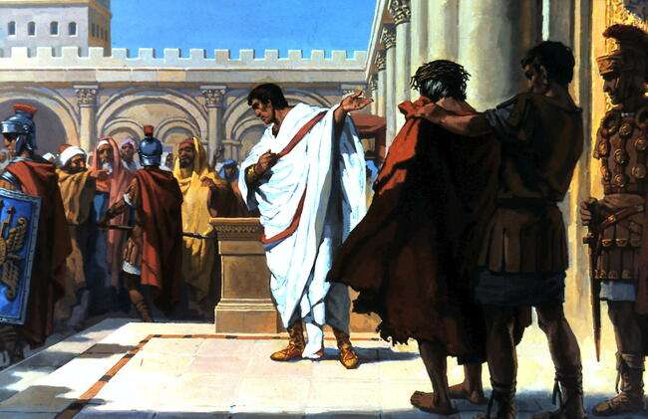
John 19:5-8 When Jesus came out wearing the crown of thorns and the purple robe, Pilate said to them, “Here is the man!” As soon as the chief priests and their officials saw him, they shouted, “Crucify! Crucify!” But Pilate answered, “You take him and crucify him. As for me, I find no basis for a charge against him.” The Jews insisted, “We have a law, and according to that law he must die, because he claimed to be the Son of God.”
When Pilate heard this, he was even more afraid,

Slide 13
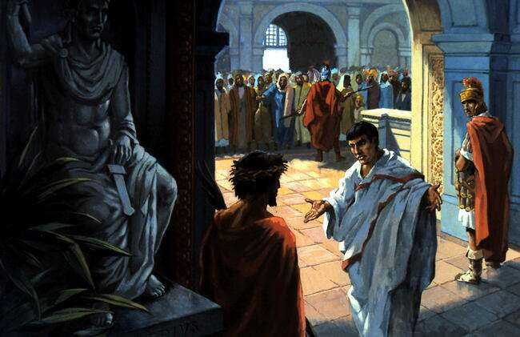
John 19:9-11 and he went back inside the palace. “Where do you come from?” he asked Jesus, but Jesus gave him no answer. “Do you refuse to speak to me?” Pilate said. “Don’t you realise I have power either to free you or to crucify you?” Jesus answered, “You would have no power over me if it were not given to you from above. Therefore the one who handed me over to you is guilty of a greater sin.”

Slide 14
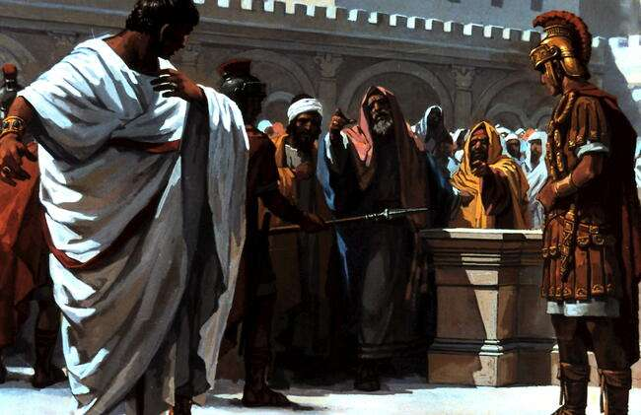
John 19:12-14 From then on, Pilate tried to set Jesus free, but the Jews kept shouting, “If you let this man go, you are no friend of Caesar. Anyone who claims to be a king opposes Caesar.” When Pilate heard this, he brought Jesus out and sat down on the judge’s seat at a place known as the Stone Pavement . It was the day of Preparation of Passover Week, about the sixth hour. “Here is your king,” Pilate said to the Jews.

Slide 15
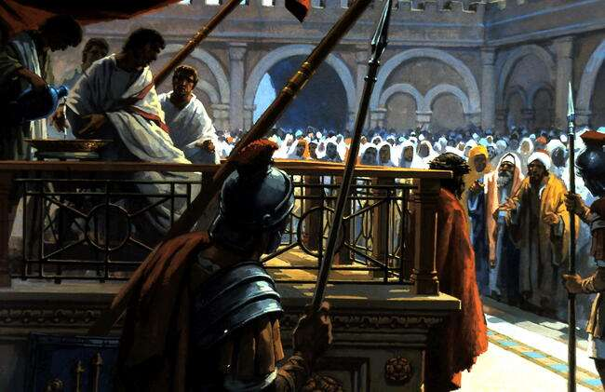
John 19:14,15 It was the day of Preparation of Passover Week, about the sixth hour. “Here is your king,” Pilate said to the Jews. But they shouted, “Take him away! Take him away! Crucify him!” “Shall I crucify your king?” Pilate asked. “We have no king but Caesar,” the chief priests answered. Mat. 27:24-25 When Pilate saw that he was getting nowhere, but that instead an uproar was starting, he took water and washed his hands in front of the crowd. “I am innocent of this man’s blood,” he said. “It is your responsibility!” All the people answered, “Let his blood be on us and on our children!”

Slide 16
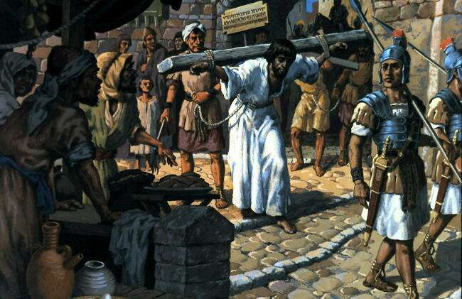
John 19:16,17 Finally Pilate handed him over to them to be crucified. So the soldiers took charge of Jesus. Carrying his own cross, he went out to the place of the Skull (which in Aramaic is called Golgotha).

Slide 17
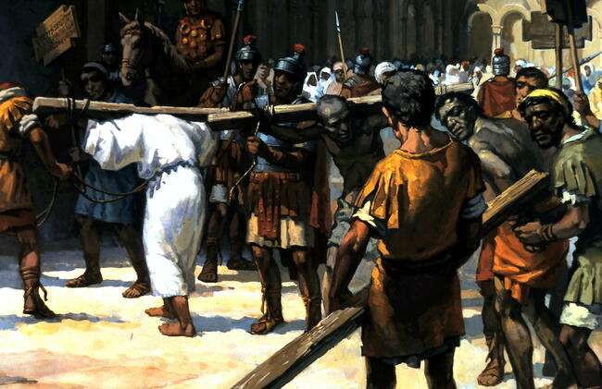
Isaiah 53:3-5 He was despised and rejected by men, a man of sorrows, and familiar with suffering. Like one from whom men hide their faces he was despised, . . Surely he hath borne our griefs, and carried our sorrows: yet we did esteem him stricken, smitten of God. But he was wounded for our transgressions, he was bruised for our iniquities: the chastisement of our peace was upon him; and with his stripes we are healed.

Slide 18
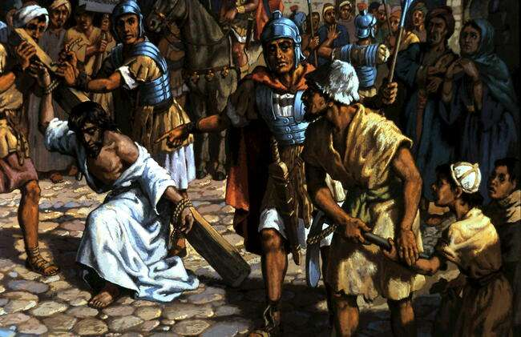
Luke 23:26,27 As they led him away, they seized Simon from Cyrene, who was on his way in from the country, and put the cross on him and made him carry it behind Jesus. A large number of people followed him, including women who mourned and wailed for him.

Slide 19
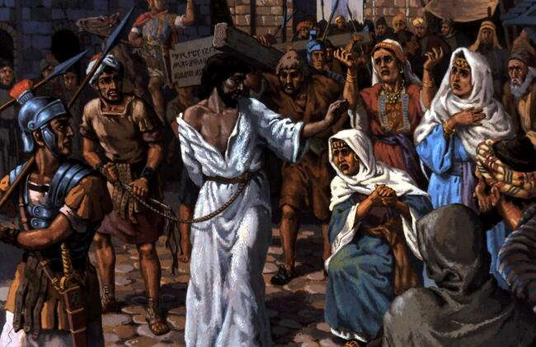
Luke 23:28-30 Jesus said to them, “Daughters of Jerusalem, weep not for me; weep for yourselves and for your children. For the time will come when you will say, `Blessed are the barren women, the wombs that never bore and the breasts that never nursed!’ Then “`they will say to the mountains, “Fall on us!” and to the hills “Cover us!”’ [Hosea 10:8]

Slide 20
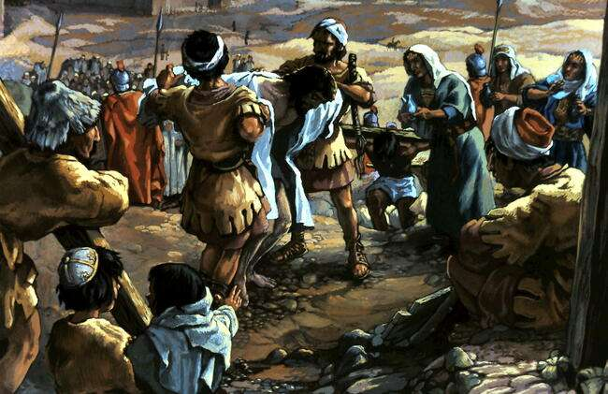
John 19:18 Here they crucified him, and with him two others - one on each side and Jesus in the middle. When the soldiers crucified Jesus, Luke 23:34 Jesus said, “Father, forgive them, for they do not know what they are doing.” And they divided up his clothes by casting lots. John 19:24 This happened that the scripture might be fulfilled which said, “They divided my garments among them and cast lots for my clothing.” [Psalm 22:18]

Slide 21
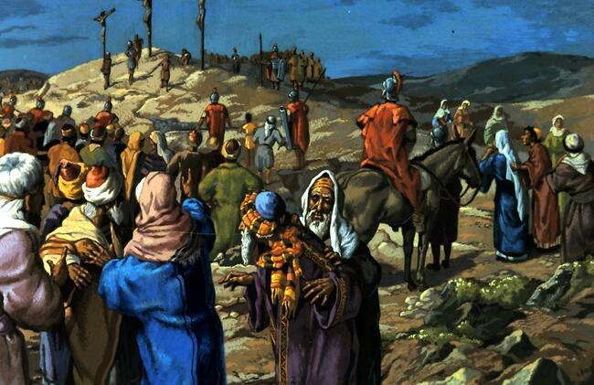
John 19:19 -22 Pilate had a notice prepared and fastened to the cross. It read: JESUS OF NAZARETH, THE KING OF THE JEWS. Many of the Jews read this sign, for the place where Jesus was crucified was near the city, and the sign was written in Aramaic, Latin and Greek. The chief priests of the Jews protested to Pilate, “Do not write `The King of the Jews’, but that this man claimed to be king of the Jews.” Pilate answered, “What I have written, I have written.”

Slide 22
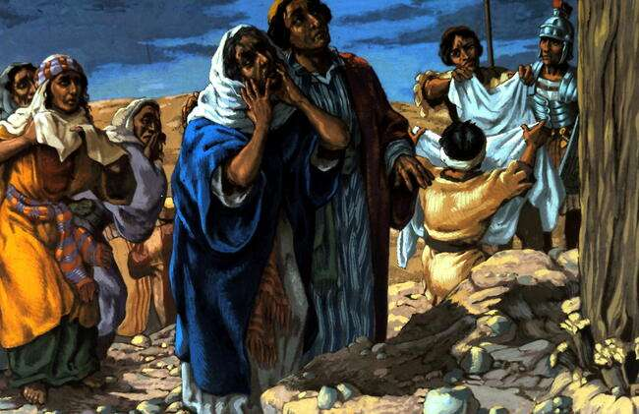
John 19:26,27 When Jesus saw his mother there, and the disciple whom he loved standing near by, he said to his mother, “Dear woman, here is your son,” and to the disciple, “Here is your mother.” From that time on, this disciple took her into his home. Luke 23:44,45 It was now about the sixth hour, and darkness came over the whole land until the ninth hour, for the sun stopped shining.

Slide 23
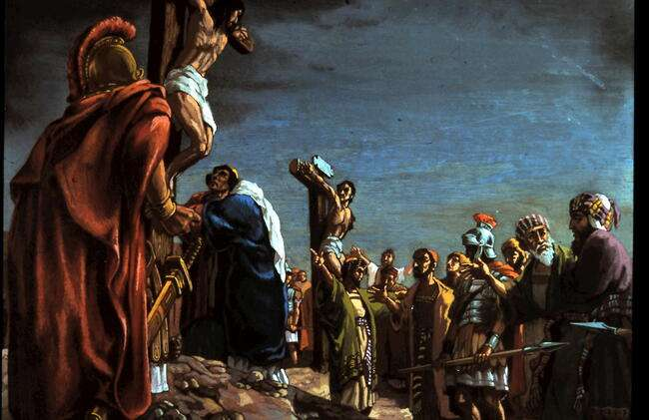
Luke 23:35-43 The people sneered at him, “He saved others; let him save himself if he is the Christ of God, the Chosen One.” One of the criminals . . hurled insults at him: “Aren’t you the Christ? Save yourself and us!” But the other criminal rebuked him. “Don’t you fear God,” . . We are punished justly, for we are getting what our deeds deserve. But this man has done nothing wrong.” Then he said, “Jesus, remember me when you come into your kingdom.” Jesus answered him, “. . today you will be with me in paradise.”

Slide 24
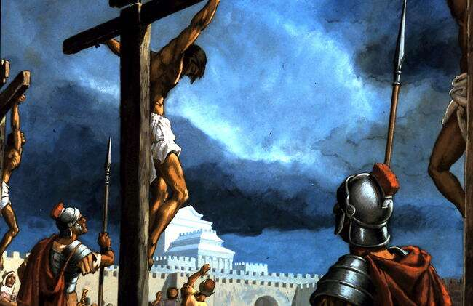
Mark 15:34 And at the ninth hour Jesus cried out in a loud voice, “Eloi, Eloi, lama sabachthani?” - which means, “My God, my God, why have you forsaken me?” [Psalm 22:1] Jn. 19:28-30 . . And so that the Scripture would be fulfilled, Jesus said, “I am thirsty.” A jar of wine vinegar was there, so they soaked a sponge in it, put the sponge on a stalk of the hyssop plant, and lifted it to Jesus’ lips. When he had received the drink, Jesus said, “It is finished.”

Slide 25
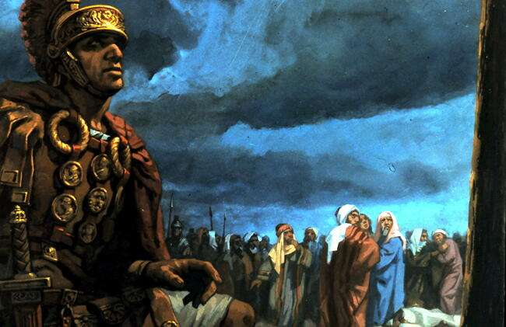
Luke 23:45-48 And the curtain of the temple was torn in two. Jesus called out with a loud voice, “Father, into your hands I commit my spirit.” When he had said this, he breathed his last. The centurion, seeing what had happened, praised God and said, “Surely this was a righteous man.” When all the people who had gathered to witness this sight saw what took place, they beat their breasts and went away.

