Slide 1
The life of Jesus part 17
English
Jesus’ burial, Grave sealed, Resurrection, Emmaus and other Appearances, Thomas
© 2013 Stichting Docete NL
www.docete.nl // info@docete.nl
Edited by Johan Peters
www.johanpeters.in
(Comments are in brackets)
Bible scriptures: New International Version

Slide 2
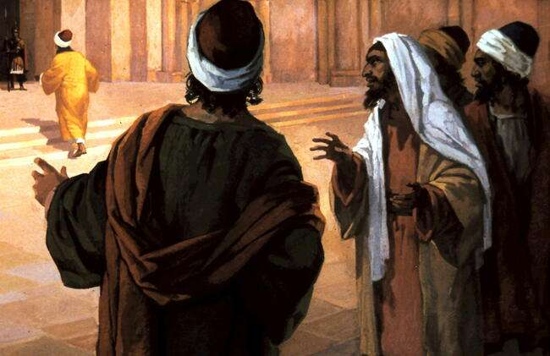
John 19:31-38 But when they came to Jesus and found that he was already dead, they did not break his legs. Instead, one of the soldiers pierced Jesus’ side with a spear, bringing a sudden flow of blood and water. . . These things happened so that the scripture would be fulfilled: “Not one of his bones will be broken,” [Exodus 12:46; Num. 9:12; Psalm 34:20]
Later, Joseph of Arimathea asked Pilate for the body of Jesus.

Slide 3
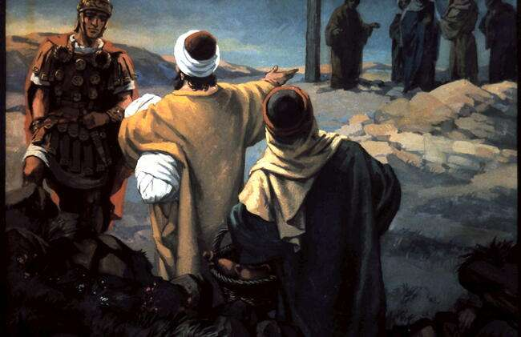
John 19:38,39. Now Joseph was a disciple of Jesus, but secretly because he feared the Jews. With Pilate’s permission, he came and took the body away. He was accompanied by Nicodemus, the man who earlier had visited Jesus at night. Nicodemus brought a mixture of myrrh and aloes, about seventy-five pounds.

Slide 4
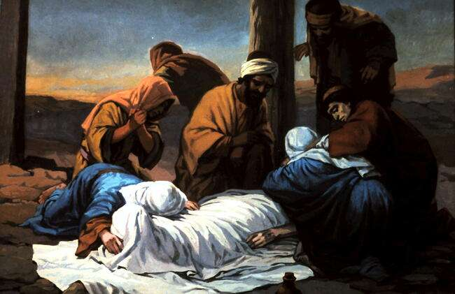
Jn. 19:40,41 Taking Jesus’ body, the two of them wrapped it, with the spices, in strips of linen. This was in accordance with Jewish burial customs.

Slide 5
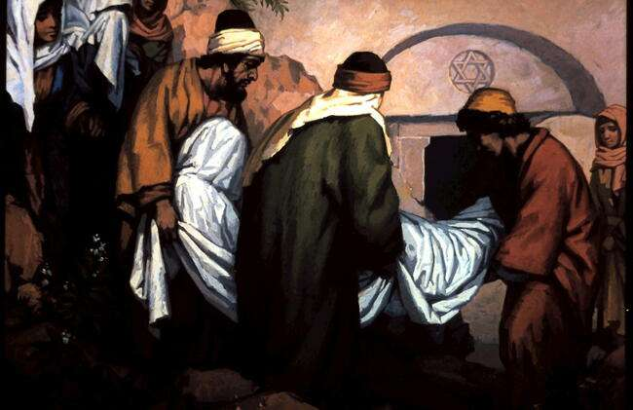
John 19:41 At the place where Jesus was crucified, there was a garden, and in the garden a new tomb, in which no-one had ever been laid.

Slide 6
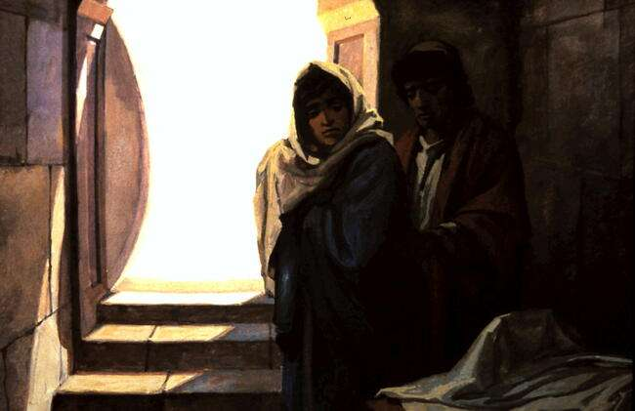
John 19:42 Because it was the Jewish day of Preparation and since the tomb was near by, they laid Jesus there.

Slide 7
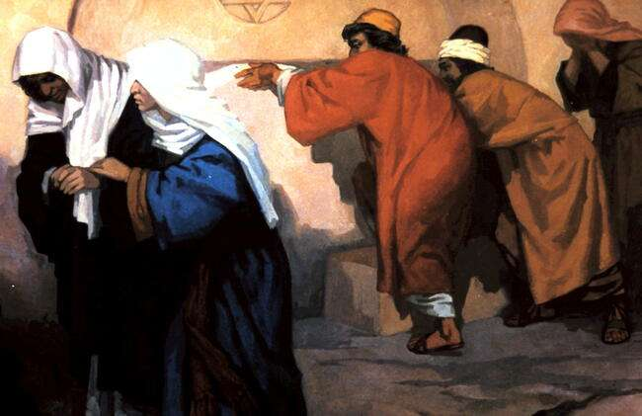
Mat. 27:59,60 Joseph took the body, wrapped it in a clean linen cloth, and placed it in his own new tomb that he had cut out of the rock. He rolled a big stone in front of the entrance to the tomb and went away.

Slide 8
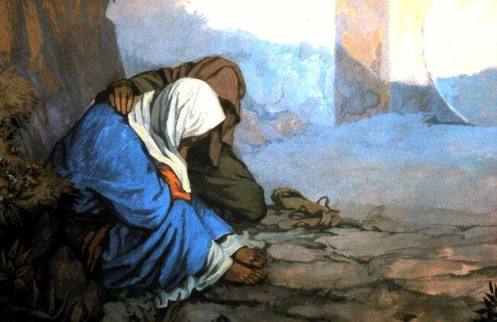
Mat. 27:61 Mary Magdalene and the other Mary were sitting there opposite the tomb.

Slide 9
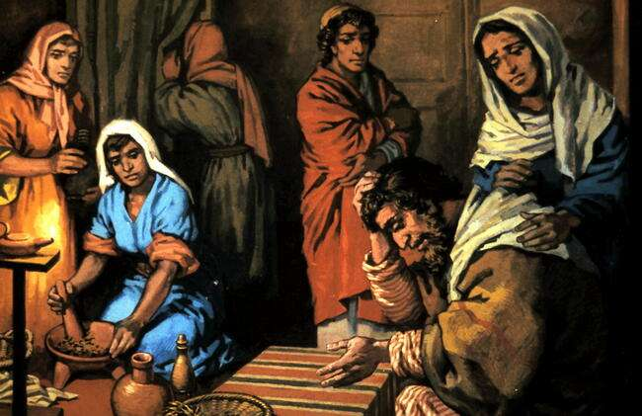
(While the disciples were despondent) Mat. 27:63-65 the chief priests and the Pharisees went to Pilate. “Sir,” they said, “we remember that while he was still alive that deceiver said, `After three days I will rise again.’ So give the order for the tomb to be made secure until the third day. Otherwise, his disciples may come and steal the body and tell the people that he has been raised from the dead. This last deception will be worse than the first.”

Slide 10
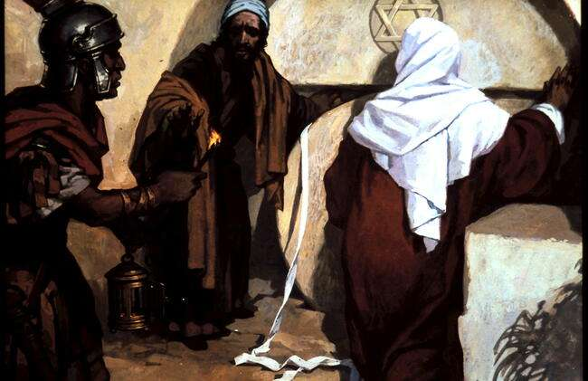
Mat. 27:65 “Take a guard,” Pilate answered. “Go, make the tomb as secure as you know how.”

Slide 11
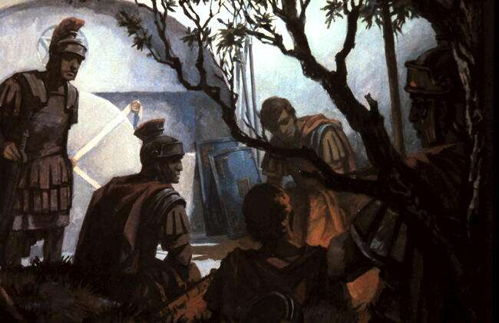
Mt. 27:66; 28:1-4 So they went and made the tomb secure by putting a seal on the stone and posting the guard. After the Sabbath, at dawn on the first day of the week, . . There was a violent earthquake, for an angel of the Lord came down from heaven and, going to the tomb, rolled back the stone and sat on it. His appearance was like lightning, and his clothes were white as snow. The guards were so afraid of him that they shook and became like dead men.

Slide 12
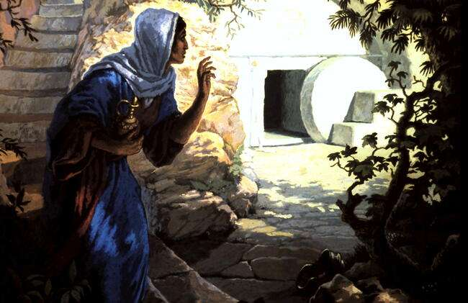
Mark 16:1,2 When the Sabbath was over, Mary Magdalene, Mary the mother of James, and Salome bought spices so that they might go to anoint Jesus’ body. Very early on the first day of the week, just after sunrise, they were on their way to the tomb . .

Slide 13
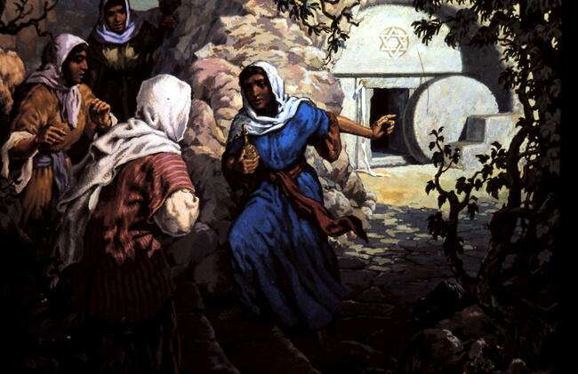
Mark 16:3,4 and they asked each other, “Who will roll the stone away from the entrance of the tomb?” But when they looked up, they saw that the stone, which was very large, had been rolled away.

Slide 14
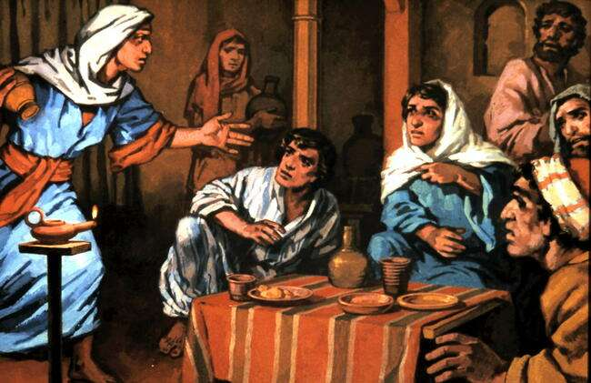
Luke 24:9-11 When they came back from the tomb, they told all these things to the Eleven and to all the others. It was Mary Magdalene, Joanna, Mary the mother of James, and the others with them who told this to the apostles. But they did not believe the women, because their words seemed to them like nonsense.

Slide 15
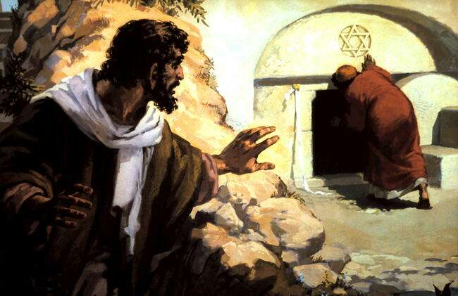
John 20:3-8 So Peter and the other disciple started for the tomb. Both were running, but the other disciple outran Peter and reached the tomb first. He bent over and looked in at the strips of linen lying there but did not go in. Then Simon Peter, who was behind him, arrived and went into the tomb. He saw the strips of linen lying there, as well as the burial cloth that had been around Jesus’ head. The cloth was folded up by itself, separate from the linen. Finally the other disciple, who had reached the tomb first, also went inside. He saw and believed.

Slide 16
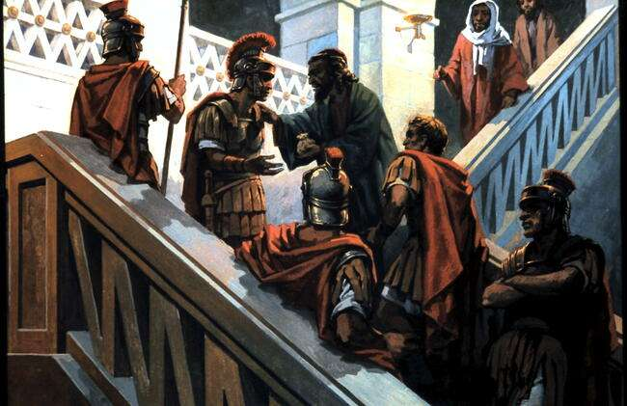
Mat. 28:11-15 While the women were on their way, some of the guards went into the city and reported to the chief priests everything that had happened. When the chief priests had met with the elders and devised a plan, they gave the soldiers a large sum of money, telling them, “You are to say, `His disciples came during the night and stole him away while we were asleep.’ If this report gets to the governor, we will satisfy him and keep you out of trouble.” So the soldiers took the money and did as they were instructed. And this story has been widely circulated

Slide 17
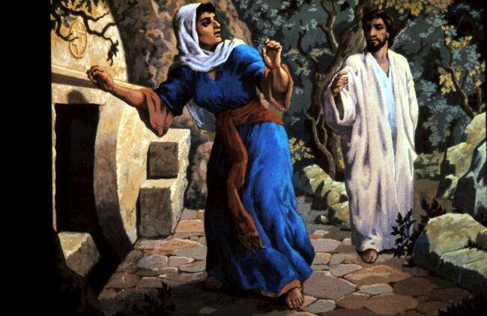
John 20:10-17 Then the disciples went back to their homes, but Mary stood outside the tomb crying. As she wept, she bent over to look into the tomb. . At this, she turned round and saw Jesus standing there, but she did not realise that it was Jesus. “Woman,” he said, “why are you crying? Who is it you are looking for?” Thinking he was the gardener, she said, “Sir, if you have carried him away, tell me where you have put him, and I will get him.” Jesus said to her, “Mary.” She turned towards him and cried out in Aramaic, “Rabboni!” (which means Teacher). Jesus said, “Do not hold on to me, for I have not yet returned to the Father. Go instead to my brothers and tell them, `I am returning to my Father and your Father, to my God and your God.’“

Slide 18
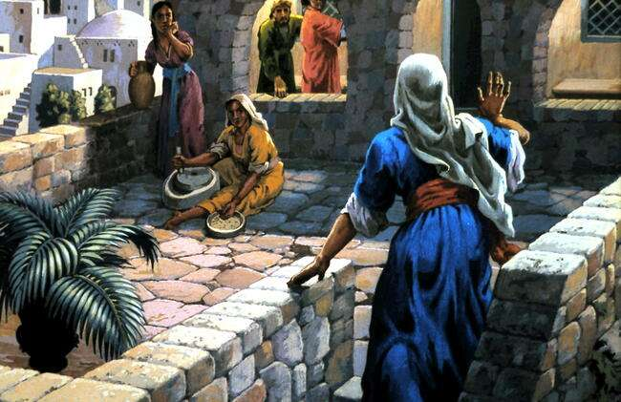
John 20:18 Mary Magdalene went to the disciples with the news: “I have seen the Lord!” And she told them that he had said these things to her.

Slide 19
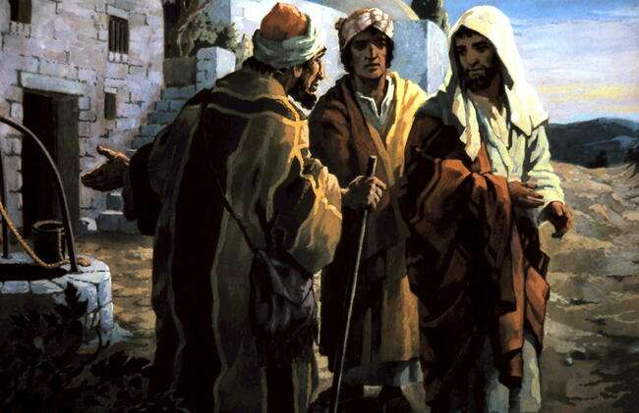
Luke 24:13-28 Now that same day two of them were going to a village called Emmaus, . . As they talked and discussed these things with each other, Jesus himself came up and walked along with them; but they were kept from recognising him. . . He said to them, “How foolish you are, and how slow of heart to believe all that the prophets have spoken! Did not the Christ have to suffer these things and then enter his glory?” And beginning with Moses and all the Prophets, he explained to them what was said in all the Scriptures concerning himself. As they approached the village to which they were going, Jesus acted as if he were going further.

Slide 20
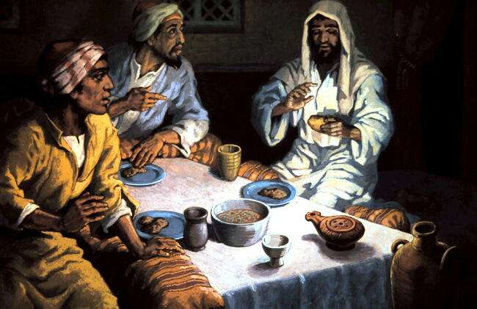
Luke 24:29-32 But they urged him strongly, “Stay with us, for it is nearly evening; the day is almost over.” So he went in to stay with them. When he was at the table with them, he took bread, gave thanks, broke it and began to give it to them. Then their eyes were opened and they recognised him, and he disappeared from their sight. They asked each other, “Were not our hearts burning within us while he talked with us on the road and opened the Scriptures to us?”

Slide 21
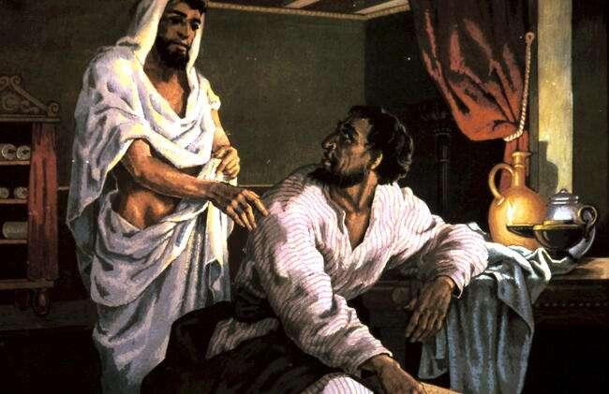
Luke 24:33-35 They got up and returned at once to Jerusalem. There they found the Eleven and those with them, assembled together and saying, “It is true! The Lord has risen and has appeared to Simon.” Then the two told what had happened on the way, and how Jesus was recognised by them when he broke the bread.

Slide 22
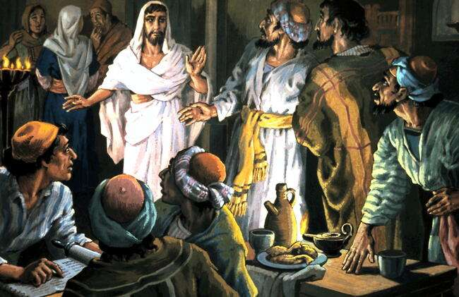
Luke 24:36-43 While they were still talking about this, Jesus himself stood among them and said to them, “Peace be with you.” They were startled and frightened. He said to them, “Why are you troubled, and why do doubts rise in your minds? Look at my hands and my feet. It is I myself! Touch me and see; a ghost does not have flesh and bones, as you see I have.” He showed them his hands and feet. And while they still did not believe it because of joy and amazement, he asked them, “Do you have anything here to eat?” They gave him a piece of broiled fish, and he took it and ate it in their presence.

Slide 23
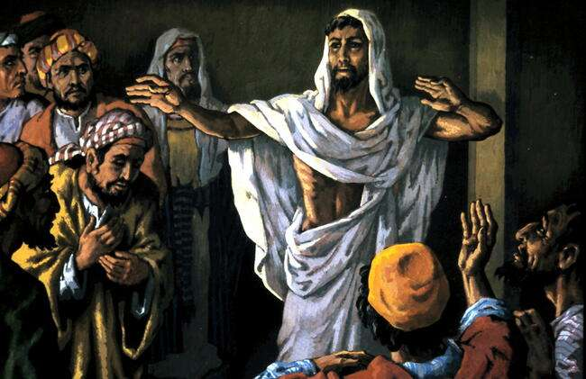
John 20:21-23 Again Jesus said, “Peace be with you! As the Father has sent me, I am sending you.” And with that he breathed on them and said, “Receive the Holy Spirit. If you forgive anyone his sins, they are forgiven; if you do not forgive them, they are not forgiven.”

Slide 24
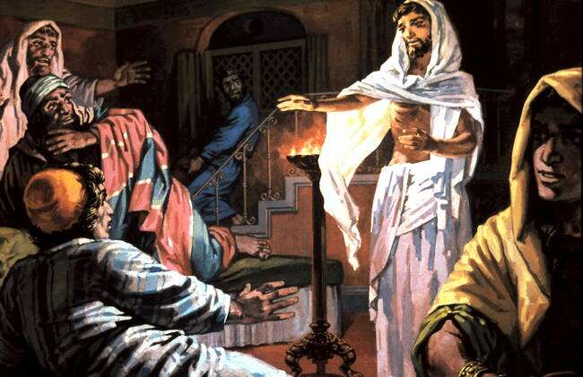
John 20:24 ,25 Now Thomas (called Didymus), was not with the disciples when Jesus came. So the other disciples told him, “We have seen the Lord!” But he said to them, “Unless I see the nail marks in his hands and put my finger where the nails were, and put my hand into his side, I will not believe it.”

Slide 25
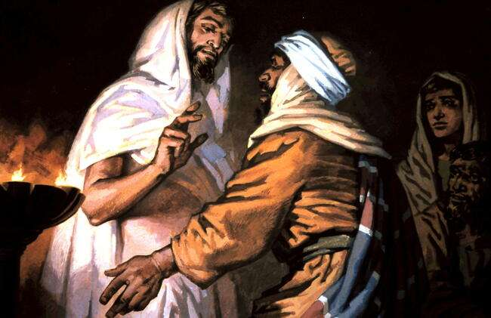
John 20:26-29 A week later his disciples were in the house again, and Thomas was with them. Though the doors were locked, Jesus came and stood among them and said, “Peace be with you!” Then he said to Thomas, “Put your finger here; see my hands. Reach out your hand and put it into my side. Stop doubting and believe.” Thomas said to him, “My Lord and my God!”
Then Jesus told him, “Because you have seen me, you have believed; blessed are those who have not seen and yet have believed.”

