Slide 1
The life of Jesus part 18
English
Jesus and the fish, Ascension, Acts of the Apostles, Peter preaching, Stephen stoned, Paul’s Conversion and Travels.
© 2013 Stichting Docete NL
www.docete.nl // info@docete.nl
Edited by Johan Peters
www.johanpeters.in
(Comments are in brackets)
Bible scriptures: New International Version

Slide 2
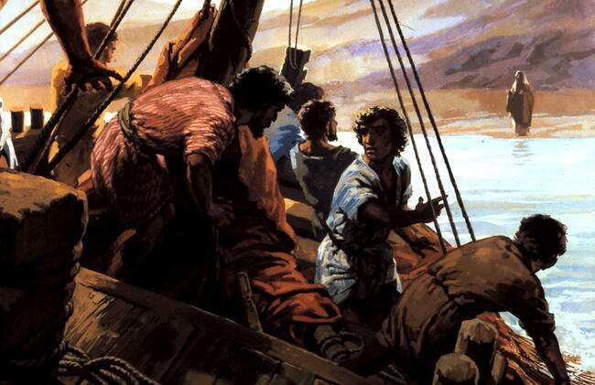
John 21:1-7 Afterwards Jesus appeared again to his disciples, by the Sea of Tiberias. Simon Peter, Thomas (called Didymus), Nathanael from Cana in Galilee, the sons of Zebedee, and two other disciples were together. “I’m going out to fish,” Simon Peter told them, and they said, “We’ll go with you.” So they went out and got into the boat, but that night they caught nothing.
Early in the morning, Jesus stood on the shore, but the disciples did not realise that it was Jesus. He called out to them, “Friends, haven’t you any fish?” “No,” they answered.
He said, “Throw your net on the right side of the boat and you will find some.” When they did, they were unable to haul the net in because of the large number of fish. Then the disciple whom Jesus loved said to Peter, “It is the Lord!” As soon as Simon Peter heard him say, “It is the Lord,” he wrapped his outer garment around him (for he had taken it off) and jumped into the water.

Slide 3
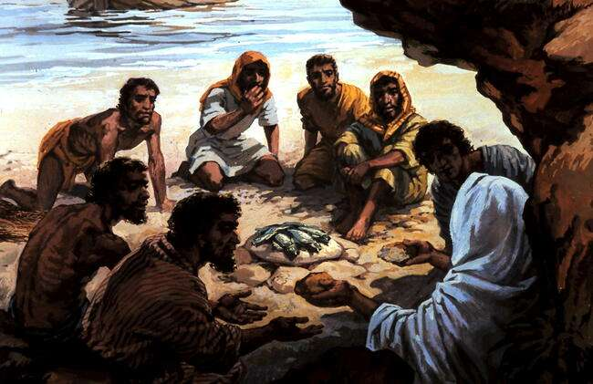
John 21:8-14 The other disciples followed in the boat, towing the net full of fish, for they were not far from shore, about a hundred yards. [Greek: about two hundred cubits (about 90 metres)]
When they landed, they saw a fire of burning coals there with fish on it, and some bread. Jesus said to them, “Bring some of the fish you have just caught.” Simon Peter climbed aboard and dragged the net ashore. It was full of large fish, 153, but even with so many the net was not torn. Jesus said to them, “Come and have breakfast.” None of the disciples dared ask him, “Who are you?” They knew it was the Lord. Jesus took the breadthe fish and gave it to them. This was now the third time Jesus appeared to his disciples after he was raised from the dead.

Slide 4
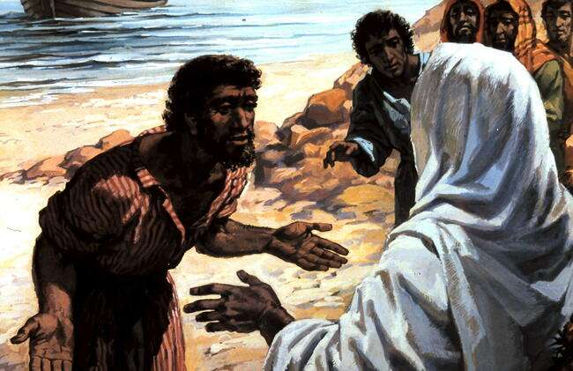
Jn. 21:15-17 When they had finished eating, Jesus said to Simon Peter, “Simon son of John, do you truly love me more than these?” “Yes, Lord,” he said, “you know that I love you.” Jesus said, “Feed my lambs.” Again Jesus said, “Simon son of John, do you truly love me?” He answered, “Yes, Lord, you know that I love you.” Jesus said, “Take care of my sheep.” The third time he said to him, “Simon son of John, do you love me?” Peter was hurt because Jesus asked him the third time, “Do you love me?” He said, “Lord, you know all things; you know that I love you.” Jesus said, “Feed my sheep.

Slide 5
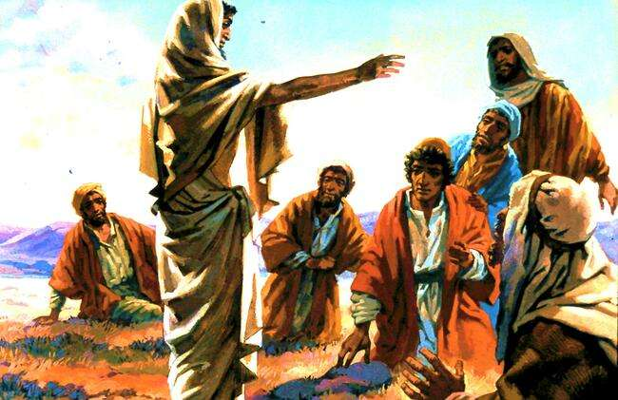
Mt. 28:16-20 Then Jesus came to them and said, “Go and make disciples of all nations, baptizing them in the name of the Father and of the Son and of the Holy Spirit, and teaching them to obey everything I have commanded you. And surely I am with you always, to the very end of the age.”

Slide 6
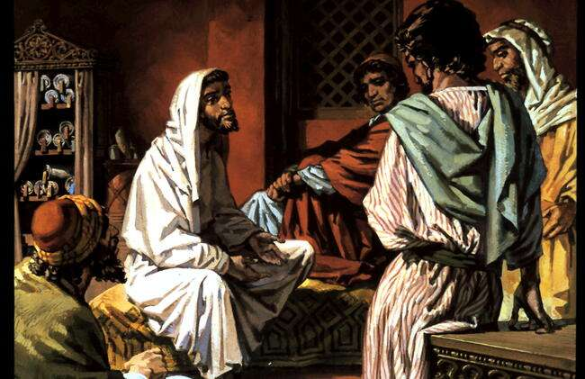
Luke 24:44-48 He said to them, “This is what I told you while I was still with you: Everything must be fulfilled that is written about me in the Law of Moses, the Prophets and the Psalms.”
Then he opened their minds so they could understand the Scriptures. He told them, “This is what is written: The Christ will suffer and rise from the dead on the third day, and repentance and forgiveness of sins will be preached in his name to all nations, beginning at Jerusalem.
You are witnesses of these things.

Slide 7
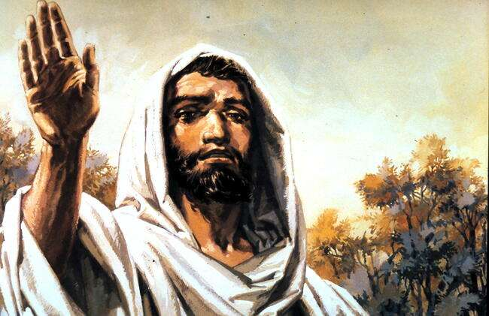
Luke 24:50,51 When he had led them out to the vicinity of Bethany, he lifted up his hands and blessed them. While he was blessing them, he left them and was taken up into heaven.

Slide 8
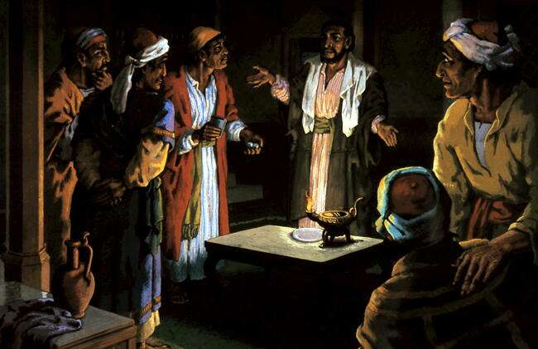
Acts 1:12-26 They returned to Jerusalem from the Mount of Olives, (about 1 km from the city).
They went upstairs to the room where they were staying. Those present were Peter, John, James and Andrew; Philip and Thomas, Bartholomew and Matthew; James son of Alphaeus and Simon the Zealot, and Judas son of James. They all joined together constantly in prayer, along with the women and Mary the mother of Jesus, and with his brothers. In those days Peter stood up among the believers (a group numbering about a hundred and twenty) “For,” said Peter, “it is written in the Book of Psalms, “`May another take his place of leadership.’ [Psalm 109:8]
Then they cast lots, and the lot fell to Matthias; so he was added to the eleven apostles.

Slide 9
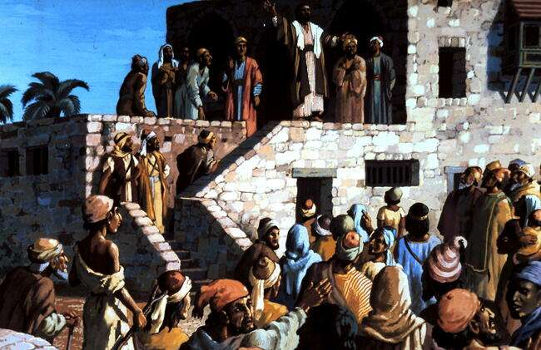
Ac. 2:4-37 All of them were filled with the Holy Spirit and began to speak in other tongues as the Spirit enabled them. A crowd came together. “Are not all these men who are speaking Galileans? Then how is it that each of us hears them in his own native language? Some made fun and said, “They have had too much wine.” Then Peter stood up with the Eleven: “Fellow Jews and all of you who live in Jerusalem; these men are not drunk. It’s only nine in the morning! “Jesus of Nazareth was a man accredited by God to you by miracles, wonders and signs, which God did among you through him, as you yourselves know.This man was handed over and put to death by nailing him to the cross. But God raised him from the dead and we are all witnesses of the fact. God has made this Jesus, whom you crucified, both Lord and Christ.”.

Slide 10
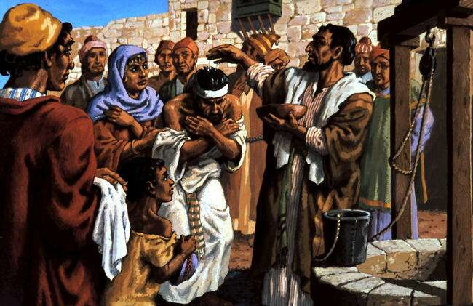
When the people heard this, they were cut to the heart and said to Peter and the other apostles, “Brothers, what shall we do?” Peter replied, “Repent and be baptised, every one of you, in the name of Jesus Christ for the forgiveness of your sins. And you will receive the gift of the Holy Spirit. All the believers were together and had everything in common. Selling their possessions and goods, they gave to anyone as he had need. And the Lord added to their number daily those who were being saved

Slide 11
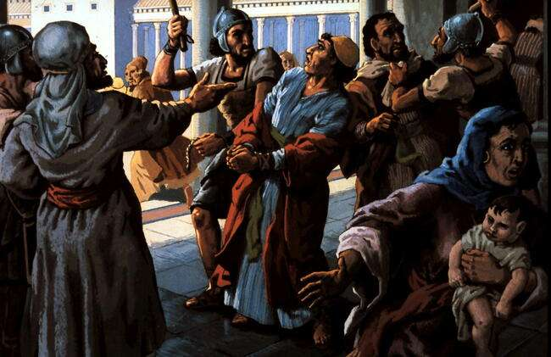
Acts 3:1-4:4 Peter and John were going up to the temple - at three in the afternoon. Now a man crippled from birth when he saw Peter and John about to enter, he asked them for money.
Then Peter said, “Look at us! Silver or gold I do not have, but what I have I give you. In the name of Jesus Christ of Nazareth, walk.” Taking him by the right hand, instantly the man’s feet and ankles became strong; walking and jumping, and praising God. The people were filled with wonder and amazement at what had happened to him. Peter saw this, he said to them: “Men of Israel, why does this surprise you? Why do you stare at us as if by our own power or godliness we had made this man walk? The God of our fathers, has glorified his servant Jesus. You killed the author of life, but God raised him from the dead. We are witnesses of this. By faith in the name of Jesus, this man was made strong as you can all see.
The priests were greatly disturbed because the apostles were teaching the people and proclaiming in Jesus the resurrection of the dead, they put them in jail until the next day.
But many believed, and the number of men grew to about five thousand.

Slide 12
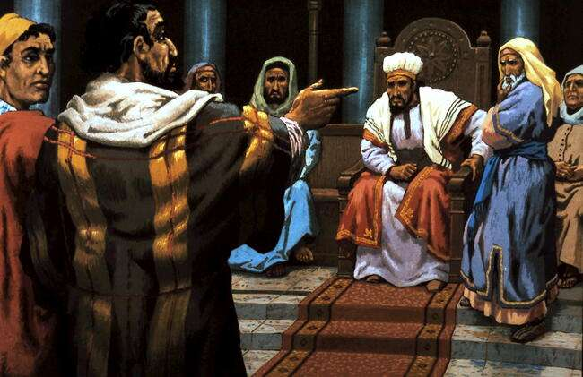
Acts 4:5 The next day the rulers, elders and teachers of the law met in Jerusalem. They had Peter and John brought before them and began to question them: “By what power or what name did you do this?” Then Peter, filled with the Holy Spirit, said to them: “Rulers and elders of the people! know this, you and all the people of Israel: It is by the name of Jesus Christ of Nazareth, whom you crucified but whom God raised from the dead, that this man stands before you healed. Salvation is found in no-one else, for there is no other name under heaven given to men by which we must be saved.” When they saw the courage of Peter and John and realised that they were unschooled, ordinary men, they were astonished and they took note that these men had been with Jesus. But since they could see the man who had been healed standing there with them, there was nothing they could say. They commanded them not to speak or teach at all in the name of Jesus. “Judge for yourselves whether it is right in God’s sight to obey you rather than God. For we cannot help speaking about what we have seen and heard.”

Slide 13
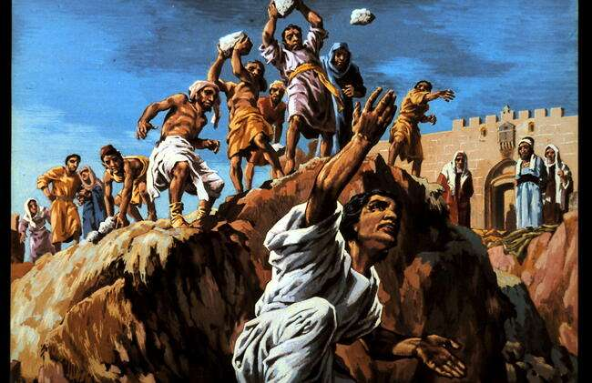
Ac. 6:8-7:58 Now Stephen, a man full of God’s grace and power, did great wonders and miraculous signs among the people. So they stirred up the people and the elders and the teachers of the law. They seized Stephen and brought him before the Sanhedrin. They produced false witnesses, who testified, “This fellow never stops speaking against this holy place and against the law. “You stiff-necked people, with uncircumcised hearts and ears! You are just like your fathers: You always resist the Holy Spirit. When they heard this, they were furious and gnashed their teeth at him. But Stephen, full of the Holy Spirit, looked up to heaven and saw the glory of God, and Jesus standing at the right hand of God. They dragged him out of the city and began to stone him. The witnesses laid their clothes at the feet of a young man named Saul.

Slide 14
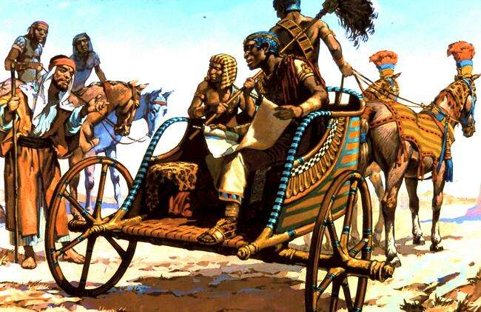
Acts 8:26-38 Now an angel of the Lord said to Philip, “Go south to the road that goes down from Jerusalem to Gaza.” On his way he met an Ethiopian in his chariot reading the book of Isaiah the prophet. Philip ran up to the chariot. “Do you understand what you are reading?” Philip asked.
“How can I,” he said, “unless someone explains it to me?” The eunuch was reading: “He was led like a sheep to the slaughter, and as a lamb before the shearer is silent, so he did not open his mouth. [Isaiah 53:7,8] Then Philip began with that very passage of Scripture and told him the good news about Jesus. As they came to some water and the eunuch said, “Look, here is water. Why shouldn’t I be baptised?” Philip said, “If you believe with all your heart, you may.” The eunuch answered, “I believe that Jesus Christ the Son of God.”] Then Philip baptised him.

Slide 15
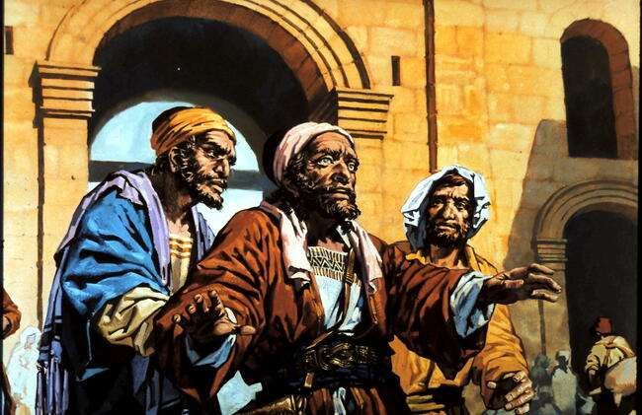
Acts 9:1-19 Meanwhile, Saul was still breathing out murderous threats against the Lord’s disciples. He had letters for the synagogues in Damascus. Suddenly a light from heaven flashed. He fell to the ground and a voice said, “Saul, Saul, why do you persecute me?” “Who are you, Lord?” Saul asked. “I am Jesus, whom you are persecuting,” Saul got up but he could see nothing. For three days he was blind, and did not eat or drink. In Damascus there was a disciple named Ananias. The Lord called to him, “Ananias!” “Yes, Lord,” he answered. “Go to the house where Saul is for he is praying. “Lord,” Ananias answered, “I have heard many reports about this man and all the harm he has done to your saints in Jerusalem. But the Lord said, “Go! He is my chosen instrument to carry my name before the Gentiles and their kings and before the people of Israel. Ananias went to the house and entered it. Placing his hands on Saul, he said, “Brother Saul, the Lord - Jesus, who appeared to you on the road as you were coming here - has sent me so that you may see again and be filled with the Holy Spirit.”… he could see and was baptised,

Slide 16
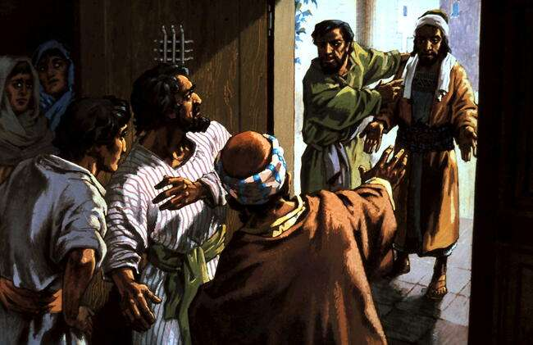
Acts 9:20-31 At once he began to preach in the synagogues that Jesus is the Son of God. All those who heard him were astonished and asked, “Isn’t he the man who caused havoc… the Jews conspired to kill him, but Saul learned of their plan. And his followers took him by night and lowered him in a basket through an opening in the wall. When he came to Jerusalem, he tried to join the disciples. They did not believe that he really was a disciple. But Barnabas took him and brought him to the apostles. He told them, and how in Damascus he had preached fearlessly in the name of Jesus. Some Jew were trying to kill him When the brothers learned of this, they took him down to Caesarea and sent him off to Tarsus.

Slide 17
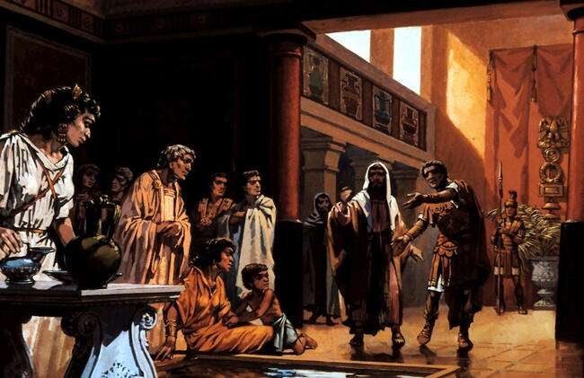
Acts 10:25-45 As Peter entered the house, Cornelius met him and fell at his feet in reverence.
But Peter said, “I am only a man myself.” All the prophets testify about him that everyone who believes in him receives forgiveness of sins through his name.” While Peter was still speaking these words, the Holy Spirit came on all who heard the message. The circumcised believers who had come with Peter were astonished that the gift of the Holy Spirit was also for the Gentiles.

Slide 18
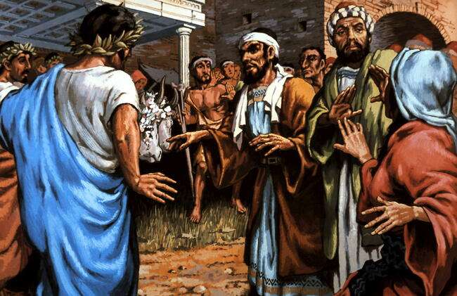
Ac. 14:8-15 In Lystra there sat a man crippled in his feet, who was lame from birth and had never walked. He listened to Paul as he was speaking. Paul looked and called out, “Stand up on your feet!” At that, the man jumped up and began to walk. When the crowd, “The gods have come down to us in human form!” Barnabas they called Zeus, and Paul they called Hermes.
The crowd wanted to offer sacrifices to them. Barnabas and Paul heard of this, “Men, why are you doing this? We too are human like you. We are bringing you good news, telling you to turn to the living God, who made heaven and earth and sea and everything in them.

Slide 19
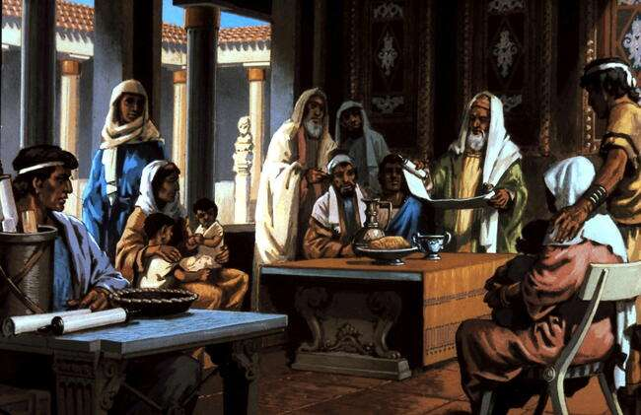
Ac. 15:1-3 Some men came down from Judea to Antioch and were teaching: “Unless you are circumcised, according to the custom taught by Moses, you cannot be saved.” This brought Paul and Barnabas into sharp dispute with them. So Paul and Barnabas were appointed, along with some other believers, to go up to Jerusalem to see the apostles and elders about this question. The church sent them on their way, and as they travelled through Phoenicia and Samaria, they told how the Gentiles had been converted. This news made all the brothers very glad.

Slide 20
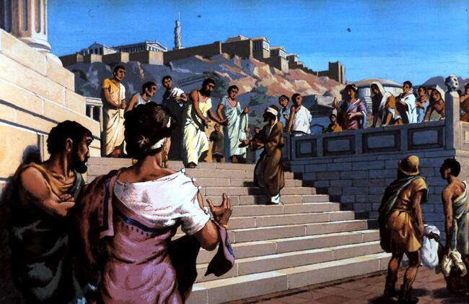
Ac. 17:16 While Paul was in Athens, he was distressed that the city was full of idols. So he reasoned in the synagogue with the Jews and the God fearing Greeks, as well as in the market-place day by day. “He seems to be advocating foreign gods.” They said this because Paul was preaching the good news about Jesus and the resurrection. Paul said: “Men of Athens, you are very religious. I even found an altar: TO AN UNKNOWN GOD. The God who made the world is the Lord of heaven and earth and does not live in temples built by hands. As some of your own poets have said, `We are his offspring.’ “Therefore since we are God’s offspring, we should not think that the divine being is like gold or silver or stone - In the past God overlooked such ignorance, but now he commands all people everywhere to repent. He has given us proof of this to all men by raising Jesus from the dead.” Among them was Dionysius, a member of the Areopagus, also a woman named Damaris, and a number of others.

Slide 21
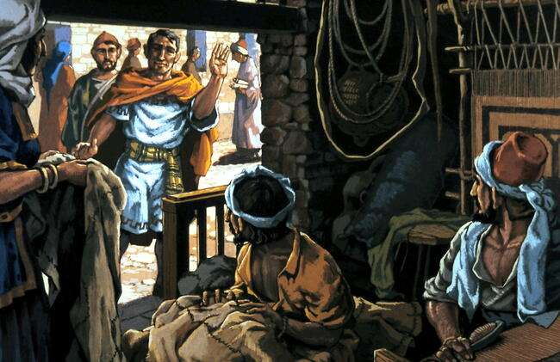
Ac. 18:1 After this Paul went to Corinth, he was a tentmaker as they were, he stayed and worked with them. Every Sabbath he reasoned in the synagogue. When Silas and Timothy came from Macedonia, Paul devoted himself exclusively to preaching. But when the Jews opposed Paul he said to them, “Your blood be on your own heads! I am clear of my responsibility. From now on I will go to the Gentiles.” Crispus, the synagogue ruler, and his entire household believed in the Lord; and many of the Corinthians who heard him believed and were baptised. Paul stayed for a year and a half, teaching them the word of God. The Jews made a united attack on Paul and brought him into court. “This man,” they charged, “is persuading the people to worship God in ways contrary to the law.” Gallio said “I will not be a judge of such things.” and had them ejected from the court. Then they all turned on Sosthenes the synagogue ruler and beat him in front of the court. But Gallio showed no concern whatever. Paul stayed on in Corinth for some time. Then he left for Syria, accompanied by Priscilla and Aquila.

Slide 22
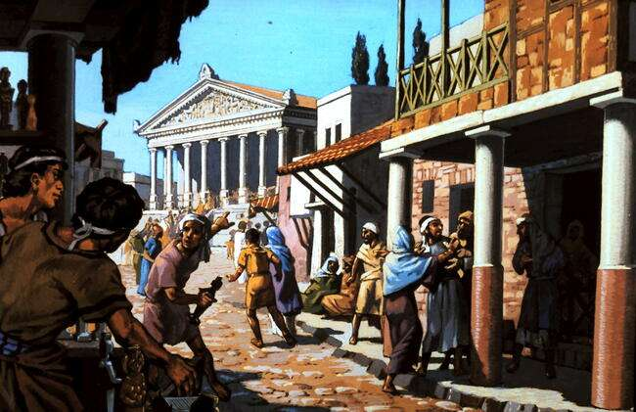
Acts 19:1-19 While Apollos was at Corinth, Paul took the road through the interior and arrived at Ephesus. There he found some disciples and asked them, “Did you receive the Holy Spirit?” They answered, “No, we have not even heard that there is a Holy Spirit.” Paul asked, “Then what baptism did you receive?” “John’s baptism,” they replied. “John’s baptism was a baptism of repentance. He told the people to believe in the one coming after him, that is, in Jesus.” On hearing this, they were baptised in the name of the Lord Jesus. Many of those who believed confessed their evil deeds. A number who had practised sorcery brought their scrolls together and burned them publicly. When they calculated the value of the scrolls, the total came to fifty thousand drachmas. [A drachma was a silver coin worth about a day’s wages.]

Slide 23
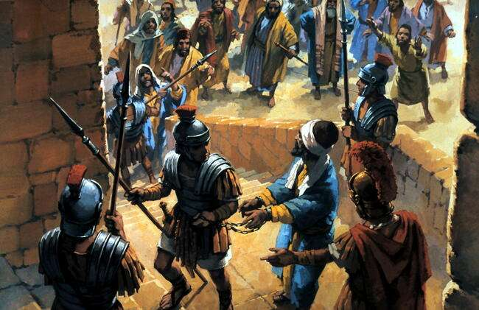
Acts 21:17-40 When we arrived at Jerusalem, the brothers received us we went to see James, and all the elders. Paul reported what God had done among the gentiles. they praised God. Then they said to Paul: “You see, brother, how many thousands of Jews have believed, and all of them are zealous for the law. The next day Paul took the men and purified himself along with them. some Jews from the province of Asia saw Paul at the temple. They stirred up the whole crowd and seized him, The whole city was aroused, and the people came running from all directions. Seizing Paul, they dragged him from the temple, and immediately the gates were shut. Roman troops heard that Jerusalem was in an uproar, they stopped beating Paul. The violence of the mob was so great he had to be carried by the soldiers

Slide 24
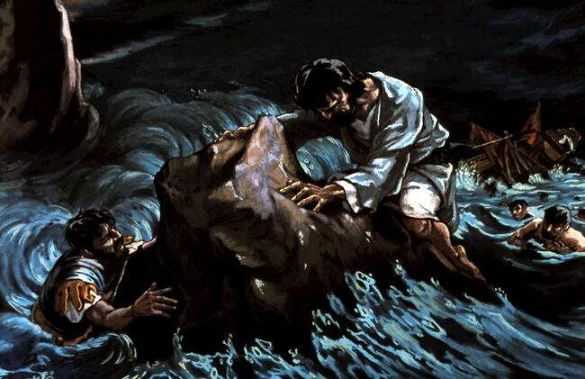
Acts 26:32-27:44 “This man could have been set free if he had not appealed to Caesar.”
Paul stood up: “Men, you should have taken my advice not to sail from Crete; then you would have spared yourselves this damage and lost; none of you will be lost; only the ship will be destroyed. Last night an angel of the God whose I am and whom I serve stood beside me and said, `Do not be afraid, Paul. You must stand trial before Caesar; and God has graciously given you the lives of all who sail with you.’ So keep up your courage, men, for I have faith in God that it will happen just as he told me. Nevertheless, we must run aground on some island.” On the fourteenth night we were still being driven across the Adriatic, there were 276 of us on board.
The soldiers planned to kill the prisoners to prevent any of them from escaping. The rest were to get there on planks or on pieces of the ship. In this way everyone reached land in safety.

Slide 25
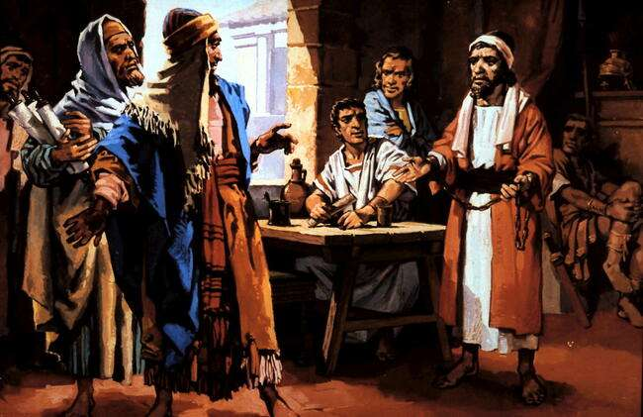
Acts 28:28,29 “Therefore I want you to know that God’s salvation has been sent to the Gentiles, and they will listen!” Paul stayed in Rome in his own rented house and welcomed all who came to see him.

